Slide 1




Pain and Addiction Care in the ED Accreditation
Katherine Hawk, MD, MHS, FACEP
Randolph Knight, MD, FACEP
July 12, 2022

Slide 2


About
ACEP
ACEP is a professional society, member organization
40,000 emergency physicians
some residents
some international members
Educate members
Provide alternatives
Align incentives
PACED goal is to reduce opioid use in emergency departments.
Notes:
ACEP represents more than 40,000 emergency physicians, emergency medicine residents and medical students. ACEP promotes the highest quality of emergency care and is the leading advocate for emergency physicians and their patients, and the public. The College continually strives to improve the quality of emergency medical services through:
The development of evidence-based clinical policies
Funding emergency medicine research
Providing public education on emergency care and disaster preparedness
Legislative and regulatory advocacy efforts
Providing industry-leading continuing medical education (CME) in the form of educational conferences, online training, professional references and news magazines
Publishing Annals of Emergency Medicine, the specialty’s leading peer-reviewed scientific journal.

Slide 3



The PACED Team
Alexis LaPietra, DO, FACEP
Chair, PACED BoG
Nicole Tidwell
Senior Accreditation Manager
Kelly Peasley
Program Manager

Slide 4
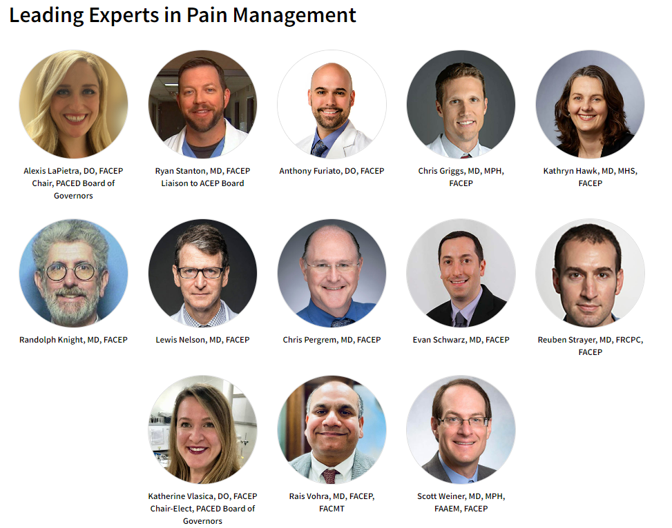
PACED Board of Governors

Slide 5


The Project
Collaborate with Indian Health Service
    Establish a plan to implement and scale pain and addiction emergency care protocols in IHS facilities
    Offer guidance towards accreditation awards for ten IHS EDs

Slide 6
April
Final Site Selection
May
Begin Application Process
June/July
In Person Bootcamp
Entire process complete by August 2022
Ten sites to apply for Level 3 accreditation at no cost to IHS

Slide 7
The Impact

Slide 8

PACED Addresses the Goal
Set criteria/standards for ED’s in the management of pain and addiction.
Established 3 Levels, with progressively higher standards.
Policies, Guidelines, Toolkits, Podcasts, Point of Care Tools
Education and Training

Slide 9
Benefits to Patients and Their Caregivers
Establish standards for high-quality care for pain and addiction management.
Reduce ED visits.
Reduce hospital readmissions and associated penalties.
Increase satisfaction scores.
Reward and acknowledge EDs/staffs/hospitals that are providing excellent care to patients.
Provide a mechanism to periodically reassess the care they provide to ensure they are maintaining high-quality care and incorporating innovations to the standard of care.

Slide 10
Benefits to Emergency Physicians/
Healthcare Providers
Accelerate the distribution and implementation of best practices.
Provide a mechanism for rapid dissemination of advances in acute pain and addiction management.
Ensure providers have the necessary resources, protocols, and training to provide optimal acute pain and addiction management.
Assist Emergency Medical Service providers in decision-making about where to seek acute care through a recognizable brand.
Incentivize, reward and acknowledge providers that are providing excellent care for patients with pain and opioid misuse.
Improve patient outcomes and satisfaction.
Reduce medical complications related to pain management and addiction

Slide 11
Benefits to Hospitals
Provide effective treatment for pain and addiction, while minimizing the use of opioid medications, utilizing them only when necessary.
Improve patient outcomes and satisfaction.
Assist patients and families in decision-making about where to seek acute pain management through a recognizable brand.
Ensure that facilities that market themselves as PACED-accredited meet established standards.
Reduce medical complications related to pain management and addiction

Slide 12
Criteria Categories
Leadership/Collaboration
Pain Management Strategies
Non-Opioid Pharm Medications
Opioid Stewardship Guidelines
Non-Pharm Pain Management
ED Quality Assurance/Improvement

Slide 13
Criteria Categories
Recognition of Opioid Use Disorder
OUD Treatment Strategies
Referral to appropriate OUD care
Harm Reduction Protocols
Community engagement

Slide 14
Criteria Overview
REQUIREMENTS | Description
Leadership and Collaboration among hospital team members | Departments shall describe the implementation of ongoing processes and definitive follow-up plans occurring in the ED and whom (from outside the ED) is involved in addressing follow-up for continuity of care for patients with pain.
Pain Management Strategies | Departments shall implement multimodal protocolized strategies for acute non-complicated conditions based on best practice guidelines. May include special population protocols such as geriatric pain and/or pediatric pain. Also includes providing patient education materials, DOT/SMART phrases, and/or discharge plans for the selected modalities as available.

Slide 15
Criteria Overview
REQUIREMENTS | Description
Non-Opioid Pharm Medications | Departments shall standardize the use of non-opioid pharmacologic modalities from a list. Also includes providing patient education materials, DOT phrases, and/or discharge plans for the selected modalities if available.
Opioid Stewardship Guidelines | Departments shall describe/upload strategies to support opioid stewardship related to prescribing in the ED and at discharge. Examples include minimizing the number of pills at discharge, the EHR default quantity for opioid drugs to reflect 3 days or less, minimizing the use of euphoria-inducing opioids and administration (e.g. minimized use of IV push drugs when appropriate).

Slide 16
Criteria Overview
REQUIREMENTS | Description
Non-Pharm Pain Management Strategies | Departments shall provide guidelines demonstrating the use of non-pharmacologic pain management modalities in the ED and inpatient units. Includes patient education materials encouraging the use of these non-pharmacologic modalities after discharge.
ED Research: Quality Assurance/ Quality Improvement | Departments shall establish a QA/QI process surrounding opioid stewardship and alternative therapies for managing acute and chronic pain in the ED.

Slide 17
Criteria Overview
REQUIREMENTS | Description
OUD recognition, engagement, and treatment | Departments shall provide guidelines for the recognition and treatment of OUD and engagement for recovery. EDs must utilize buprenorphine for acute opioid withdrawal and have established protocols for transition of care for continued treatment in the community
Harm Reduction | Departments shall establish a protocol for high risk patients to receive naloxone kits (with education) or receive a prescription for naloxone. Patients should also be educated on syringe access and HIV or Hepatitis testing sites in the community.

Slide 18

Bronze Level
Led by a clinical champion.
Recognizes ED’s that have established basic protocols and resources for addressing patients with pain and addiction issues.
3-year accreditation at $2,500

Slide 19
Getting Started

Slide 20
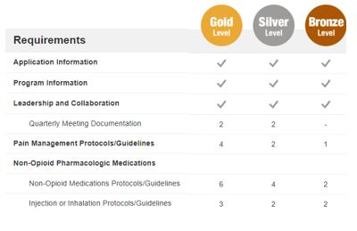
Application Assets
ACEP.org/PACED
Review requirements for accreditation Level 3
    PACED Criteria
    Preparing for PACED Accreditation Guide
    Sample application available for review

Slide 21


Starting an Application
ACEP.org/PACED
Click “Apply Today”
  ACEP Members log in with credentials
  Non-members create a new account
Click the “New Application” button
Use Chrome!

Slide 22
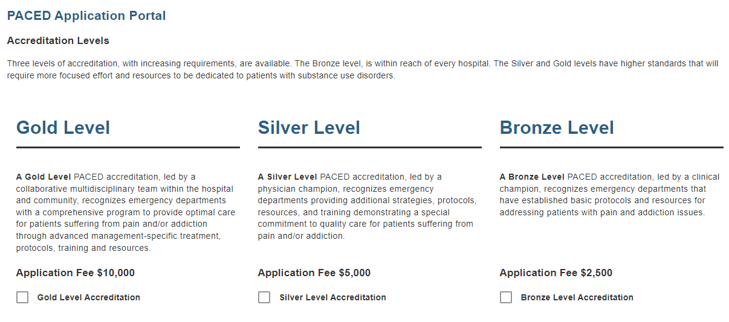
Select Level

Slide 23
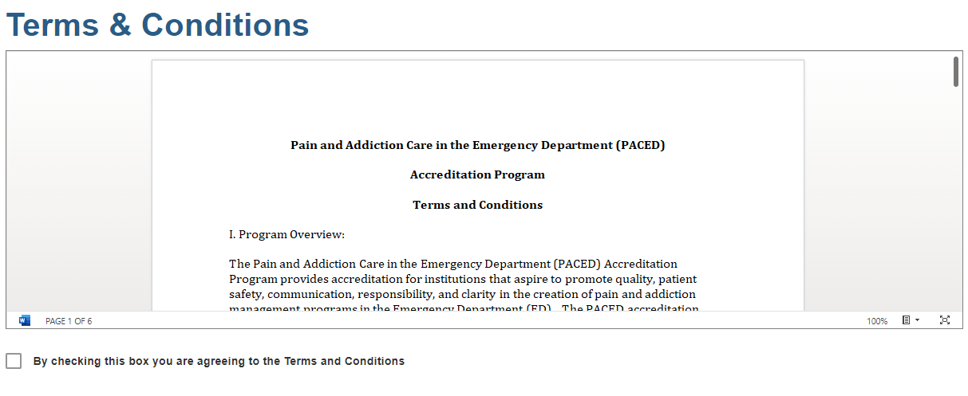
Terms & Conditions
Read the Terms & Conditions

Slide 24
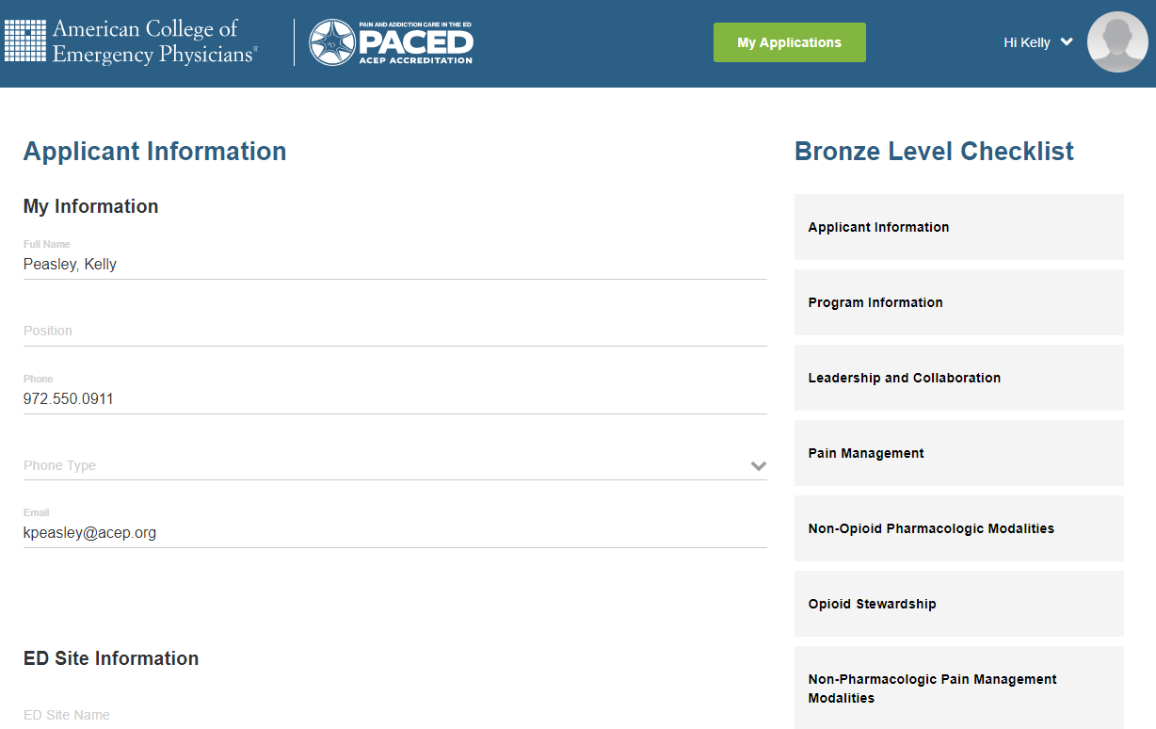
Checklist
Application fields
Checklist
You must complete the “Applicant Information” tab entirely to navigate to additional tabs

Slide 25
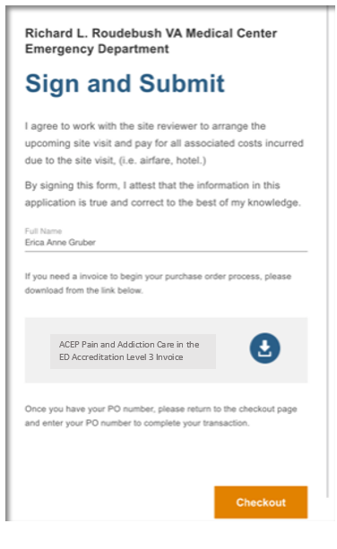
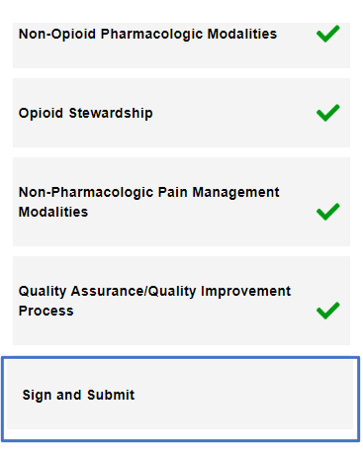
Sign and Submit
Once each tab is complete, 1. Click “Sign and Submit”
2. Sign the app
3. Click “Checkout”

Slide 26
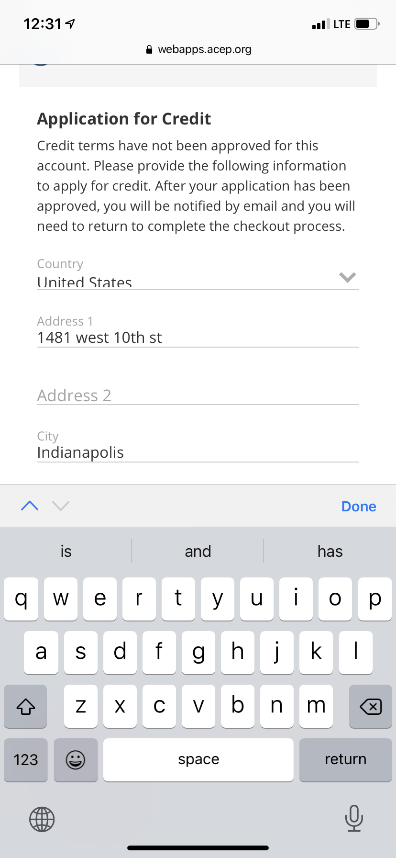
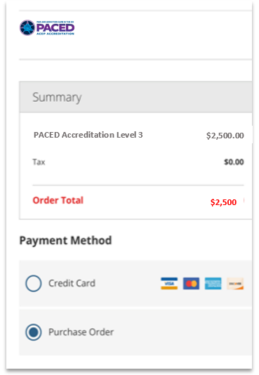
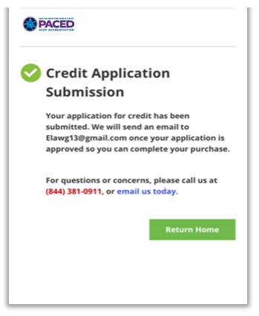
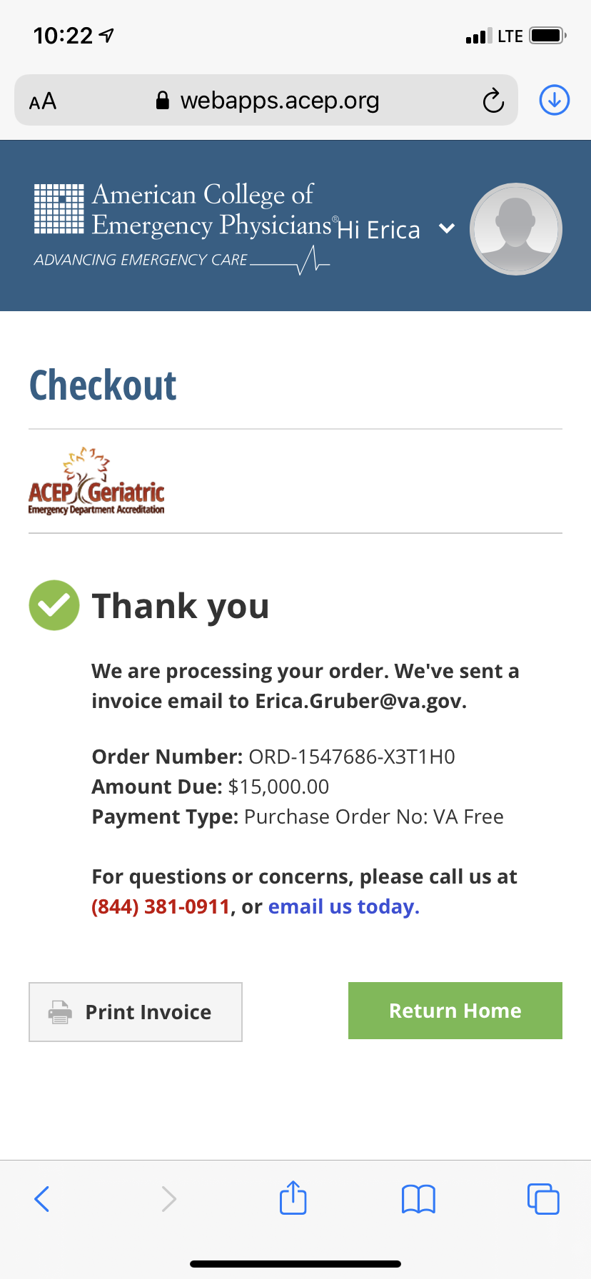
Checkout
Select “PO“
(2) Then apply for credit
Fill out form
Will receive automated response that credit app received
You’re almost finished!

Slide 27


Enter Your Unique Code
With in 48 hours, you will receive an email from Kelly Peasley with instructions on how to enter your code and submit:
1. Log back into your application
2. Re-click “Sign and Submit”
3. Put code provided into PO area
4. Click “Submit” button

Slide 28
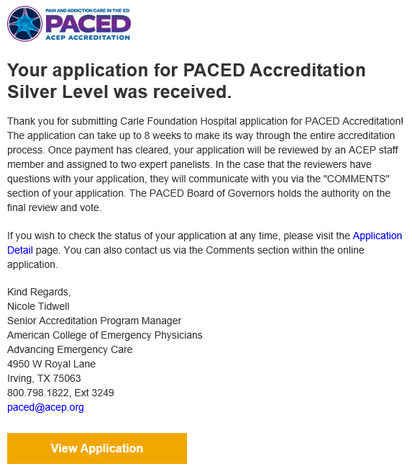
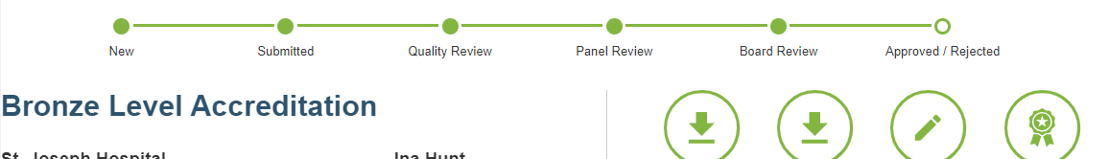
Submission
Once you enter your application IHS code and submit, ACEP will send an automated confirmation email similar to this →
Review process is approx. 6-8 weeks.
Check your status any time in the portal

Slide 29
Review Process

Slide 30
Admin Review
Clinical Review*
PACED Board Review and Vote
Review Process
* Comprehensive evaluation by a team of two ACEP appointed physician reviewers

Slide 31
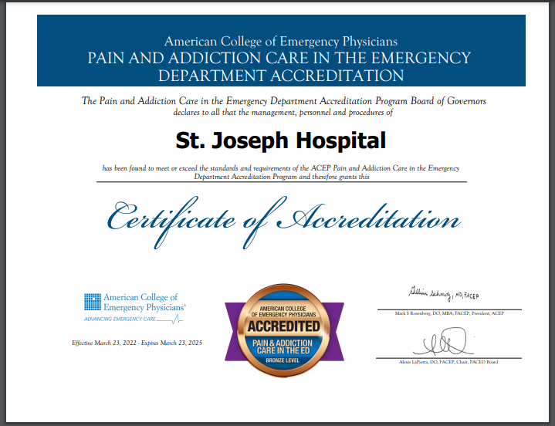



Accreditation Award
Award Granted:
    Applicant notified via portal and email
    Marketing assets accompany email
    Formal letter & certificate mailed to Leadership
2

Slide 32
Questions?
PACED Program Contact
Kelly Peasley: kpeasley@acep.org

