Slide 1
ACEP Chapter Board Member Orientation
Updated June 2022

Slide 2
You have been elected to the Board
What do you need to know?
Notes:
First, congratulations and thank you for your willingness to serve. Being a part of a Board can be very rewarding. You will work with dedicated professionals, and really get to know the association.

Slide 3
This presentation has been created by the National Chapter Relations Committee
Members:
Beth Brooks, CAE, Executive Director, Texas Chapter
Jason Langenfeld, MD, FACEP, Board Member, Nebraska Chapter
Andrew Zinkel, MD, FACEP, Board Member, Minnesota Chapter
Maude S. Hancock, CAE, Senior Manager, Chapter and Community Engagement, ACEP
Notes:
This presentation was created by a subgroup of the National Chapter Relations committee.
The people who worked on it are:
Beth Brooks, CAE, Executive Director of the Texas Chapter
Jasen Langenfeld, MD, FACEP, Nebraska Chapter Board Member
Andrew Zinkel, MD, FACEP, Minnesota Chapter Board Member, and
Maude S. Hancock, CAE, Senior Manager, Chapter and Community Engagement at ACEP

Slide 4
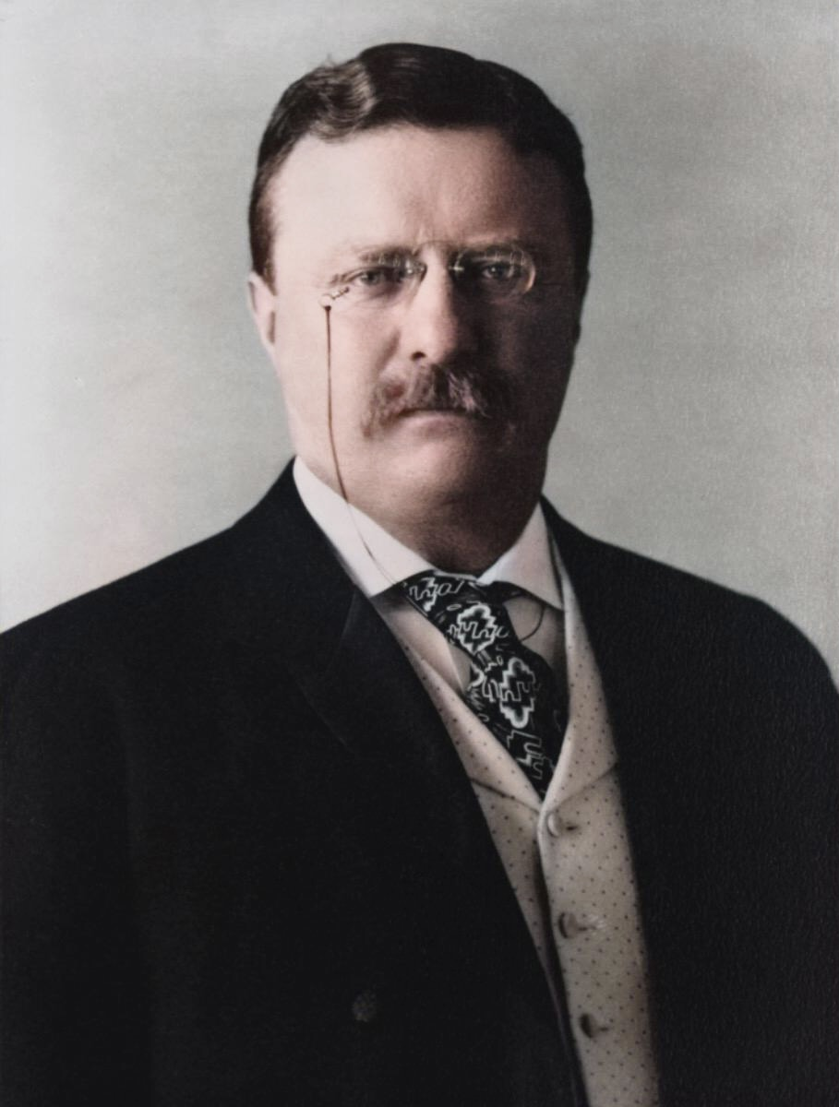
“Every man owes part of his time to the business or industry to which he is engaged. No man has a moral right to withhold his support from an organization that is striving to improve conditions within his sphere.”
- Theodore Roosevelt
Notes:
President Theodore Roosevelt, in 1908 said “Every man owes part of his time to the business or industry to which he is engaged. No man has a moral right to withhold his support from an organization that is striving to improve conditions within his sphere”.
This quote epitomizes the essence of associations. A common way for people to give back to their profession is through service as an association member. Many people find this work highly satisfying. Serving on the Board of a professional association is usually a high point of a member’s career.
The unique structure of associations practically guarantees that anyone joining a board needs training to understand the role, be effective, and help the association thrive.
This orientation is a broad presentation on the responsibilities of being a board member. This applies to all chapters, large and small. Several areas will not be covered here, and you will need to ask for this information from your chapter leaders. That will include financials, PAC information, membership data…. etc.
So let’s get started!

Slide 5
Board Member Fiduciary Responsibilities
Duty of Care
Duty of Loyalty
Duty of Obedience
Notes:
As a Board member, you have fiduciary responsibilities. Board members are volunteers and do not get paid, but there are fiduciary duties that you need to be aware of.
Not understanding fiduciary duties — or not being well-informed about them — doesn’t relieve board directors from any obligations or liabilities they may face if they fail to fulfill these important duties. Board directors are called fiduciaries because they are legally responsible for managing a nonprofit entity’s assets
Nonprofit board directors only have three fiduciary responsibilities, and each of them is very important. It’s critical for board directors to practice them in word and in deed, and to make sure that their fellow board directors do as well. The three fiduciary responsibilities of all board directors are the duty of care, the duty of loyalty and the duty of obedience, as mandated by state and common law.

Slide 6
Duty of Care Responsibilities
Perform Due Diligence
Exercise Sound Decision Making
Uphold Fiscal Responsibility
Recruit Future Board Members
Notes:
Duty of care means that board directors must give the same care and concern to their board responsibilities as any prudent and ordinary person would. They are also responsible for strategic planning and achieving the nonprofit’s short- and long-term goals.
Due diligence includes preparing for board meetings by reading materials in advance, attending and participating in association meetings and events, and supporting the association staff. Board members should be actively working with other board directors to advance the organization’s mission and goals.
Good Decision-Making includes using research and data in decision making, developing a strategic plan to direct the organization’s activities, and hiring and conducting chief executive evaluations.
Fiscal responsibility includes overseeing and monitoring the nonprofit’s activities. Board directors are expected to be able to read and understand financial reports, and be willing to question expenditures and examine variances. They must ensure that adequate resources are available for operations. It is important to know your Chapter’s major revenue and expense programs and monitor trends over time.
Membership responsibilities include knowing how many members you represent, who they are, and mentoring a pipeline of future leaders. It is the Board’s responsibility to plan for the organization’s leadership succession.

Slide 7
Duty of Obedience
Ensure Organizational Compliance
Serve as Steward of the Association Mission
Guide the Organization through Policy
Notes:
Ensure Organizational Compliance with all applicable laws and regulations and with its own internal documents and policies. Be sure to review, understand and follow bylaws.
If a court were to ask a director, “Did you receive the governing documents”, the minutes should affirm that they were distributed or accessible at orientation.
One good practice is to sign a commitment form acknowledging you understand your roles, including policies such as conflict of interest and antitrust.
Serve as Steward of the Association Mission. Guarantee resources are dedicated to accomplishing the mission.
Guide the Organization. Monitor, adjust, develop policies in order to clarify ambiguity or address conflicts, etc.
Duty of obedience means that board members must make sure that the nonprofit is abiding by all applicable laws and regulations and doesn’t engage in illegal or unauthorized activities. The duty of obedience also means that board members must carry out the organization’s mission in accordance with the purpose they stated in getting qualified as a nonprofit organization.
The board is responsible for creating and approving policies and being transparent to the membership about these policies.
If it is not explained, ask about: ?
Board Meeting protocol. President runs the meeting and develops the agenda.
Go through President before bringing things to the Board
Executive Sessions – discuss litigation, alleged improper activities, ED review.

Slide 8
Duty of Loyalty
Avoid Conflicts of Interest
Uphold & Communicate Board Decisions
Evaluate Executive Director
Hold Board Accountable
Notes:
Duty of loyalty means that board directors must place the interests of the organization ahead of their own interests at all times. This includes disclosing potential conflicts of interest and not using board service as a means for personal or commercial gain. Speaking with a unified voice outside of the Board room, maintaining confidentiality, objectively evaluating the executive director, and holding other Board members accountable.
The Board’s role is governance, not management. The Board sets policy; staff administers it.
A formal evaluation of the Executive Director should be held each year. Sometimes this is done by the Executive Committee with input from the Board members. It should address goals achieved, plans for the upcoming year, improvement suggestions, professional education. The final report should be a great opportunity for the President or Executive Committee to discuss and work together with the Executive Director to improve the association.

Slide 9
Common Types of Non-Profits
Status | Description of Category
501(c)(3) | Religious, Educational, Charitable, Scientific, Literary.
501(c)(4) | Civic Leagues, Social Welfare Organizations, and Local Associations of Employee
501(c)(5) | Labor, Agricultural, and Horticultural Organizations
501(c)(6) | Business Leagues (Trade and Professional), Chambers of Commerce, Etc.
Notes:
Chapters are incorporated as nonprofits under state law. There are 20 types of nonprofits under the IRS.
An association is one type of organization under the nonprofit umbrella
501c(3): Charitable – people give donations for a cause; tax deductible; limited lobbying
501c(6): Association – people pay dues to belong; they are voting members; can lobby

Slide 10
Common Myths
Nonprofits Don’t Pay Taxes
America’s nonprofit associations pay more than $1 billion annually in payroll, sales, and property taxes.
Nonprofits Can’t Make a Profit
Profit (retained earnings) is critical to association growth. Income cannot be distributed to members, directors or officers.
No margin, no mission!
Associations pay UBIT on income from business activities not related directly to their mission.
Notes:
It is a myth to think associations don’t pay taxes.
America’s nonprofit associations pay more than $1 billion annually in payroll, sales, and property taxes.
We also pay UBIT (unrelated business income taxes). Taxes are imposed on certain activities of a nonprofit if those activities are found to be business activities unrelated to your tax-exempt purpose. A good example of UBIT== advertising in your magazine or newsletter.
Another myth is that we cannot make a profit.
In order to maintain your nonprofit status, income cannot be distributed to members, directors, or officers. There can be reasonable reimbursement for direct expenses (airfare, registration, reimbursement) depending on your policies. But we can make a profit. The non-profit status is with the IRS.
We need to make a profit.
What would you do if your major income source ended? Could you pay all your bills?
You need to have reserves. Why?
Reserves are needed in case you have to cancel your convention, or revenue from registration and corporate support is lower than expected; or you could have a special project (public relations campaign, research white papers, surveys, technology upgrades) that needs additional funding. Maybe you want to build a building.
A good benchmark is 6-12 months of operating expenses held in reserves.

Slide 11
Governance Systems
Articles of Incorporation, Bylaws, Mission
Policies & Procedures
Strategic Plan
Budget and Decision-Making Processes
Committee Structure
Nomination Process/Succession Plan
Board Development
Notes:
There are a variety of policies and systems that deal with Governance.
Bylaws – determine your chapter’s organization and governance. National ACEP developed model chapter bylaws that chapters can adapt to their organizational structure.
The mission guides everything the Board does – if a proposed suggestion does not fulfill the mission, question doing it. Always have your association mission front and center at Board meetings (I like to put it on the agenda) as a reminder of what your purpose is.
Policies: interpret the bylaws and articles of incorporation. Set parameters or specific mandates for action and decision making.
Strategic Plan: “if you don’t know where you are going, you might wind up somewhere else” – Yogi Berra
This doesn’t have to be a huge document, perhaps a plan of work for the next year or two.
Budget and Decision-Making Process:
Do board meeting agendas focus the board’s attention on issues of strategic importance?
Do board members have easy access to information needed for effective decision making?
Are the organization’s strategic priorities adequately reflected in the annual budget?
Are the committees doing work that is needed? Understand what committees your chapter has.
Nomination process: do you have a lot of people running for the Board or councilor positions? If not, may want to review the requirements and how the nominations are done.
Are the terms too long? Too much work/time commitment? How often are meetings held? You want to make sure that you have members who want to serve, and that it is not too daunting.
Does the board’s composition reflect the strategic needs of the organization? Do you have a leadership identification program that addresses diversity and inclusiveness?
High performing boards invest in themselves through a culture of learning. Holding orientation for new and continuing board members is crucial. Ongoing education at Board meetings and periodic self-evaluation is also recommended. Does the board regularly assess its own performance?

Slide 12
Board Review and Approval Responsibilities
Financial Audit
Form 990
Annual Budget
Monthly Financial Statements
Bylaws and Policies
Chief Executive Evaluation
Board Meeting Minutes
Notes:
As a board, there are several documents that you must review and approve. Remember Duty of Obedience?
Audit: Has your chapter done an audit recently? An outside CPA will do the audit to ensure that all financial procedures are being done correctly. They will also check on fraud prevention steps that should be done to avert fraud. The board needs to approve the audit report at a formal Board meeting. Yes, this costs money, but you want to be confident that all financial work is being done correctly. Many, many associations have been victim of fraud – you don’t want to be on the Board if that happens on your watch.
Form 990 – this is required by the IRS. It is an annual filing due by the 15th day of the 5th month after the close of your tax year. It is required that the Board review this form with your CPA (or Executive Director) before filing. You will note that several questions on the 900 pertain to your governing policies – For example, they ask if you refer to a compensation survey when evaluating salary of Executive Director…. And they ask if you have a written conflict of interest policy….and do you have a whistleblower policy…
(**Most small tax-exempt organizations can satisfy the requirements by submitting Form 990-N, Electronic Notice (e-Postcard) which is done electronically. )
Budget – some of the board members may be involved in creating the annual budget as part of the budget or finance committee. The whole board needs to review and approve the budget. You need to know what the budgeting cycle is for your chapter.
Monthly Financials– these should be sent to you each month by the Executive Director, or the Treasurer. It’s important that you understand how to read the financials. Ask about big swings in income or expenses from year to year.
Bylaws- Is your chapter following its bylaws? When was the last time they were updated? Any substantive bylaws changes need to be approved by ACEP, the chapter membership and the Board.
Chief executive evaluation: we have already gone over this, but make sure that everyone understands that the evaluation is confidential.
As a new board member, ask for policies that the Board has passed.

Slide 13
Common Governance Policies
Antitrust
This policy prohibits contracts, combinations, or conspiracies in restraint of trade.
Conflict of Interest
Potential conflict scenarios should be discussed, and members taught what to do if they have conflicts of interest.
Whistleblower
Prohibits publicly traded companies and nonprofits from retaliating against whistleblowers.
Notes:
We’ve been talking about policies in general, but what exactly are some policies we should have?
Antitrust Policy
This policy prohibits contracts, combinations, or conspiracies in restraint of trade.
Conflict of Interest Policy
Potential conflict scenarios should be discussed, and members taught what to do if they have conflicts of interest.
Whistleblower
Prohibits publicly traded companies and nonprofits from retaliating against whistleblowers.
If you have reserves, you should have a financial policy, especially if you have funds that you invest.
A reimbursement policy would be helpful as well.

Slide 14
Common Insurance Policies
General Liability
Covers general liability such as injury at the office or at an event
Directors & Officers
Covers Board members acting within their fiduciary responsibilities
Meeting Cancellation
Covers potential losses from cancellations due to weather or other factors
Notes:
You may not think about insurance, but your chapter needs to be covered.
General Liability: You should have this in case someone is injured at an event, in the chapter office, etc.
Directors & Officers (D&O) – Very important. This is legal protection for the Board. It defends you against a lawsuit, meaning you cannot be sued personally. If you don’t have D&O insurance, you should discuss purchasing this insurance.
Meeting cancellation: If your annual meeting generates substantial income, you should consider this coverage. It’s usually purchased if your meeting could be affected by inclement weather (hurricane, ice).

Slide 15
Role of the Board
Know the organization’s mission, purpose, goals, policies, programs, services, strengths, and needs.
Stay informed of trends in the organization’s field of interest.
Faithfully read and understand the organization’s financial statements and fulfill fiduciary responsibilities.
Prepare for and conscientiously participate in board meetings and uphold confidentiality.
Speak only with one voice outside of Board room and act as an ambassador for the organization when in public.
Notes:
Know the organization’s mission, purpose, goals, policies, programs, services, strengths, and needs.
Stay informed of trends in the organization’s field of interest.
Faithfully read and understand the organization’s financial statements and fulfill fiduciary responsibilities.
Prepare for and conscientiously participate in board meetings and uphold confidentiality.
Speak only with one voice outside of Board room and act as an ambassador for the organization when in public.
Depending on the size of your chapter, your may find that the roles of Board members vary from one chapter to another. While the overriding governance and legal aspects of serving are the same, your chapter may assign different responsibilities on top of your Board role.
That can include Membership recruitment and retention, educational planning, event planning, advocacy etc.

Slide 16
Things to ask about next:
Your Chapter’s membership
Review financials and policies
Upcoming Board meetings
Advocacy issues and legislative tracking
Available ACEP resources
Notes:
To help you better understand your chapter, the following items should be shared with you at your chapter’s board member orientation. If not, ask for the information.
Membership: How many members do you have? How does that compare to 2-3 years ago? Do you get regular membership updates at the Board meetings?
Finances: again, make sure you are getting regular financial reports and that you know how to read them. Ask about the major revenue producers – income and expenses (dues, educational meetings, etc.). Ask about financial policies, D&O insurance.
Upcoming board meetings:
Get list of upcoming board meetings for the rest of the year.
Explain if any travel expenses are reimbursed. If so, how to do.
What about hotel reservations?
What is your term?
Are you also an ACEP councillor or alternate?
Do board members pay for attending annual conference?
Advocacy efforts: Understand what the issues are and who works on them.
Want to know about the bills being introduced in your state legislature and stay up to date on the progress those bills make in the legislative process?
ACEP provides a state legislative tracking service for chapters where they receive weekly reports while their legislatures are in session. If you’re interested, contact Harry Monroe.
Available ACEP Resources: ACEP has several resources available to chapters and its leaders including:
Education and training at events;
Opportunities for chapter leaders to connect with each other for knowledge-sharing and discussion either virtually, in-person or through online communities, and with National leadership through town halls and leader visits;
Online resources, toolkits, public policy grants, and administrative services. If you’d like to know more, please contact Maude Hancock.

Slide 17
Thank You!
Questions?
Feedback on this presentation?
Email chapters@acep.org.
Notes:
Closing: We hope that this has given you a good grounding on your role as a board member. There is still more you need to know about your chapter details so make sure you get those answers. Serving on the Board can be very beneficial -- for your personal growth, and for the association. You will be so proud to be part of making changes and helping the association flourish. We wish you the very best!

