Slide 1



Improving the Safety and Quality of Inter-hospital Transfer for Nontraumatic Intracranial Hemorrhage
Ross Littauer, MD; Michael Yip, MD; John Sather, MD; Craig Rothenberg, MPH; Emily B. Finn, MPH; Charles Matouk, MD; Laura Pham, MD; Kevin N. Sheth, MD; Andrew Ulrich, MD; Vivek Parwani, MD; Arjun K. Venkatesh, MD, MBA, MHS

Slide 2
Disclosures and Funding Sources
Arjun K. Venkatesh reports support from the Emergency Medicine Foundation Health Policy Scholar Award and the Yale Center for Clinical Investigation KL2 TR000140 from the National Center for Advancing Translational Science (NCATS), a component of the National Institutes of Health (NIH).
This research was supported by a grant (#P30HS023554-01) from the Agency for Healthcare Research and Quality (AHRQ) and receives support from Yale New Haven Hospital and the Claude D. Pepper Older Americans Independence Center at Yale School of Medicine (#P30AG021342 NIH/NIA).
The content is solely the responsibility of the authors and does not necessarily represent the official views of these organizations.

Slide 3

Background
Inter-hospital transfer (IHT) exposes patients to multiple care transitions across a wide range of providers and systems
IHT may harbor latent safety threats given multiple handoffs and data points
Pre-intervention problem analysis identified delays in care and areas for improvement, including blood pressure control, communication (ED/OSH/NICU/NSGY) and a variety of process/throughput measures including ED boarding.

Slide 4
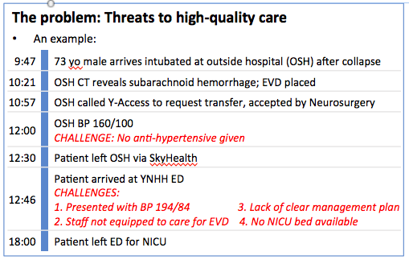
Background

Slide 5
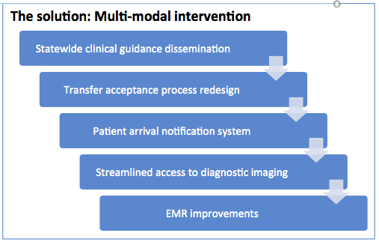
Methods
Pre- and post-intervention analysis
  EMR dashboard
  Call center analysis
  Case audits
Notes:
-EMR-based dashboard tracks clinical, throughput, and process metrics. We manually input relevant cases and our Epic analyst has written code to query the various metrics for all patients. Let me know if you would like more detail.
-I believe by the call-center analysis you mean the content analysis of IHT requests. All Y-Access calls are recorded, so we listened to all relevant calls for ten months (May ’17 – Mar ’18) and identified whether each step in the communication chain was occurring in each call. We tracked the data in a spreadsheet and thus were able to see trends and improvements in uptake of the intervention, as well as identify more challenging steps that needed additional support/education.

Slide 6
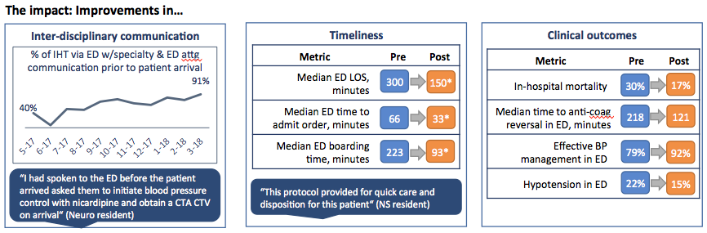
Results
* Clinical outcome results were not statistically significant
Notes:
Significant improvements in communication and process measures

Slide 7
Conclusion
Implementing a multi-modal intervention to improve inter-hospital transfers is possible, and resulted in significant improvement in process and communication metrics
This approach may be scalable to other health systems and other critical care entities (Trauma, ACS, Vascular emergencies, etc)

Slide 8
Limitations/Future Directions
Potential limitations:
  Small sample size – rare diagnosis
  Not powered to detect differences in mortality or other rarer clinical outcomes\
Future studies should examine patient outcomes such as mortality and disability
  May also examine inter-hospital transfer for other critically ill patients

