Slide 1
GEDA: Level 1 Accreditation
Equipment & Supplies
&
Physical Environment
Evidence

Slide 2
Equipment & Supplies
4 point walkers
4 point canes
non-slip socks
pressure reducing mattresses and pillows
blanket warmer
hearing assist device
bedside commodes
condom catheters
low beds
reclinable chairs

Slide 3
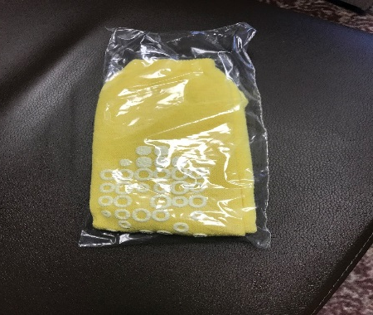
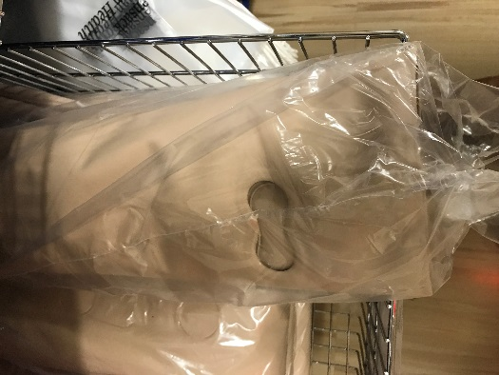
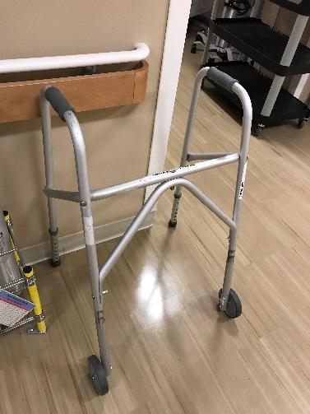
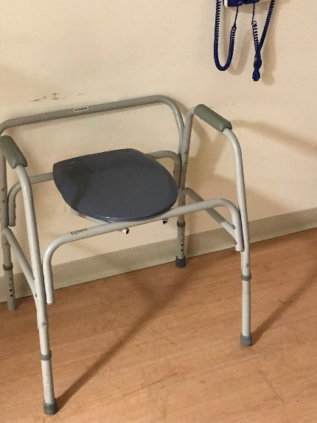
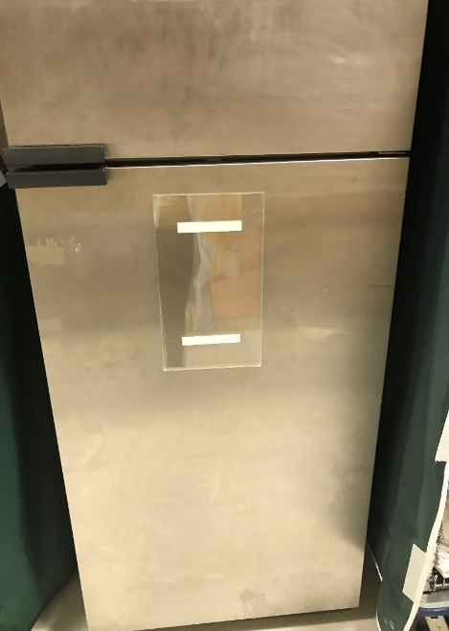
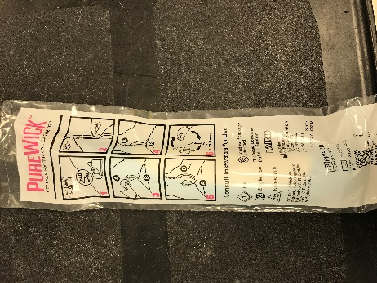
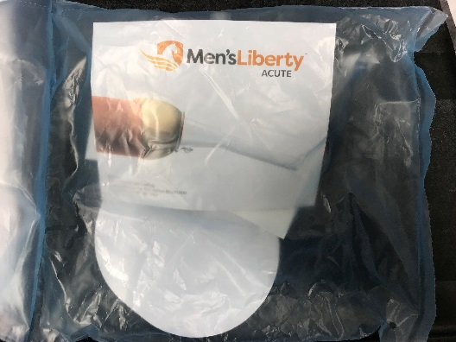
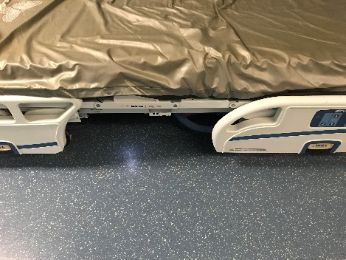
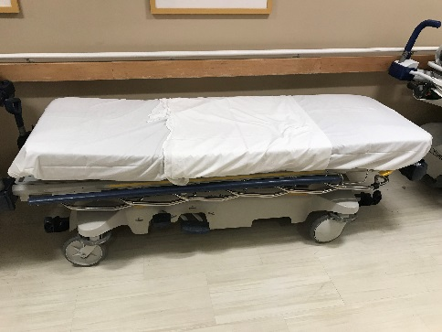
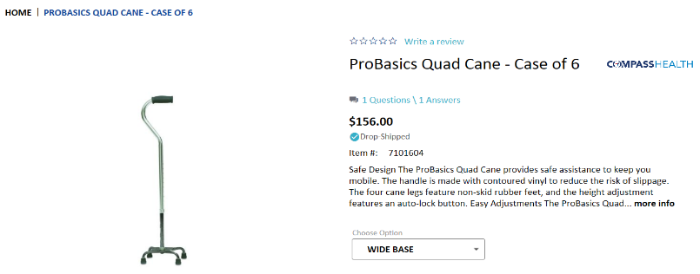
pressure reducing mattresses
non-slip socks
4 point walkers
bedside commodes
blanket warmer
External Cath: PureWick
External Cath: ReliFit
hearing assist device
Low beds(2’ from top of the mattresses to the floor
4 point canes

Slide 4
Room Amenities:
2 Chairs
Large face analog clock
Easy Access to food & Drink (Picture of pantry)
Enhanced lighting
Efforts at noise reductions
Non-slip floors
Adequate hand rails
High quality signage
Wheelchair accessible toilets
Raised toilet seats

Slide 5
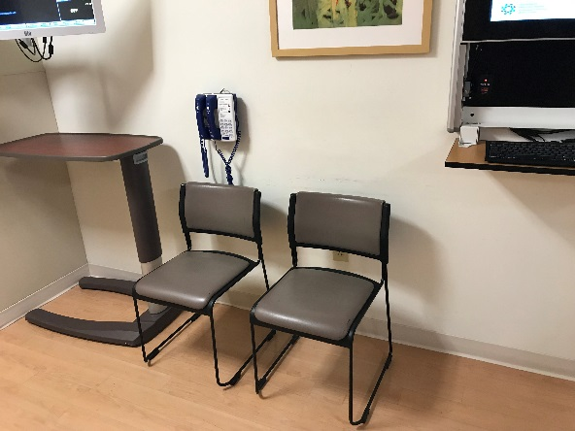
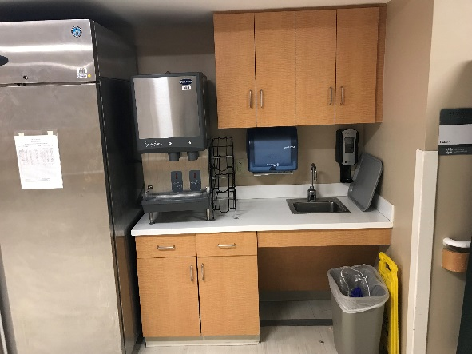
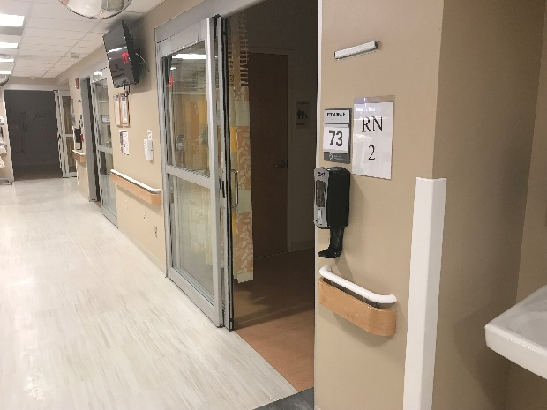
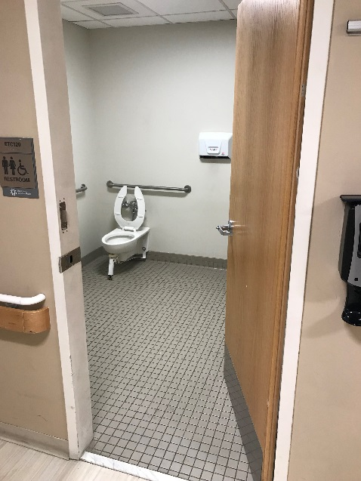
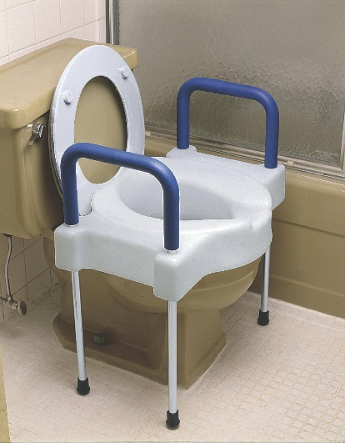
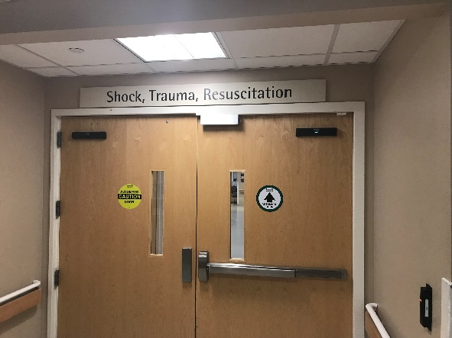
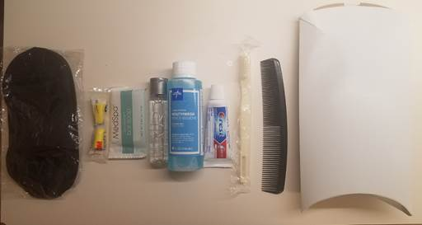
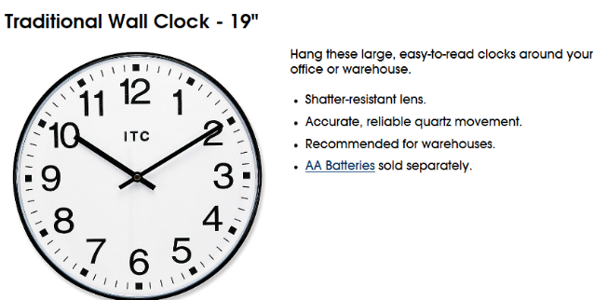
2 Chairs
Easy Access to food & Drink (Picture of pantry)
Adequate hand rails
Wheelchair accessible toilets
High quality signage
Efforts at noise reductions
Raised toilet seats
Large face analog clock

