Slide 1
ACEP Simulation Ultrasound Case
64 year old female with vision change

Slide 2
Labs
Na 140
K 3.5
Cl 103
Bicarb 30
BUN 17
Creatinine 0.81
Glucose 122
WBC 6.6
Hgb 14.3
Hct 42.8
Plt 220
Trop 9
PT-INR 2.1

Slide 3
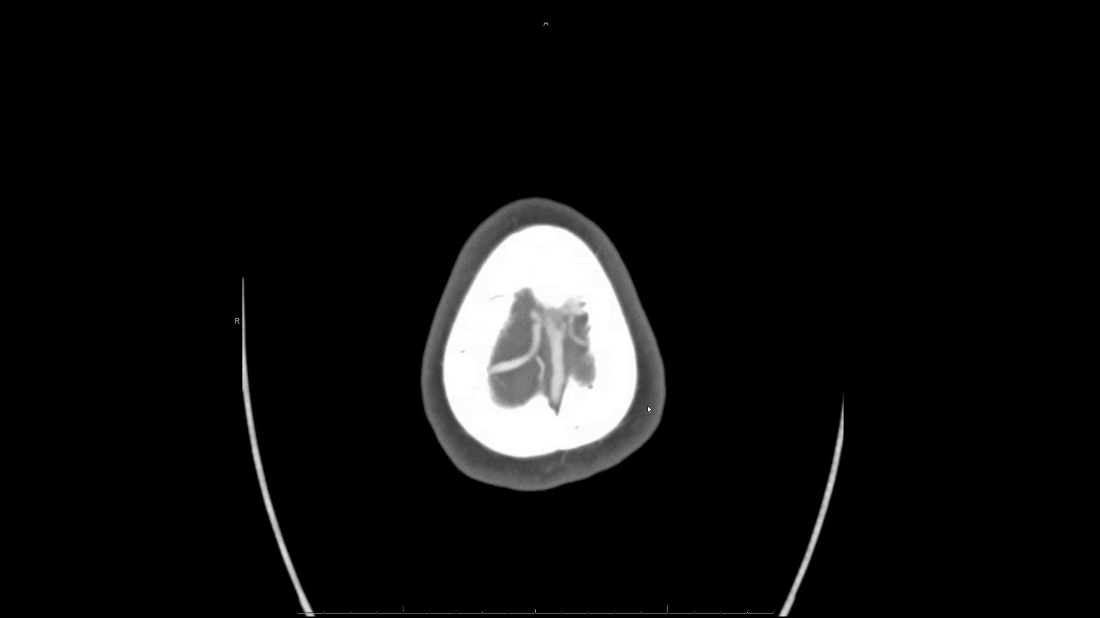
CTA Head and Neck

Slide 4
CTA Head and Neck Report
CTA Neck:
No occlusion or significant stenosis
CTA Brain:
No acute large vessel occlusion
Mild stenosis of bilateral ICAs
No aneurysm identified
Major dural venous sinuses are patent

Slide 5
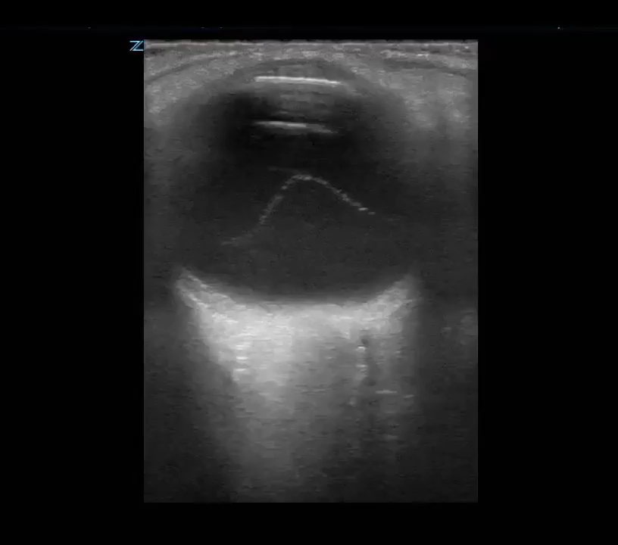
Ocular Ultrasound

Slide 6
Ocular Ultrasound Report
Findings:
Vitreous hemorrhage, vitreous detachment
Optic nerve sheath is 4mm

