Slide 1
The Painful Truth about Spinal Immobilization
Bryan Bledsoe, DO, FACEP, FAAEM
Professor of Emergency Medicine
University of Nevada School of Medicine
Las Vegas, Nevada

Slide 2
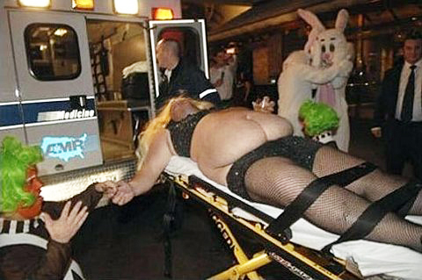

Slide 3
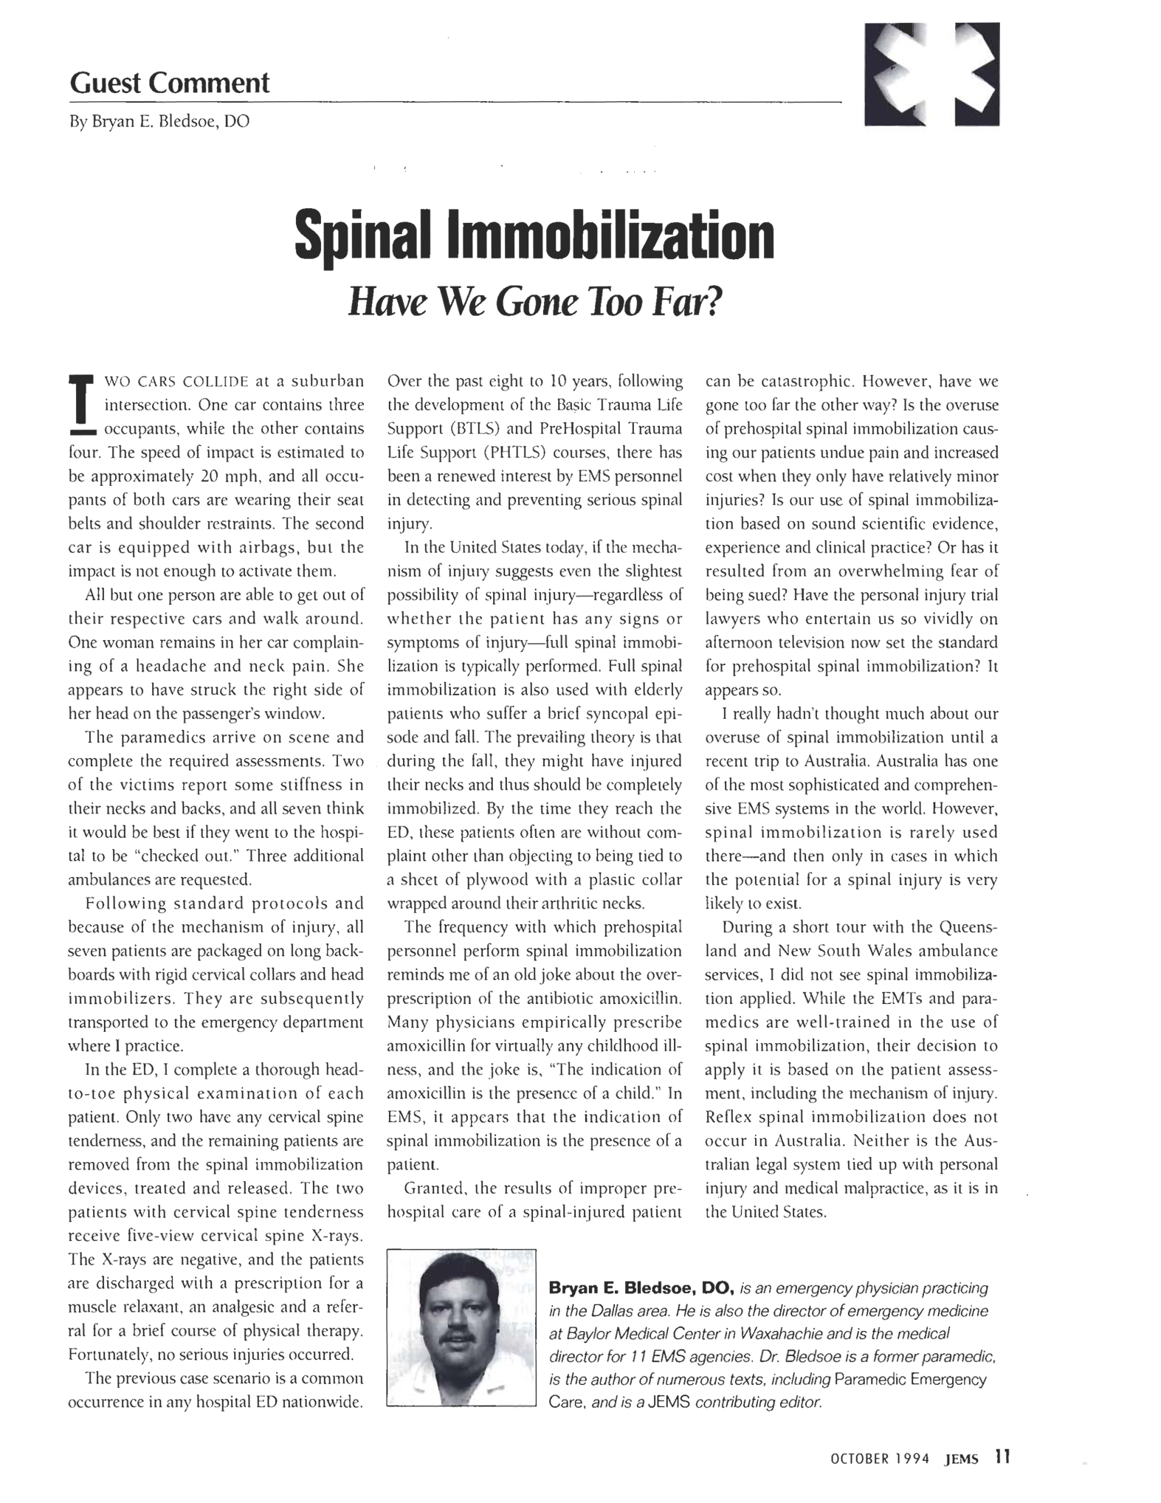

Slide 5
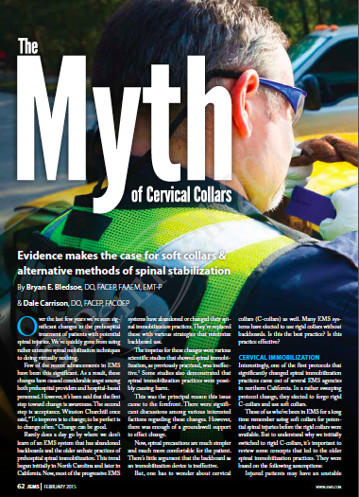
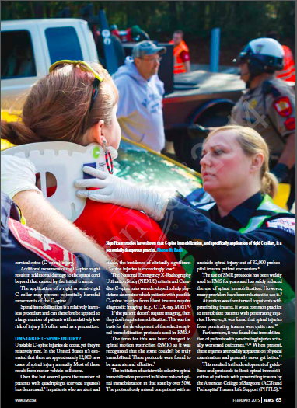

Slide 6
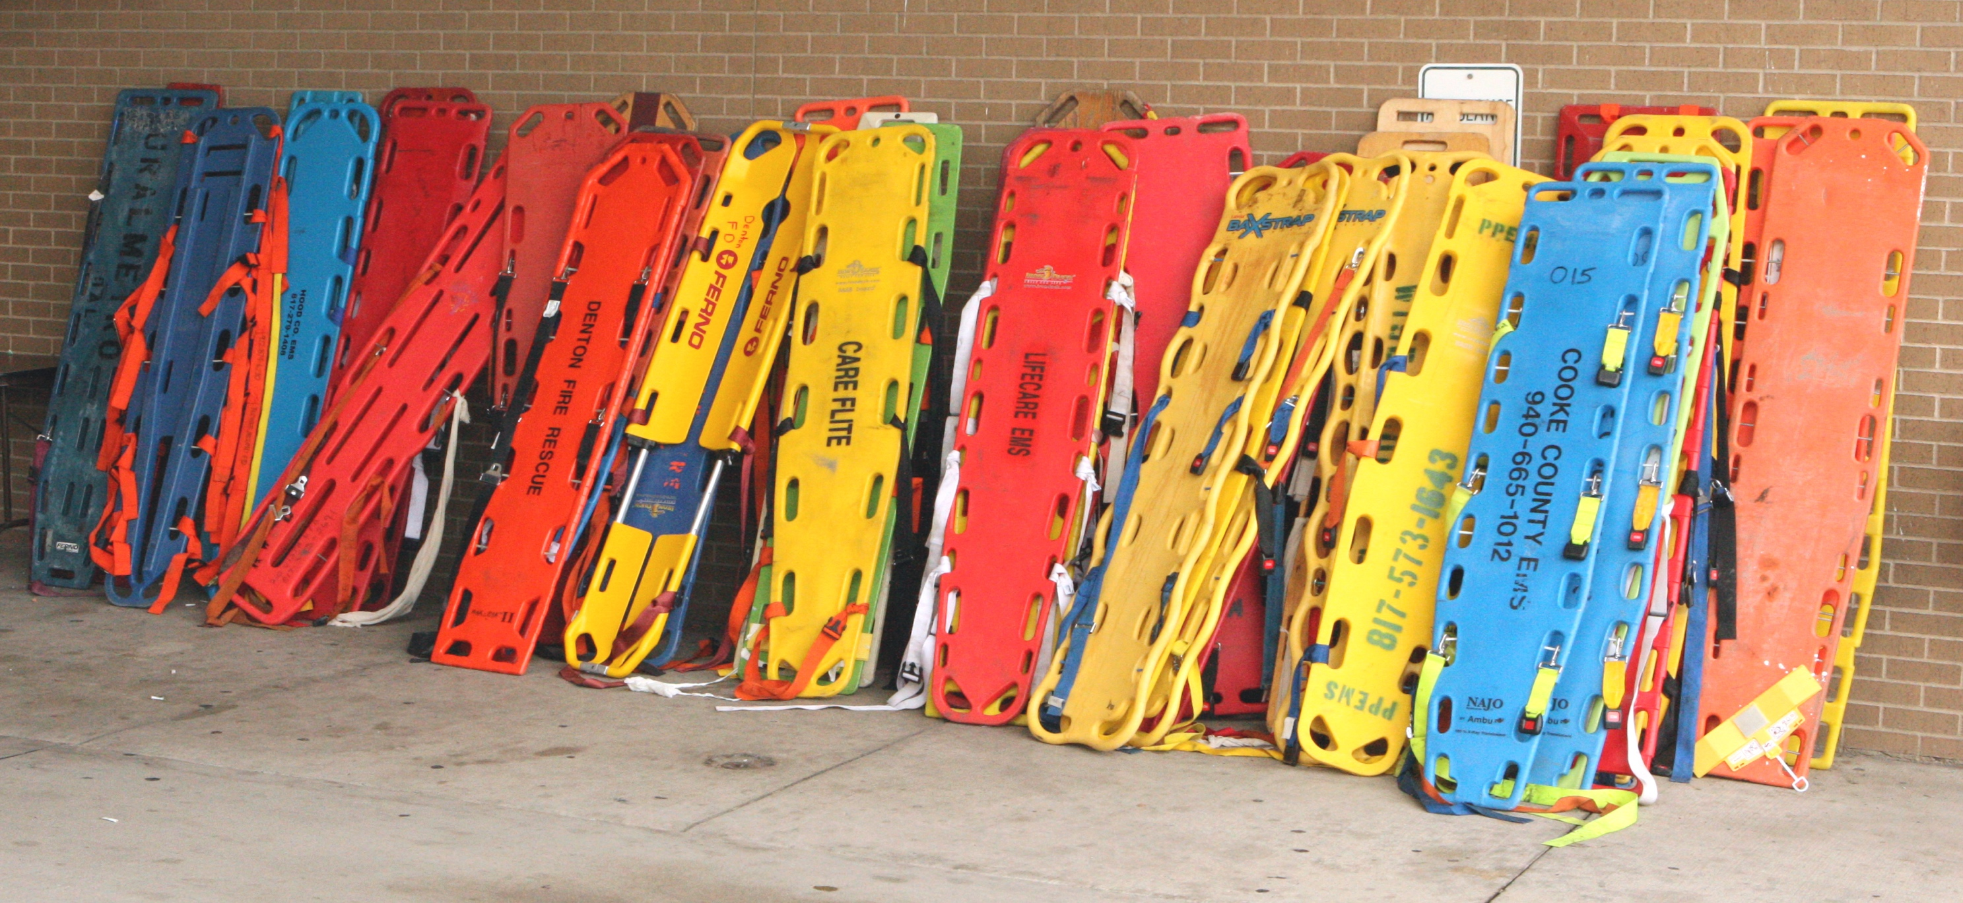
Is it out of control?

Slide 7
Dogma

Slide 8
Dogma
An authoritative belief or principle that is considered to be valid regardless of the accuracy or validity.
Oftentimes the origin of the belief or principle is lost to history.

Slide 9
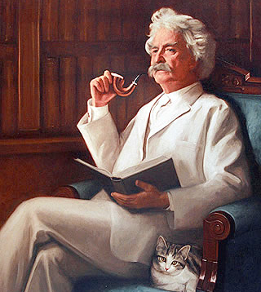
Heretic
Anyone who does not conform to an established attitude, doctrine, or principle.

Slide 10
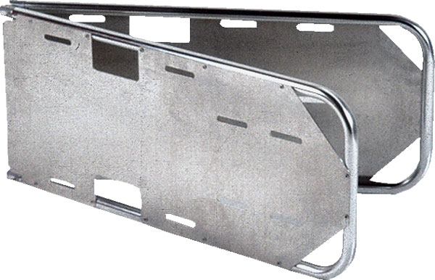
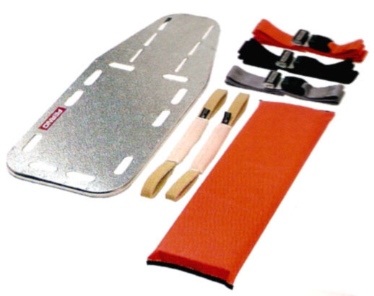
Spinal Immobilization
Backboards have always been a part of “modern” EMS.

Slide 11
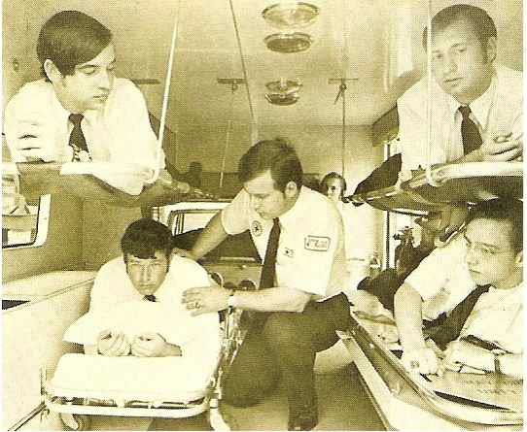
Spinal Immobilization
But why?

Slide 12
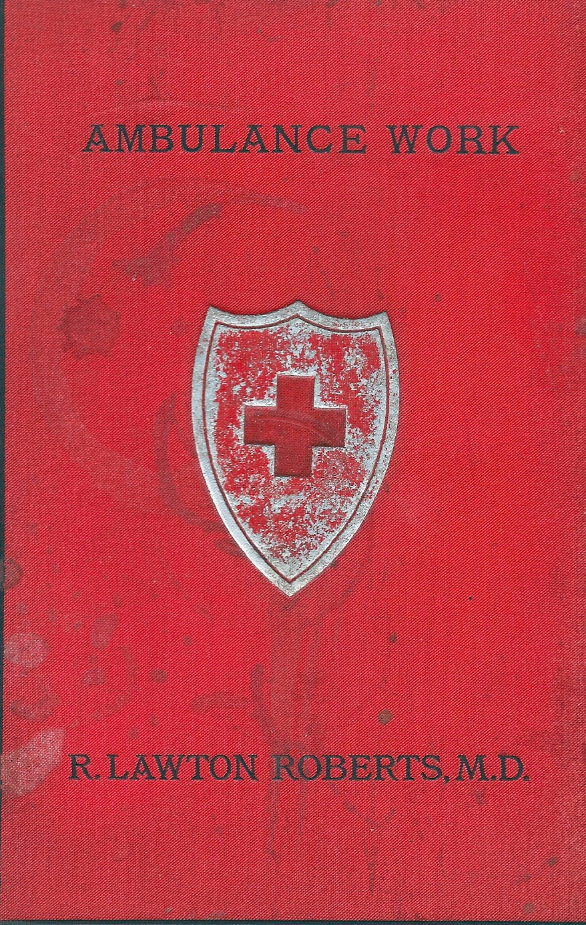
Spinal Immobilization
Order of Saint John core textbook Ambulance Work (1891).
No mention of spinal immobilization.

Slide 13

Spinal Immobilization
“Survey of the accident victims, firm immobilization and in-line traction are the basic principles of extrication.”
Farrington JD. Extrication of victims--surgical principles. J Trauma. 1968;8:493-512.

Slide 14
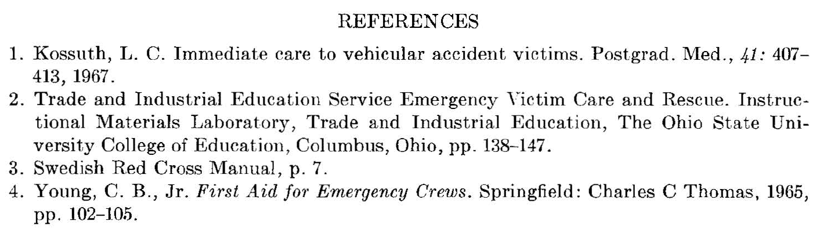
Spinal Immobilization

Slide 15
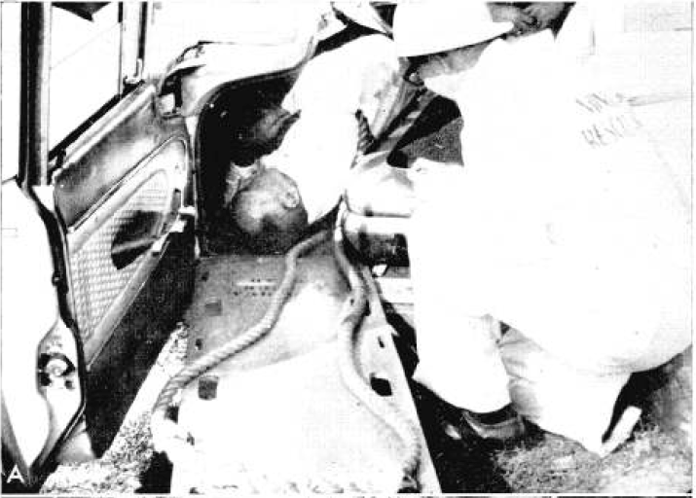
Spinal Immobilization

Slide 16
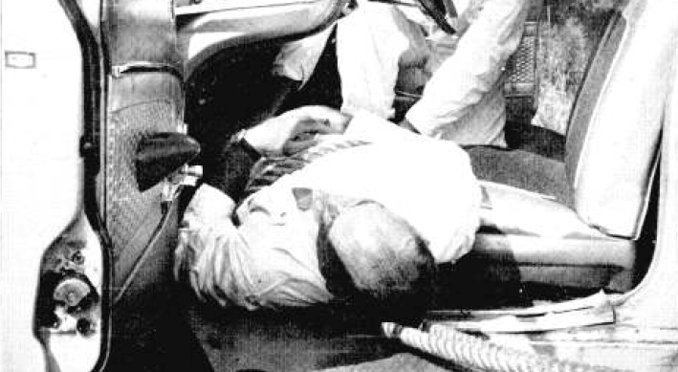
Spinal Immobilization

Slide 17
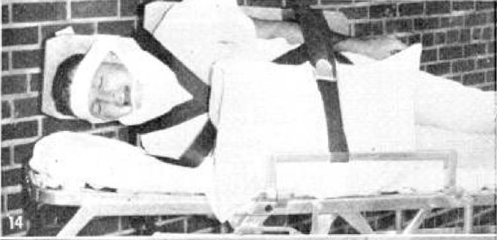
Spinal Immobilization

Slide 18
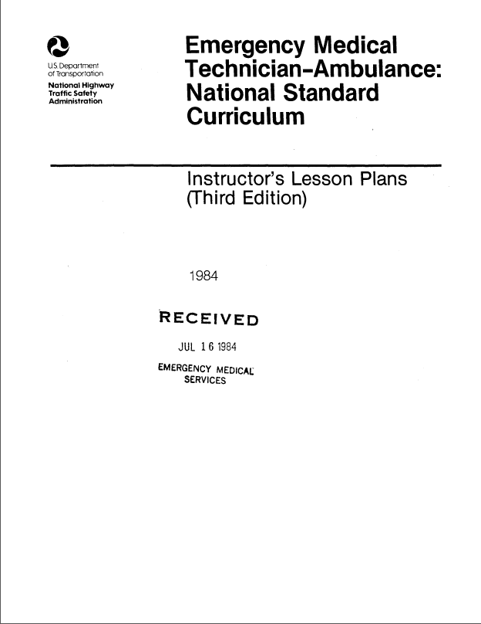
Spinal Immobilization

Slide 19
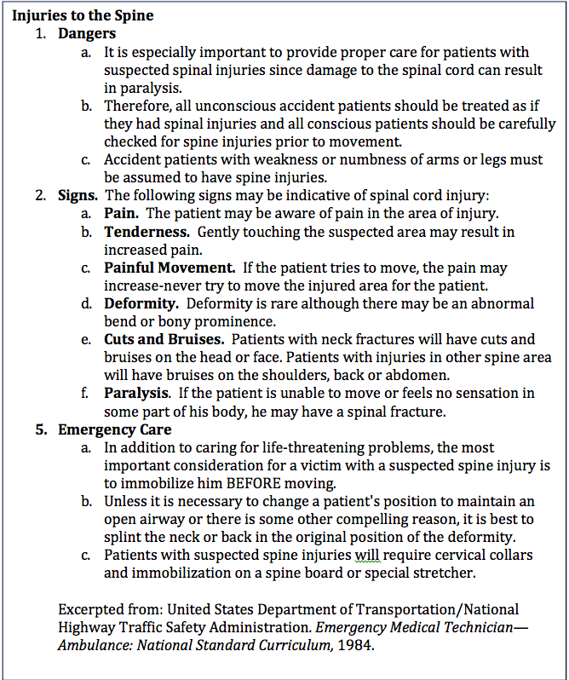
Spinal Immobilization

Slide 20

What is the truth?

Slide 21
Truths
There is no evidence that backboards immobilize the spine.
Backboards can cause pain, make airway management more difficult, impair the patient’s respirations, and place the patient at increased risk of aspiration.
Spinal fractures are uncommon.
There is no evidence that backboards improve patient outcomes.

Slide 22

Truths
If a medication had these same characteristics, use of the drug would be stopped immediately.

Slide 23
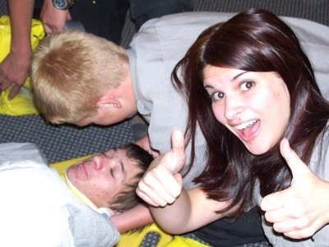
Spinal Immobilization
So why do we keep subjecting our patients to the torture of the backboard?

Slide 24
Spinal Immobilization
No Evidence of Benefit

Slide 25
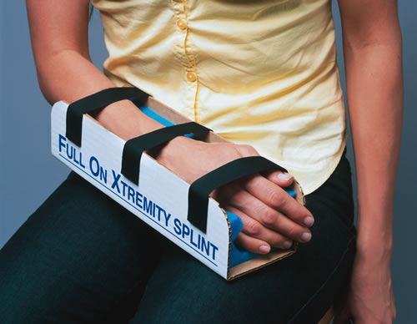
Immobilization Concepts
FRACTURES: Immobilize from the joint above to the joint below.
DISLOCATIONS: Immobilize from the bone above to the bone below.

Slide 26
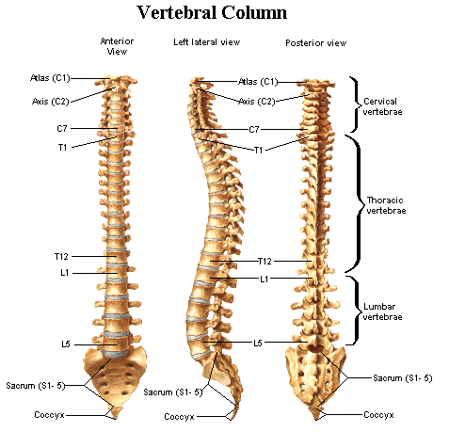
Spinal Immobilization

Slide 27
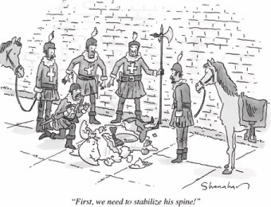
Spinal Immobilization
It is difficult to determine, without imaging, the presence of an injury and the location of any injury.
So, let’s just immobilize the whole spine.

Slide 28
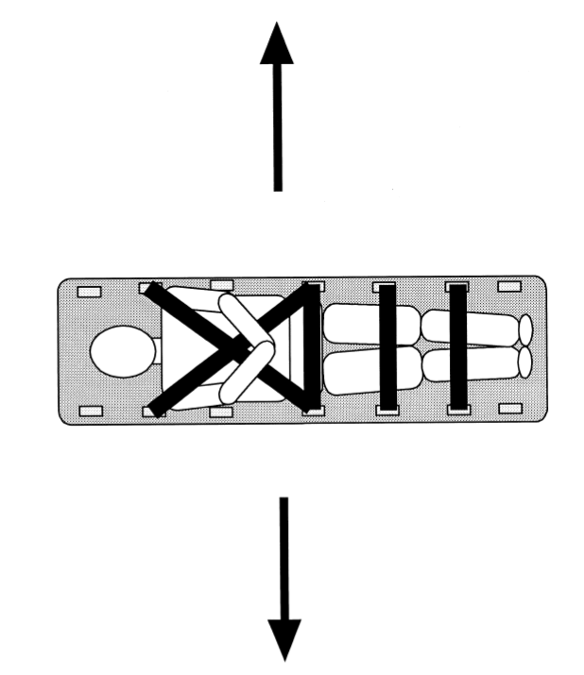
Spinal Immobilization
Canadian study of 6 volunteers that simulated ambulance transport of immobilized patients.
All wore c-collar.
Compared:
  Towels
  Wedges
  Headbed

Slide 29
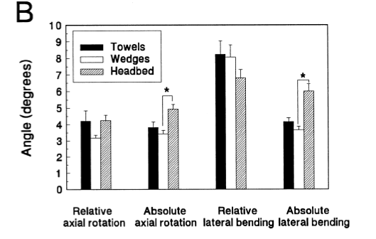
Spinal Immobilization
“None of the three immobilization techniques was successful in eliminating head motion or neck rotation. Movement of the trunk contributed substantially to the lateral bending that occurred across the neck.”
Perry SD, McLellan B, McIlroy WE, Maki BE, Schwartz M, Fernie GR. The efficacy of head immobilization techniques during simulated vehicle motion. Spine (Phila Pa 1976). 1999;24:1839-1844.

Slide 30
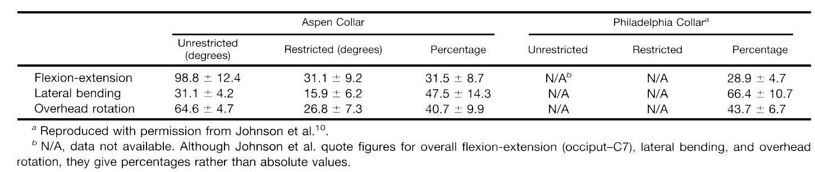
Spinal Immobilization
Hughes SJ. How effective is the Newport/Aspen collar? A prospective radiographic evaluation in healthy adult volunteers. J Trauma. 1998;45:374-378.

Slide 31
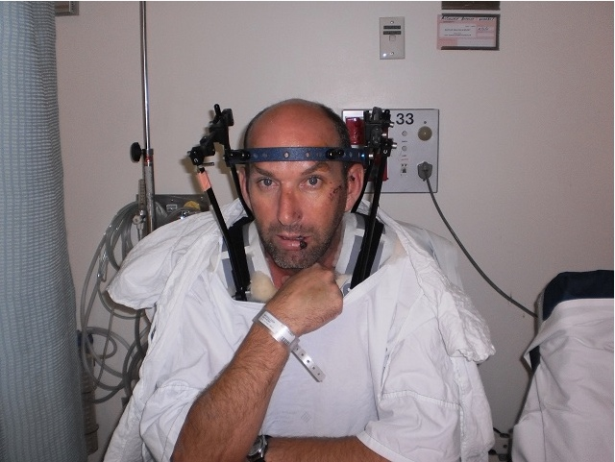
Spinal Immobilization
“Cervical immobilization is a myth. Even the halo frame permits 4% motion.”

Slide 32
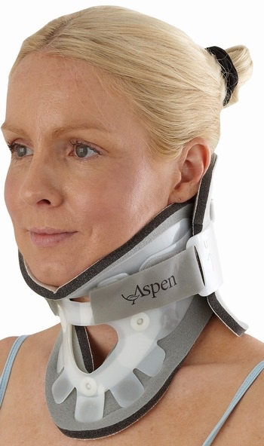
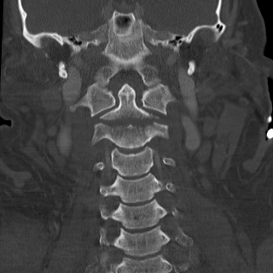
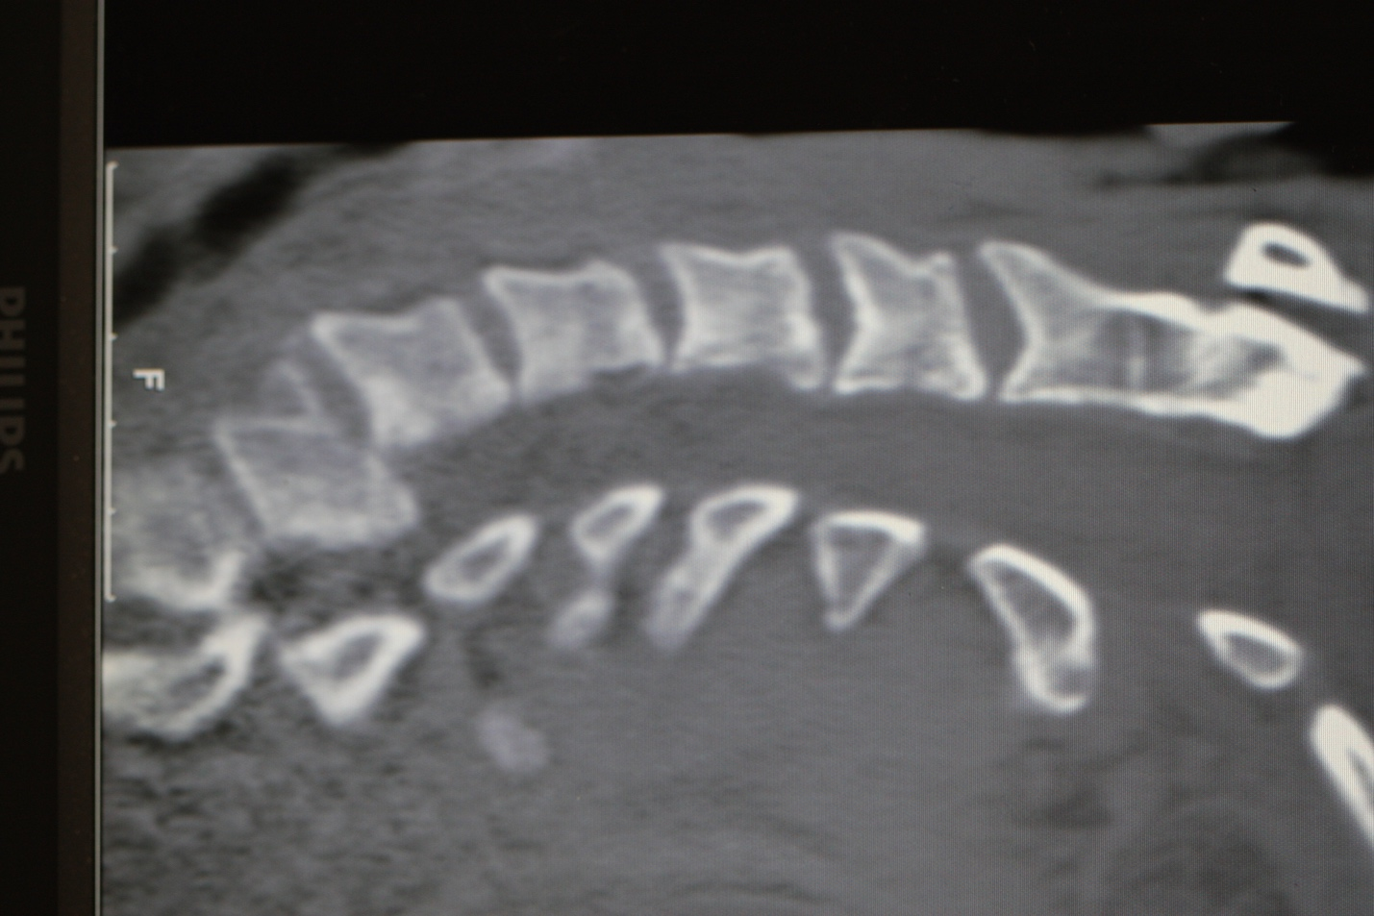
Spinal Immobilization

Slide 33
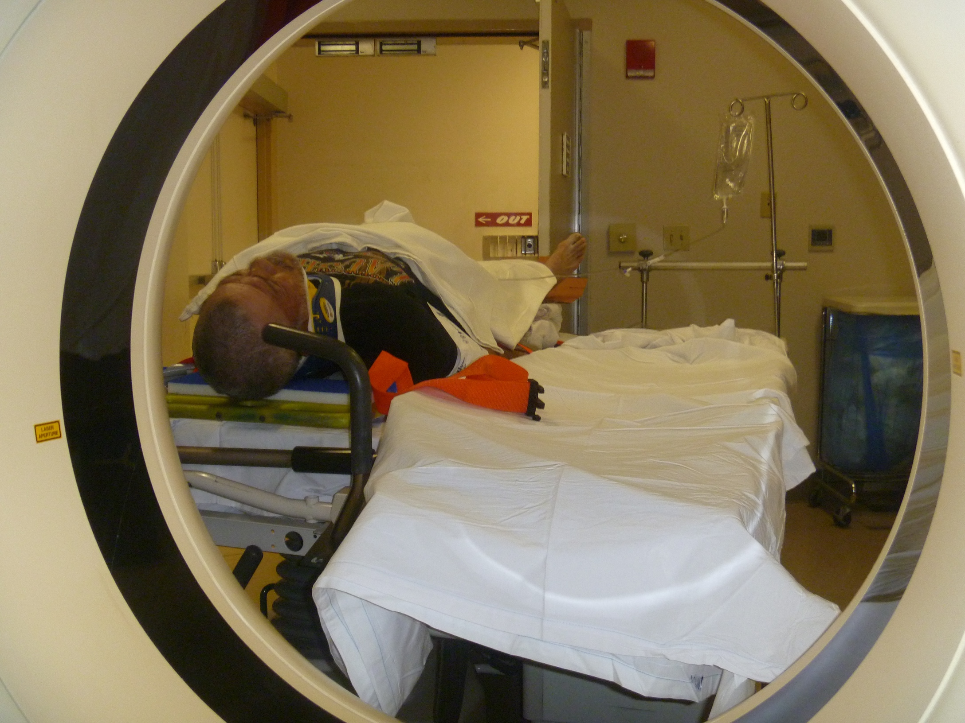
Spinal Immobilization

Slide 34

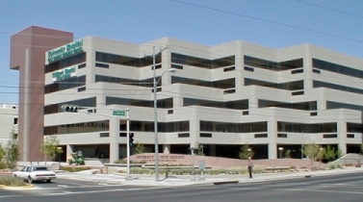
Spinal Immobilization
University of Malaya
University of New Mexico

Slide 35
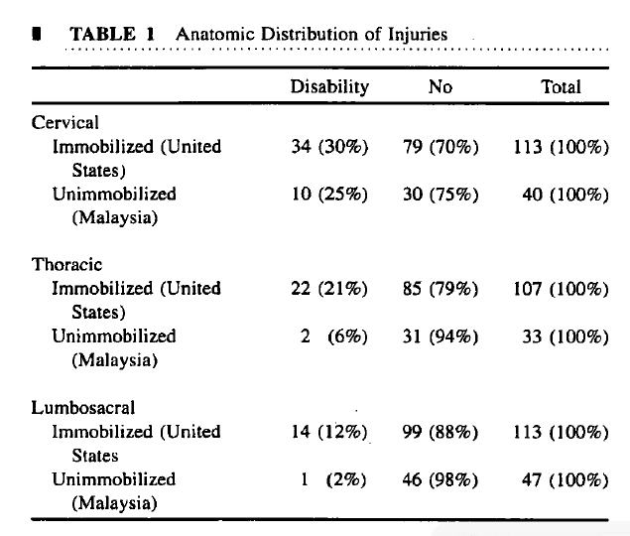
Spinal Immobilization

Slide 36
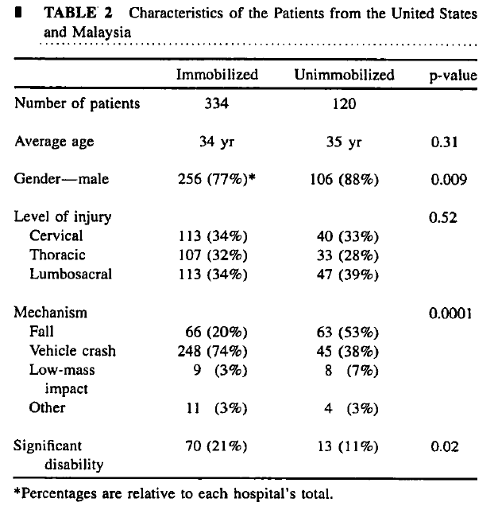
Spinal Immobilization

Slide 37
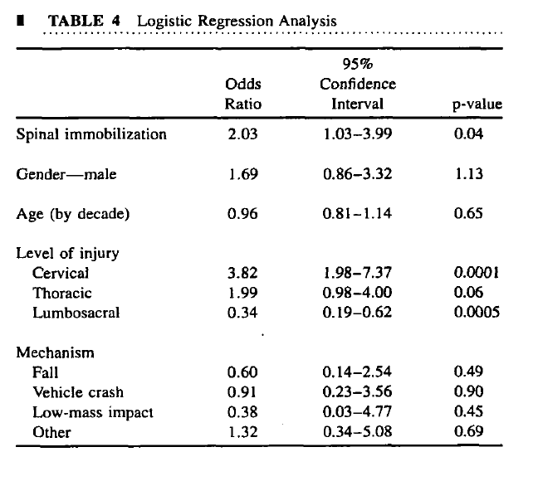
Spinal Immobilization

Slide 38
Spinal Immobilization
The OR for disability was higher for patients in the United States (all with spinal immobilization) after adjustment for the effect of all other independent variables (2.03; 95% CI 1.03-3.99; p = 0.04).
The estimated probability of finding data as extreme as this if immobilization has an overall beneficial effect is only 2%. Thus, there is a 98% probability that immobilization is harmful or of no value.
We repeated this analysis using only the subset of patients with isolated cervical level deficits. We again failed to show a protective effect of spinal immobilization (OR 1.52; 95% CI 0.64-3.62; p = 0.34).
Hauswald M, Ong G, Tandberg D, Omar Z. Out-of-hospital spinal immobilization: its effect on neurologic injury. Acad Emerg Med. 1998;5:214-219

Slide 39

Spinal Immobilization
The effect of spinal immobilisation on mortality, neurological injury, spinal stability and adverse effects in trauma patients remains uncertain.
Because airway obstruction is a major cause of preventable death in trauma patients, and spinal immobilisation, particularly of the cervical spine, can contribute to airway compromise, the possibility that immobilisation may increase mortality and morbidity cannot be excluded.

Slide 40
Spinal Immobilization
Spinal cord damage from injury causes long-term disability and can dramatically affect quality of life. The current practice of immobilising trauma patients before hospitalisation to prevent more damage may not always be necessary, as the likelihood of further damage is small.
Means of immobilisation …can cause tissue pressure and discomfort, difficulty in swallowing and serious breathing problems.

Slide 41
Spinal Immobilization
The review authors could not find any randomised controlled trials of spinal immobilisation strategies in trauma patients.
From studies of healthy volunteers it has been suggested that patients who are conscious, might reposition themselves to relieve the discomfort caused by immobilisation, which could theoretically worsen any existing spinal injuries.
Kwan I, Bunn F, Roberts I. Spinal immobilization for trauma patients. Cochrane Database Syst Rev. 2001;(2):CDC002803

Slide 42
Extrication
2 paramedics and 4 firefighter first responders used 9 different extrication techniques.
3-D biomedical analysis of movement.
Conventional extrication techniques record up to four times more cervical spine movement during extrication than controlled self-extrication.
Dixon M, O’Halloran J, Cummins NM. Biomechanical analysis of spinal immobilisation during prehospital extrication—a proof of concept study. Emerg Med J. 2-13;June 28 (epub ahead of print)

Slide 43
Extrication
Spinal movement monitored during vehicle exit:
  Unassisted, unprotected: Driver allowed to exit vehicle on own volition.
  Cervical collar unassisted, protected: EMS personnel (2) applied c-collar and allowed to exit vehicle on own volition.
  Cervical collar assisted, protected: 2 EMS providers applied c-collar and extricated through standard technique.
  Cervical collar assisted, KED protected: 2 EMS providers applied c-collar and KED and extricated through standard technique

Slide 44
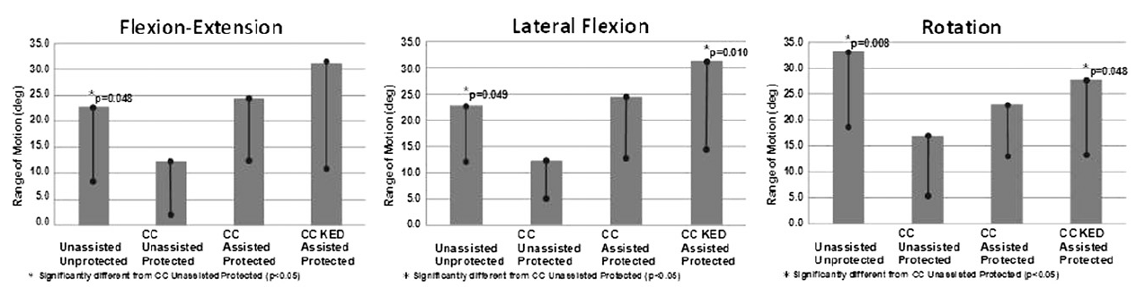
Extrication
Engsberg JR, Standeven JW, Shurtleff TL, Eggars JL, Shafer JS, Naunheim RS. Cervical Spine Motion During Extrication. J Emerg Med. 2013;44:122-127.

Slide 45
Truths
Backboards Have Risks

Slide 46
Pain
 | Number | Percentage
Subjects* | 21
Symptoms | 61
Patients with:
1 symptom | 4 | 19
2 symptoms | 5 | 24
3 symptoms | 3 | 14
4 symptoms | 7 | 33
5 symptoms | 2 | 10
*-Healthy volunteers with no pre-existing back pain or problems.

Slide 47
Immediate Symptoms
Symptom | Number | Percentage
Immediate Symptoms | 21 | 100
Number of Symptoms | 49
Occipital pain | 16 | 72
Sacral pain | 9 | 43
Lumbosacral pain | 7 | 33
Mandible pain | 7 | 33
Scapular pain | 3 | 14
Heel pain | 2 | 10
Buttock pain | 1 | 5
Chondrocostal pain | 1 | 5
Shoulder pain | 1 | 5
Panic | 1 | 5
Nausea | 1 | 5

Slide 48
Delayed Symptoms
Symptom | Number | Percentage
Delayed Symptoms | 6
Number of Delayed Symptoms | 12
Headache | 6 | 29
Low back pain | 2 | 10
Stiffness (neck/upper back) | 1 | 5
Sciatica | 1 | 5
Nausea | 1 | 5
Exhaustion | 1 | 5
Chan D, Goldberg R, Tascone A, Harmon S, Chan L. The effect of spinal immobilization on healthy volunteers. Ann Emerg Med. 1994;23:48-51

Slide 49
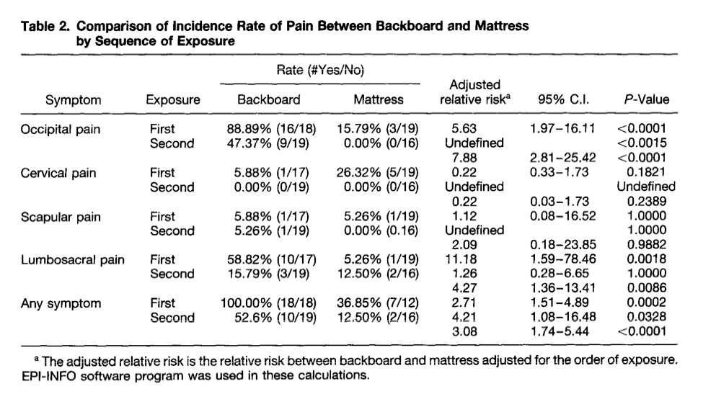
Pain
Chan D, Goldberg RM, Mason J, Chan L. Backboard versus mattress splint immobilization: a comparison of symptoms generated. J Emerg Med. 1996;14:293-298.

Slide 50
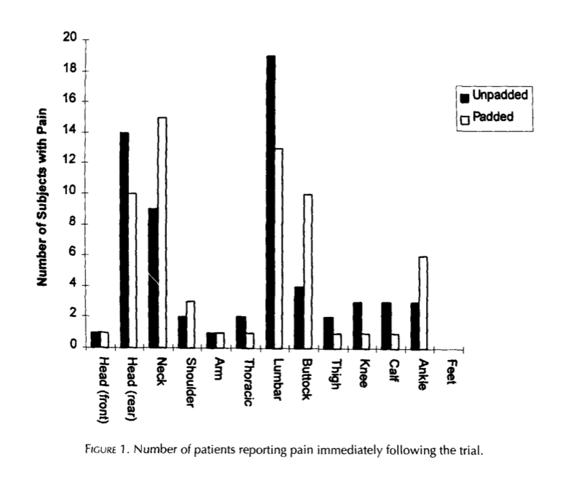
Pain
39 Healthy Volunteers

Slide 51
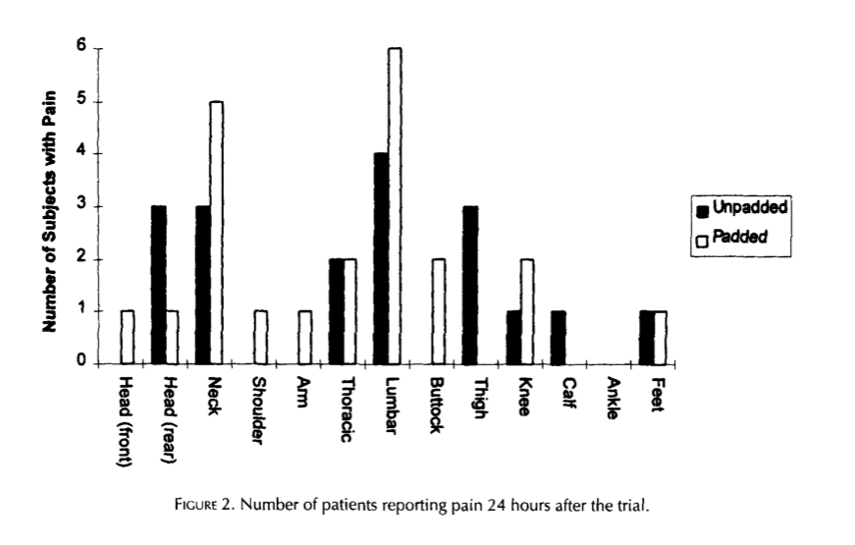
Pain

Slide 52
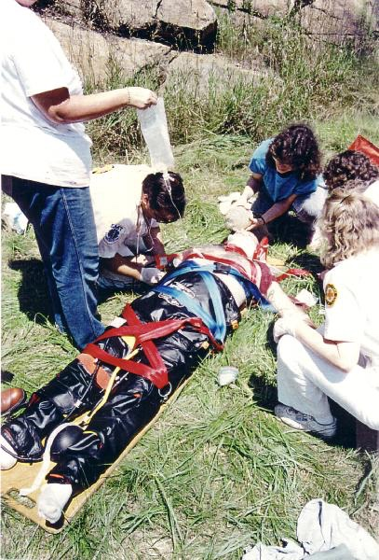
Pain
Healthy volunteers frequently experienced pain following spinal immobilization. The use of occipital padding does not appear to alleviate this pain.
Lerner EB, Billittier AJ, Moscati RM. The effects of neutral positioning with and without padding on spinal immobilization of healthy subjects. Prehospital Emergency Care. 1998;2:112-116.

Slide 53
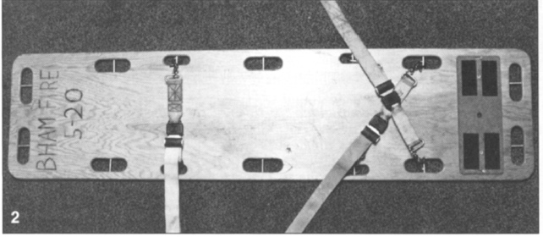
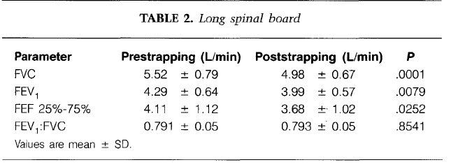
Respiratory Impairment

Slide 54
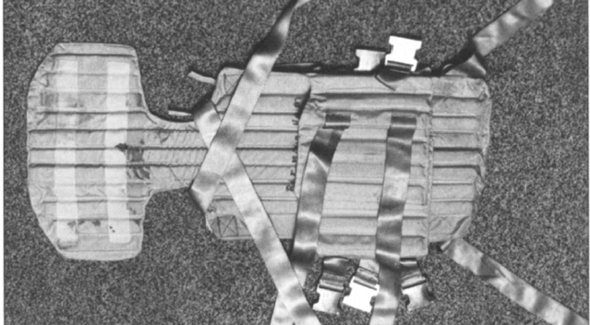
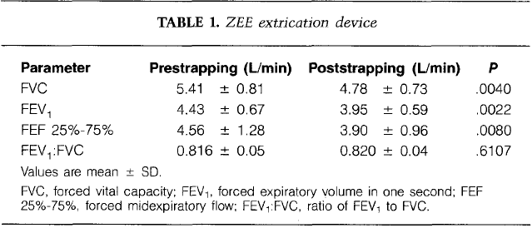
Respiratory Impairment

Slide 55
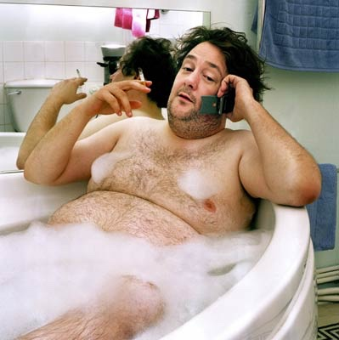
Respiratory Impairment
Our study demonstrated that the long spinal board and the ZED board used for spinal immobilization have restrictive effects on pulmonary function in the healthy, nonsmoking man.
Bauer D, Kowalski R. Effect of spinal immobilization devices on pulmonary function in the healthy, nonsmoking man. Ann Emerg Med. 1988;17:915-918.

Slide 56
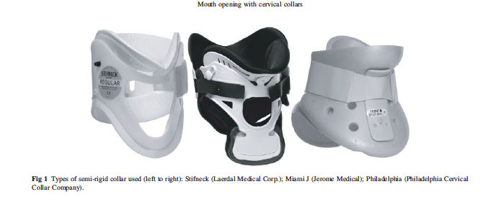
Airway Interference

Slide 57
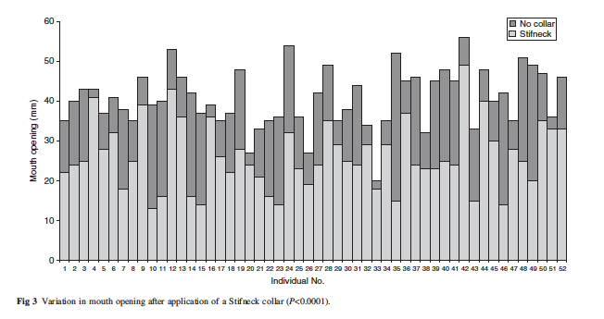
Airway Interference

Slide 58
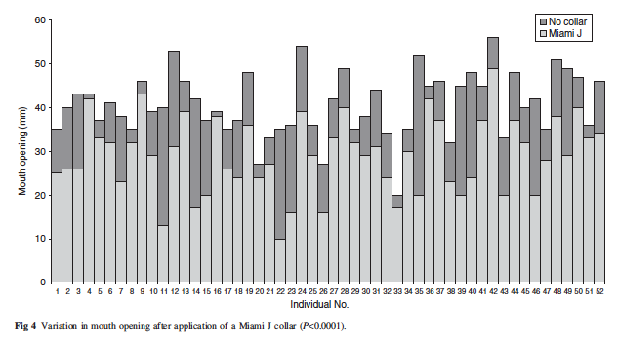
Airway Interference

Slide 59
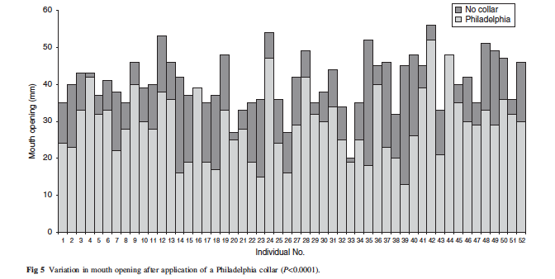
Airway Interference

Slide 60
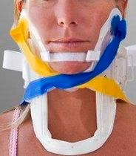
Airway Interference
Cervical collars and spinal immobilization have been found to reduce mouth opening by 20-25%.
Goutcher CM, Lochhead V. Reduction in mouth opening with semi-rigid cervical collars. Br J Anaesth. 2005;95:344-348.

Slide 61
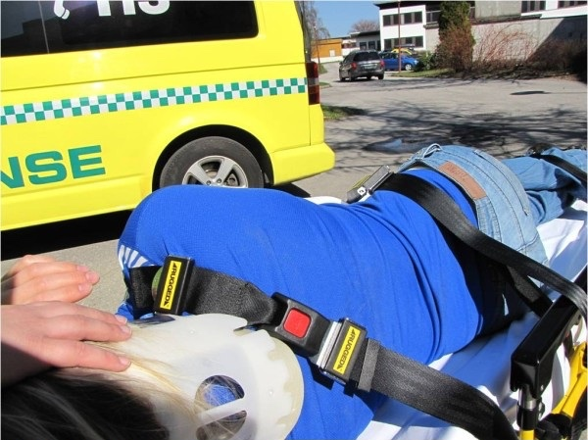
Aspiration

Slide 62
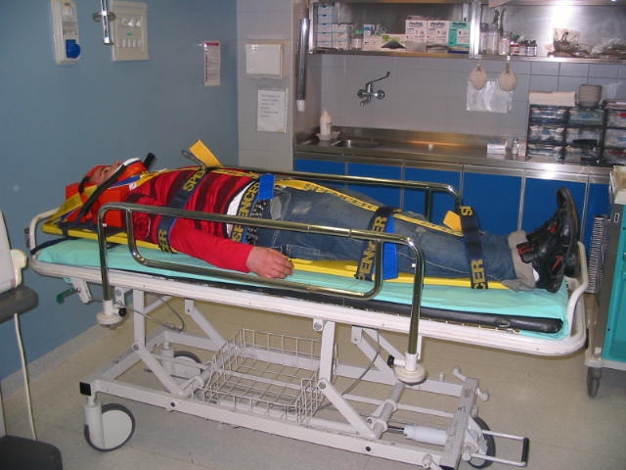
Aspiration

Slide 63
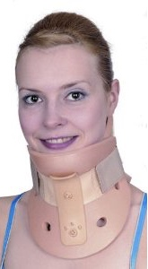

Increased ICP

Slide 64

Increased ICP
Significant rise (p < 0.001) in ICP:
  Mean rise in ICP of 4.5 mmHg (σ 4.1).
  Insignificant changes in MAP suggested that this effect is due to distortion of venous drainage.

Slide 65

Increased ICP
“In the prehospital environment, similar concerns exist. Patients at risk of raised ICP require alternative means of cervical spine immobilization.”
Davies G, Deakin C, Wilson A. The effect of a rigid collar on intracranial pressure. Injury. 1996;27:647-649..

Slide 66
Increased ICP
Sydney, NSW prospective study:
  10 head-injured patients with GCS ≤ 9 (post-resuscitation).
  ICP measurements before and after cervical collar application.
  9 or 10 patients had statistically significant increase in ICP (p < 0.05).
Mobbs RJ, Stoodley MA, Fuller J. Effect of cervical hard collar on intracranial pressure after head injury. ANZ J Surg. 2002;72:389-391.

Slide 67

Increased ICP

Slide 68
Increased ICP
In healthy volunteers, internal jugular vein cross-sectional area increases after application of a rigid cervical collar.
This may provide a possible explanation for the increase in intracranial pressure seen with rigid cervical collar use in victims of head trauma.
Stone MB, Tubridy CM, Curran R. The effect of rigid cervical collars on internal jugular vein dimensions. Acad Emerg Med. 2010;17:100-102.

Slide 69

Distraction Injuries

Slide 70

Distraction Injuries

Slide 71
Distraction Injuries
Baylor study.
9 unembalmed cadavers.
AP ligamentous support of C1-C2 surgically cut (posteriorly).
Standard C-collar applied.
Collar application resulted in 7.3 mm +/- 4.0 mm of separation between C1 and C2.
Ben-Galim P, Dreiangel N, Mattox KL, Reitman CA, Kalantar SB, Hipp JA. Extrication Collars Can Result in Abnormal Separation Between Vertebrae in the Presence of a Dissociative Injury. J Trauma. 2010.

Slide 72
Truths
Spinal Injuries are
Uncommon

Slide 73


Slide 74


Incidence
SCI is a relatively rare condition.
Annual incidence of spinal cord injury:
  ~ 40 cases/million population in the US (~12,000 new cases annually).

Slide 75


Cervical Fracture Incidence
BLUNT TRAUMA

Slide 76
Cervical Fracture Incidence
NEXUS derivative study.
34,069 patients with blunt trauma:
  818 (2.4%) individuals had:
    1,496 distinct cervical spine injuries to 1,285 different cervical spine structures.
  C2 vertebra was the most common level of injury (286 [24.0%] fractures).
  1/3 of all injuries (29.3%) were considered clinically insignificant.

Slide 77

Cervical Fracture Incidence
BLUNT TRAUMA

Slide 78
Cervical Fracture Incidence
Cervical spine injuries occur in a small minority of patients with blunt trauma who undergo imaging:
  Most common site: atlantoaxial region and C6 and C7 (over 1/3 of injuries).
  A substantial minority of radiographically defined cervical spine injuries are of little clinical importance.
Goldberg W, Mueller C, Panacek E, et al. Distribution and patterns of blunt traumatic cervical spine injury. Ann Emerg Med. 2001;38:17-21.

Slide 79

Spinal Injury Mortality/Year
DeVivo MJ. Epidemiology of traumatic spinal cord injury: trends and future implications. Spinal Cord. 2012;50:365-372.

Slide 80

MOI and Spinal Injury
57,523 trauma patients:
  LAC/USC
  WHC
Evaluated by:
  Blunt asaault
  Stab wounds
  Gunshot wounds
Rhee P, Kuncir EJ, Johnson L, et al. Cervical spine injury is highly dependent on the mechanism of injury following blunt and penetrating assault. J Trauma. 2006;61:1166-1170.

Slide 81

MOI and Spinal Injury

Slide 82
MOI and Spinal Injury
Rates for CSF:
  GSW (1.35%)
  BA (0.41%)
  SW (0.12%).
Rates of CSCI:
  GSW (0.94%)
  BA (0.14%)
  SW (0.11%)
Surgical stabilization:
  GSW (26/158 [15.5%])
  BA (6/19 [31.6%])
  SW (3/11 [27.8%])
No patient with penetrating SCI regained significant neurologic recovery.

Slide 83
MOI and Spinal Injury
Rates overall low.
Consider mechanism of injury.
Neurologic deficits from penetrating assault were established and final at the time of presentation.
Concern for protecting the neck should not hinder the evaluation process or life saving procedures.

Slide 84

Penetrating Trauma
45,284 penetrating trauma patients:
  Median age: 29 years
  Male: 87.8%
  Race:
    Black: 41.8%
    White: 34.6%
    Hispanic: 19.3%
Injuries:
  Neck and torso: 32.0%
  ISS>15: 22.0%
  Prehospital spinal immobilization: 4.3%
  Mortality: 8.1%

Slide 85

Penetrating Trauma
Haut ER, Kalish BT, Efron DT, et al. Spine immobilization in penetrating trauma: more harm than good? J Trauma. 2010;68:115-20; discussion 120-1.

Slide 86

Penetrating Trauma
Prehospital spine immobilization is associated with higher mortality in penetrating trauma and should not be routinely used in every patient with penetrating trauma.

Slide 87
Penetrating Trauma
NOLA retrospective chart review:
  847 charts
  188 studied patients
    35 (22.9%) died
      27 immobilized
      8 not immobilized
      GSW (94%)
      Stab wound (6%)
C-spine immobilisation in this study was associated with an increased risk of death (p = 0.016, odds ratio 2.77, 95% CI 1.18- 6.49).
Vanderlan WB, Tew BE, McSwain NE. Increased risk of death with cervical spine immobilisation in penetrating cervical trauma. Injury. 2009;40:880-883.

Slide 88
Penetrating Trauma
Fresno study.
215 patients with GSW to head:
  DOA and c-spine injuries excluded.
Cervical spine clearance was determined in 202 (93%).
No patients had indirect c-spine injury.
3 patients had direct c-spine injury that was readily apparent.
Kaups KL, Davis JW. Patients with gunshot wounds to the head do not require cervical spine immobilization and evaluation. J Trauma. 1998;44:865-867.

Slide 89
Penetrating Trauma
More intubation attempts occurred in patients with cervical collars:
  49 attempts in 34 patients with c-collars
  5 attempts in 4 patients without c-collars (p=0.008).
Indirect spinal injury does not occur with GSWs to head.
Airway management compromised by c-collars.

Slide 90

Penetrating Trauma
There are no data to support routine spine immobilization in patients with penetrating trauma to the neck or torso.
There are no data to support routine spinal mobilization in patients with isolated penetrating trauma to the cranium.

Slide 91
Penetrating Trauma
Spine immobilization should never be done at the expense of accurate physical examination or identification and correction of life-threatening conditions in patients with penetrating trauma.

Slide 92
Penetrating Trauma
Spinal mobilization may be performed after penetrating injury when a focal neurologic deficit is noted on the examination although there is little evidence of benefit even in these cases.
Stuke LE, Pons PT, Guy JS, Chapleau WP, Butler FK, McSwain NE. Prehospital spine immobilization for penetrating trauma--review and recommendations from the Prehospital Trauma Life Support Executive Committee. J Trauma. 2011;71:763-9; discussion 769-70.

Slide 93

Imaging

Slide 94

Imaging

Slide 95
Imaging
Supine Trauma Resus CXR
26 M s/p GSW to back/chest
FINDINGS:
Backboard artifacts noted. Low lung volume is seen. There is opacity in both
lungs likely related to the low lung volume. The mediastinum cannot be
evaluated. Cardiac silhouette is grossly unremarkable. No bullet fragments
identified.
IMPRESSION:
Exam is compromised. Mediastinum cannot be evaluated. There is opacity in
both lungs that may be secondary to low lung volume atelectasis, but cannot
exclude pulmonary infiltrates or pulmonary contusion.

Slide 96

Imaging

Slide 97

Imaging

Slide 98

Imaging
Leonard JC, Mao J, Jaffe DM. Potential adverse effects of spinal immobilization in children. Prehosp Emerg Care. 2012;16:513-518.

Slide 99
Truths
No Evidence it Improves Outcomes

Slide 100

Truths
There is no evidence!

Slide 101
Summary
Procedure | Usage
Proven benefit; no risks | Ethical NOT to use procedure
Proven benefits; possible risks | Weigh benefits against risks and apply if expected outcomes are worth the known risks.
Proven benefits; proven risks | Weigh benefits against risks and apply if expected outcomes are worth known risks.
No proven benefits; no proven risks | Why use procedure?
No proven benefits; possible risks | Unethical to use procedure.
No proven benefit; proven risks | Criminal to use procedure.

Slide 102

AHA 2015 Guidelines
Not published until October 15, 2015.

Slide 103
San Joaquin EMS
No rigid collars
No adhesive tape
Backboards used only for movement
GCS motor component (<5) instead of total GCS used to apply spinal immobilization

Slide 104

Las Vegas

Slide 105

One should never allow knowledge or reason to substitute for dogma.

Slide 106

Politics and Medicine

Slide 107

Summary

Slide 108
Summary
We cannot direct the wind, but we can adjust the sails.
Dolly Parton

Slide 109

Summary

