Slide 1
Can Oxygen Really Be Bad?
Bryan E. Bledsoe, DO, FACEP
Clinical Professor of Emergency Medicine
University of Nevada School of Medicine
Las Vegas, Nevada

Slide 2

Chemistry Warning

Slide 3

Oxygen
“Not all chemicals are bad. Without chemicals such as hydrogen and oxygen, for example, there would be no water, a vital ingredient for beer.”
-Dave Barry

Slide 4
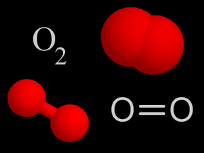
Oxygen
Oxygen:
  Diatomic gas
  Atomic weight = 15.9994 g⁻¹
  Colorless
  Tasteless
  Third most abundant element in the Universe.
  Present in Earth’s atmosphere at 20.95%.

Slide 5
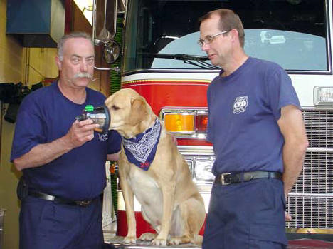
Oxygen
Oxygen is essential for animal life.

Slide 6
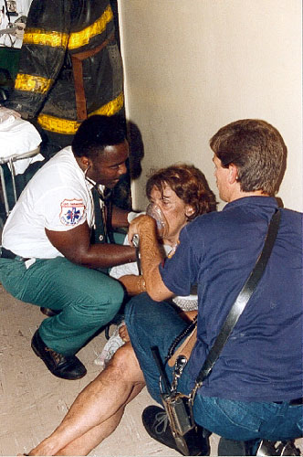
Oxygen
Oxygen therapy has always been a major component of prehospital care.

Slide 7

Oxygen
What do we know now that we didn’t know then?

Slide 8
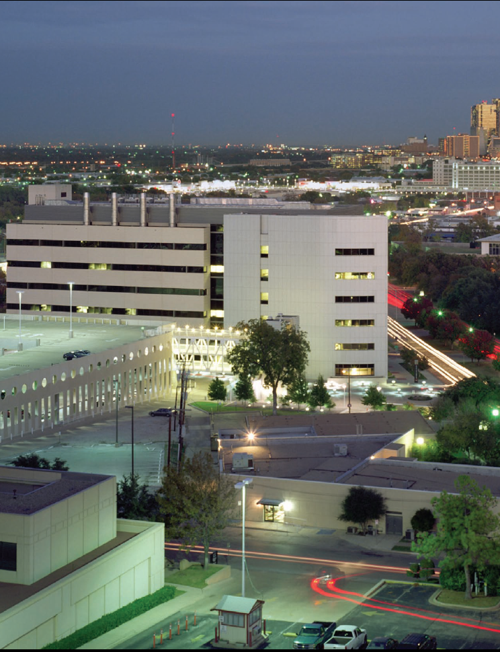
Oxygen
In medical school, in 1983, we only received a 1 hour presentation in Year 1 biochemistry on reactive oxygen species.

Slide 9
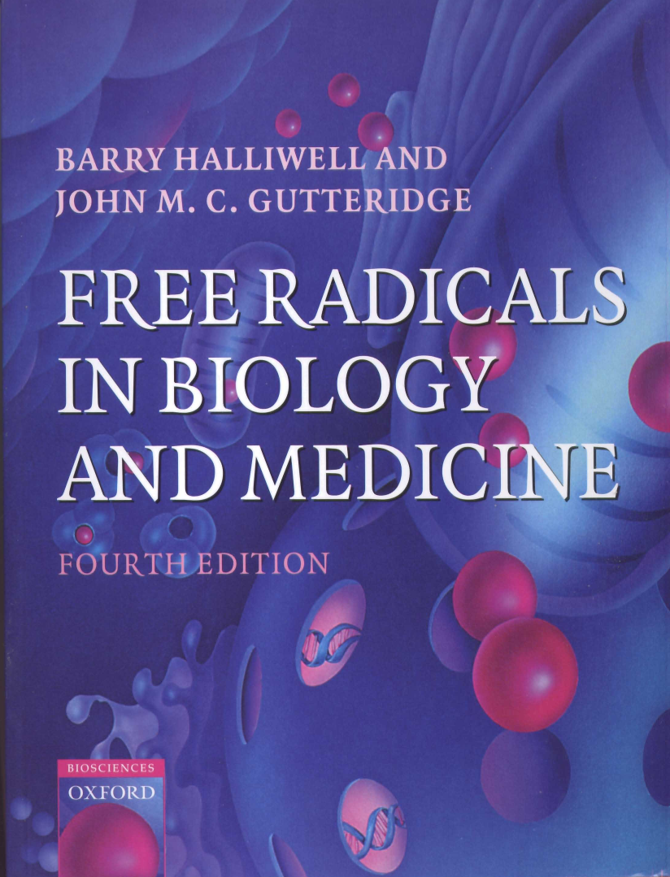
Oxygen
Now, there are shelves of textbooks on the subject.

Slide 10
Oxygen
We are learning that oxygen is a two-edged sword.
It can be beneficial.
It can be harmful.

Slide 11

The Chemistry of Oxygen
Oxygen is a highly reactive substance.
It shares electrons between two atoms in order to maintain stability.
Overall, diatomic oxygen has 2 unpaired electrons.

Slide 12
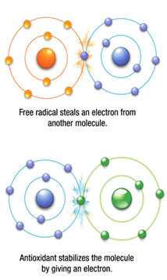
The Chemistry of Oxygen
Molecules/atoms with unpaired electrons are extremely unstable and highly-reactive.

Slide 13
The Chemistry of Oxygen
Reactive oxygen species (ROS) are common in biological systems.
They can exist as a cation or anion:
  X – e⁻ X^{•+} (radical cation)
  Y + e⁻ Y^{•-} (radical anion)

Slide 14
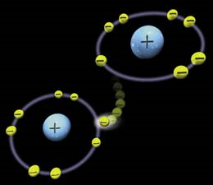
The Chemistry of Oxygen
Free Radicals:
  An atom or group of atoms that has at least one unpaired electron and is therefore unstable and highly reactive. In animal tissues, free radicals can damage cells and are believed to accelerate the progression of cancer, cardiovascular disease, and age-related diseases.
    American Heritage Dictionary

Slide 15
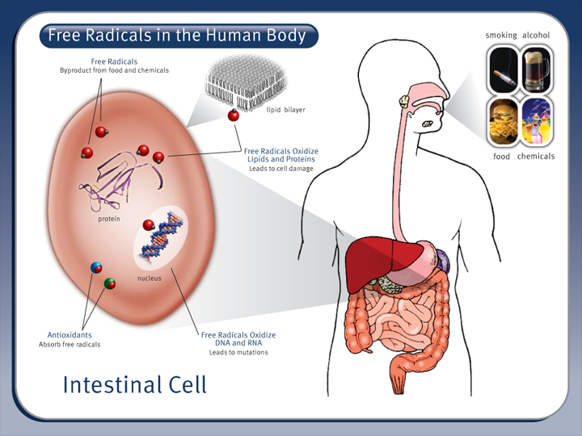
The Chemistry of Oxygen
Reactive oxygen species (ROS) are a normal byproduct of the normal metabolism of oxygen.

Slide 17
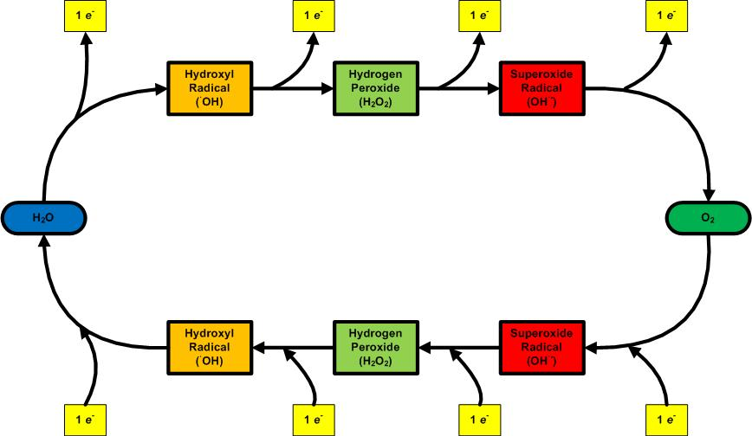
The Chemistry of Oxygen

Slide 18
The Chemistry of Oxygen
Free radicals, in normal concentrations, are important in intracellular bacteria and cell-signaling.
Most important free radicals:
  Superoxide (•O₂⁻)
  Hydroxyl radical (•OH)

Slide 19
The Chemistry of Oxygen
Oxygen produces numerous free-radicals—some more reactive than others:
    Superoxide free radical (•O₂⁻)
    Hydrogen peroxide (H₂O₂)
    Hydroxyl free radical (•OH)
    Nitric oxide (•NO)
    Singlet oxygen (¹O₂)
    Ozone (O₃)

Slide 20
The Chemistry of Oxygen
How are free-radicals produced?
Normal respiration and metabolism.
Exposure to air pollutants.
Sun exposure.
Radiation
Drugs
Viruses
Bacteria
Parasites
Dietary fats
Stress
Injury
Reperfusion

Slide 21
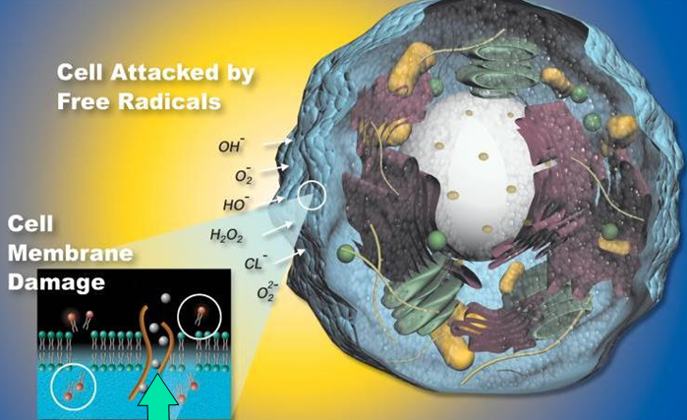
The Chemistry of Oxygen

Slide 22
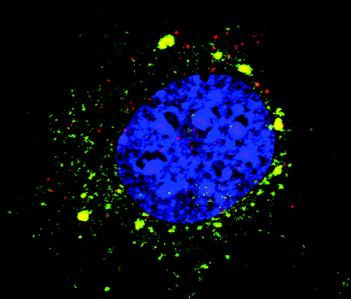
The Chemistry of Oxygen
Most cells receive approximately 10,000 free-radical hits a day.
Enzyme systems can normally process these.

Slide 23
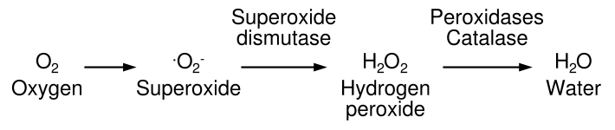
The Chemistry of Oxygen
The body has enzyme systems that can process low levels of free radicals.

Slide 24
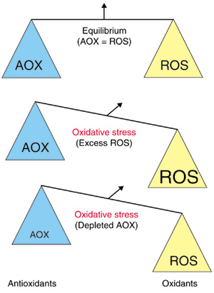
The Chemistry of Oxygen
The amount of free-radicals is dynamic.
It reflects a balance between:
  Number of free-radicals present.
  Number of anti-oxidants present.

Slide 25
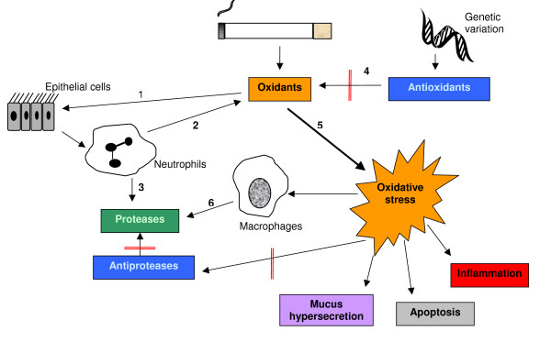
The Chemistry of Oxygen
An excess of free-radicals damages cells and is called oxidative stress.

Slide 26
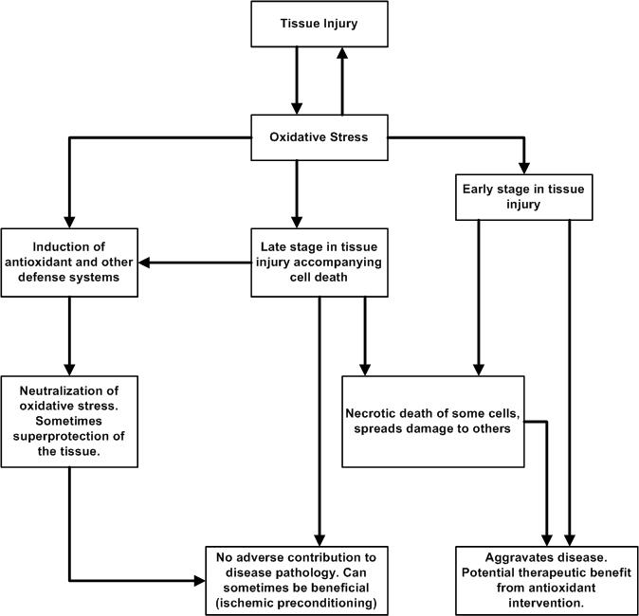
The Chemistry of Oxygen

Slide 27
The Chemistry of Oxygen
Diseases associated with free-radicals:
Arthritis
Cancer
Atherosclerosis
Parkinson’s disease
Alzheimer’s disease
Diabetes
ALS
Neonatal diseases:
  Intraventricular hemorrhage
  Periventricular leukomalacia
  Chronic lung disease / bronchopulmonary dysplasia
  Retinopathy of prematurity.
  Necrotizing enterocolitis.

Slide 28

The Chemistry of Oxygen
Many of the changes associated with aging are actually due to the effects of free-radicals.
As we age, the antioxidant enzyme systems work less efficiently.

Slide 29
The Chemistry of Oxygen
Lifespan = 3.5 years
Lifespan = 21 years
Lifespan = 24 years

Slide 30
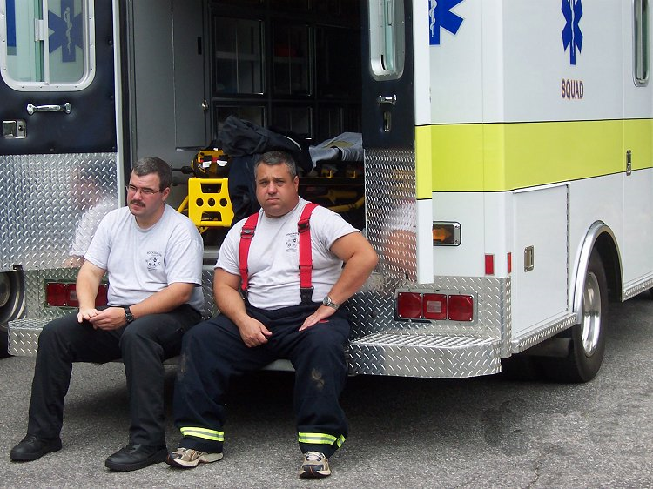
The Chemistry of Oxygen
So, what does all this crap mean to me as an EMS provider?

Slide 31
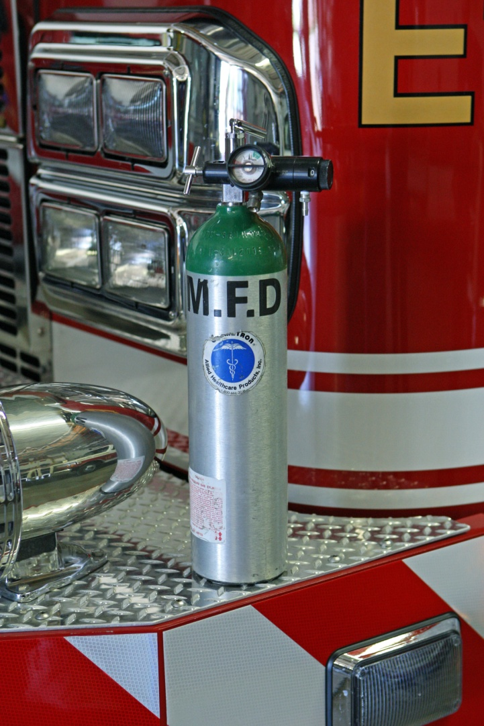
The Chemistry of Oxygen
Oxidative stress occurs primarily during reperfusion—not during hypoxia.
Flooding previously ischemic cells with oxygen during reperfusion worsens oxidative stress.

Slide 32
REPERFUSION INJURY

Slide 33
Reperfusion Injury
Reperfusion injury occurs when oxygen is reintroduced to ischemic tissues.
Organs most affected:
  Heart
  Kidney
  Liver
  Lung
  Intestine

Slide 34
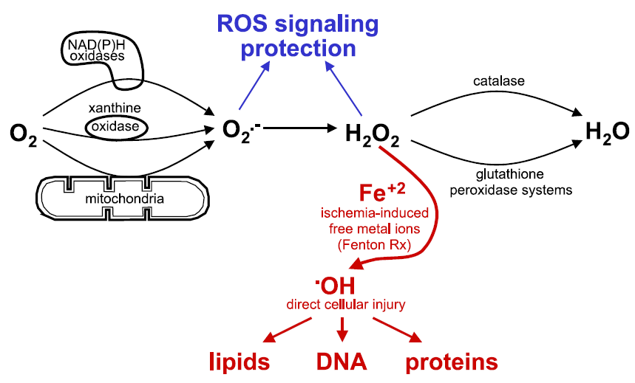
Reperfusion Injury
When tissues are reperfused with oxygen, free-radical species are produced.

Slide 35
Reperfusion Injury
Reperfusion injury is particularly problematic in:
  Stroke
  Acute coronary syndrome
  Trauma
  Carbon monoxide poisoning
  Cyanide poisoning

Slide 36
STROKE

Slide 37
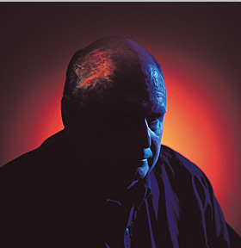
Stroke
Reperfusion injury in stroke:
  Free-radical release.
  Leukocyte adhesion and infiltration.
  Neuronal breakdown (leading to more free-radicals).

Slide 38
Stroke
The brain in stroke is vulnerable to oxidative stress:
  It contains more fatty acids.
  It has few antioxidants.
  It has high oxygen consumption.
  It has high levels of iron and ascorbate (worse oxidative stress).
  Dopamine and glutamine oxidation.

Slide 39
Stroke
Lactic acid accumulates in the neurons as a consequence of ischemic stroke.
The acidic environment has a pro-oxidant effect:
  Increased H₂O₂ conversion.
  Superoxide anion converted to hydroperoxyl radical (HO₂).
  Increases iron availability for free radical formation.

Slide 40
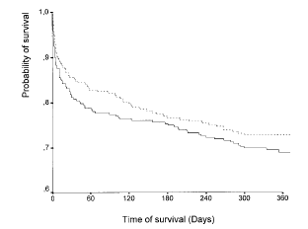
Stroke
 | Minor or Moderate Strokes |  | Severe Strokes
Variable | Oxygen | Control | Oxygen | Control
Survival | 81.8% | 90.7% | 53.4% | 47.7%
SSS Score | 54 (54-58) | 57 (52-58) | 47 (28-54) | 47 (40-52)
Barthel Index | 100 (95-100) | 100 (95-100) | 70 (32-90) | 80 (47-95)
Ronning OM, Guldvog B. Should Stroke Victims Routinely Receive Supplemental Oxygen? A Quasi-Randomized Controlled Trial. Stroke. 1999;30:2033-2037.

Slide 41
Stroke
“In 1994, the American Heart Association Stroke Council concluded that there were no data to support the routine use of supplemental oxygen in patients who had a stroke.”
“More recently, supplemental oxygen has been suggested to be potentially detrimental.”
Panciolli AM, et al. Supplemental oxygen use in ischemic stroke patients: does utilization correspond to need for oxygen therapy. Arch Intern Med. 2002;162:49-52.

Slide 42
Stroke
“In non-hypoxic patients with minor or moderate strokes, supplemental oxygen is of no clinical benefit.”
Portier de la Morandiere KP, Walter D. Oxygen therapy in acute stroke. Emergency Medicine Journal. 2003;20:547-553

Slide 43
Stroke
“Supplemental oxygen should not routinely be given to non-hypoxic stroke victims with minor to moderate strokes.”
“Further evidence is needed to give conclusive advice concerning oxygen supplementation for patients with severe strokes.”
Ronning OM, Guldvog B. Should Stroke Victims Routinely Receive Supplemental Oxygen? A Quasi-Randomized Controlled Trial. Stroke. 1999;30:2033-2037.

Slide 44
Stroke
Prehospital concerns:
Determine time of onset (if possible).
Determine glucose level.
Administer dextrose ONLY if hypoglycemia is verified.
Determine oxygenation status with pulse oximetry.
Administer supplemental oxygen if SpO₂ is < 95%.
Avoid IV fluids (especially dextrose-containing).
Do not attempt to lower blood pressure.

Slide 45
NEONATES

Slide 46
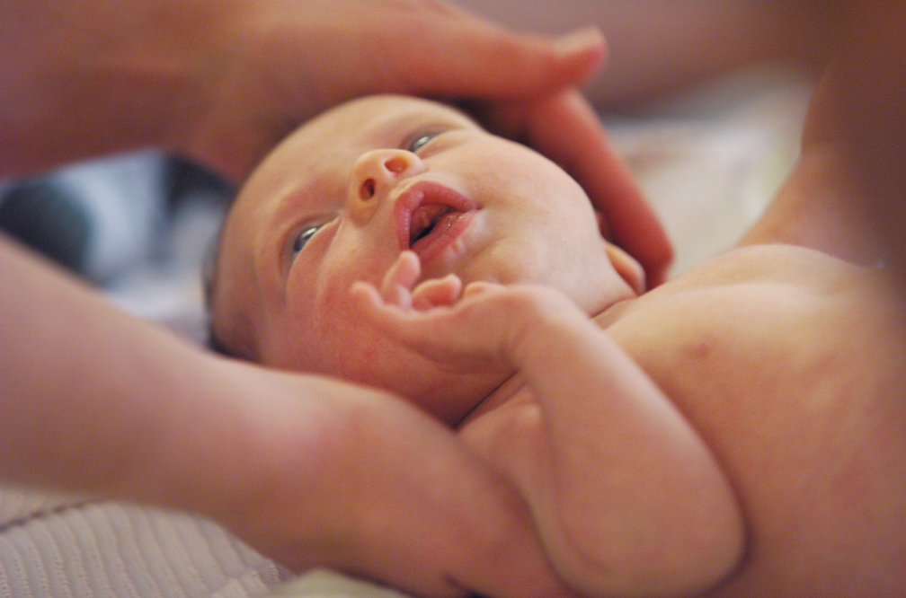
Neonates
The prevailing wisdom is that oxygen is harmful to most neonates.
Transition from intrauterine hypoxic environment to extrauterine normoxic environment leads to an acute increase in oxygenation and development of ROS.

Slide 47
Neonates
Health hazards and morbidities associated with excess oxygen:
  Aging
  DNA damage
  Cancer
  Retinopathy of prematurity (ROP)
  Bronchopulmonary dysplasia (BPD)
Sola A, Rogido MR, Deulofeut R. Oxygen as a neonatal health hazard: call for détente in clinical practice. Acta Pediatrica. 2007;96:801-812.

Slide 48
Neonates
Consequences of neonatal resuscitation with supplemental oxygen:
  Delayed onset of first cry and sustained respiratory effort.

Slide 49
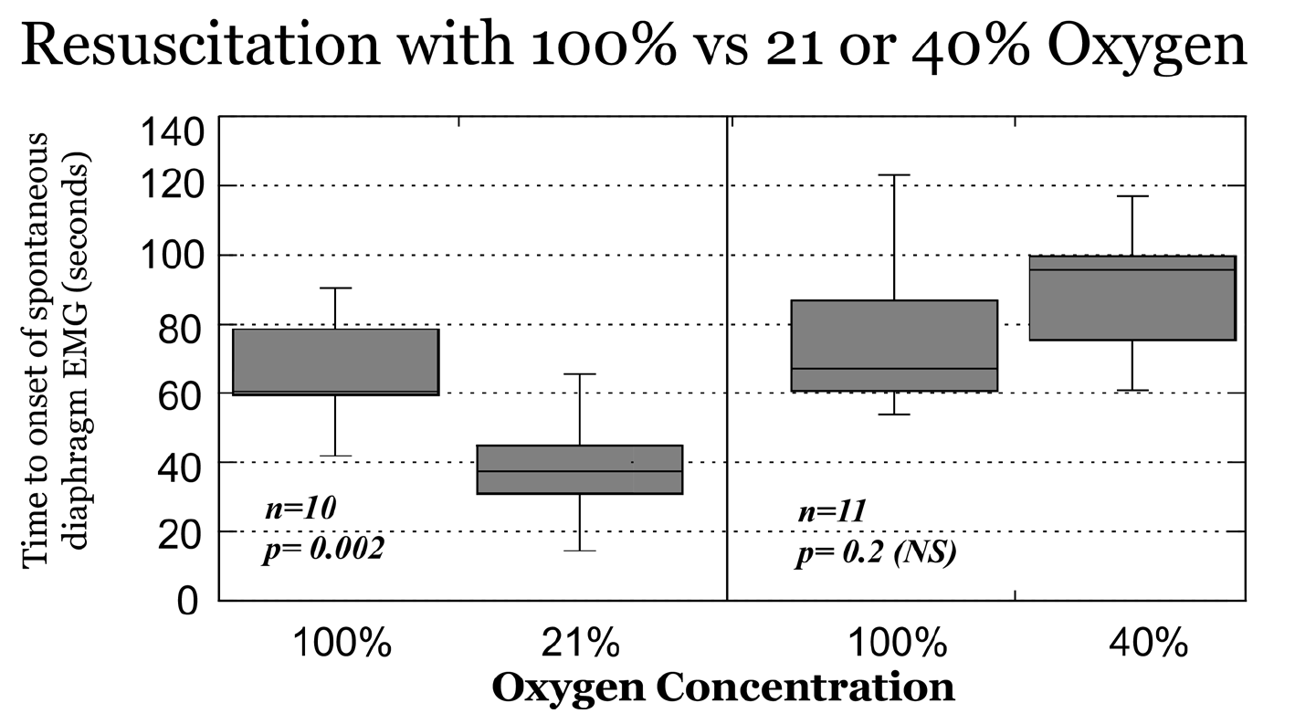
Martin RJ, Bookatz GB, Gelfand SL, et al. Consequences of Neonatal Resuscitation with Supplemental Oxygen. Semin Perinatol. 2008;32:355-366.

Slide 50
Neonates
1,737 depressed neonates:
  881 resuscitated with room air
  856 resuscitated with 100% oxygen
Mortality:
  Room air resuscitation: 8.0%
  100% oxygen resuscitation: 13.0%
Neonatal mortality reduced with room air resuscitation.
Davis PG, Tan A, O’Donnell CP, et al: Resuscitation of newborn infants with 100% oxygen or air: a systematic review and meta-analysis. Lancet 364:1329-1333, 2004

Slide 51
Neonates
Neonates resuscitated with room air had lower mortality in the first week of life (OR 0.70, 95% CI 0.50-0.98) and at 1 month and beyond (OR 0.63, 95% CI 0.42-0.94).
Room air is superior to 100% oxygen for initial resuscitation.
Rabi Y, Rabi D, Yee W: Room air resuscitation of the depressed newborn: a systematic review and meta-analysis. Resuscitation 72:353-363, 2007

Slide 52
Neonates
Supplementary oxygen is recommended whenever positive-pressure ventilation is indicated for resuscitation
Free-flow oxygen should be administered to infants who are breathing but have central cyanosis.
American Heart Association. 2005 American Heart Association guidelines for cardiopulmonary resuscitation (CPR) and emergency cardiovascular care (ECC) of pediatric and neonatal patients: pediatric basic life support. Circulation. 2005;13:IV1-203.

Slide 53
Neonates
Although the standard approach to resuscitation is to use 100% oxygen, it is reasonable to begin resuscitation with an oxygen concentration of less than 100% or to start with no supplementary oxygen (i.e., start with room air).
American Heart Association. 2005 American Heart Association guidelines for cardiopulmonary resuscitation (CPR) and emergency cardiovascular care (ECC) of pediatric and neonatal patients: pediatric basic life support. Circulation. 2005;13:IV1-203.

Slide 54
Neonates
If the clinician begins resuscitation with room air, it is recommended that supplementary oxygen be available to use if there is no appreciable improvement within 90 seconds after birth.
American Heart Association. 2005 American Heart Association guidelines for cardiopulmonary resuscitation (CPR) and emergency cardiovascular care (ECC) of pediatric and neonatal patients: pediatric basic life support. Circulation. 2005;13:IV1-203.

Slide 55
ACUTE CORONARY SYNDROME

Slide 56
Acute Coronary Syndrome
“In acute uncomplicated MI, there is no evidence that supplemental oxygen reduces mortality. However, there is no evidence of harm. Further research is required before changes in clinical practice should be recommended.”
Mackway-Jones K. Oxygen in uncomplicated myocardial infarction. Emerg Med J. 2004;21:75-81.

Slide 57
POST-CARDIAC ARREST

Slide 58
Post-Cardiac Arrest
Post-cardiac arrest brain injury is a common cause of morbidity and mortality.
  68% of out-of-hospital cardiac arrests
  23% of in-hospital cardiac arrests
Causes:
  Limited tolerance of ischemia
  Unique response to reperfusion

Slide 59
Post-Cardiac Arrest
Burst of ROS has been observed in cardiomyocytes in the first few minutes of reperfusion.
Antioxidants and other cardioprotective measures diminish during the reperfusion burst.

Slide 60
TRAUMA

Slide 61
Trauma
Charity Hospital (1/1/2000-9/30/2002):
5,549 trauma patients by EMS
  459 received assisted ventilation and excluded)
  5,090 remaining prehospital patients:
    2,203 (43.3%) received prehospital oxygen
    2,887 (56.7%) did not receive prehospital oxygen

Slide 62
Trauma
Age, ISS and Mortality by Oxygen Device
Variable | Oxygen | No Oxygen | P
Age (mean ± σ) | 31.8 ± 16.3 | 31.0 ± 17.3 | 0.0911
ISS (mean ± σ) | 7.6 ± 8.7 | 5.7 ± 6.0 | <0.0001
Mortality | 2.3% | 1.1% | 0.0011

Slide 63
Trauma
MORTALITY

Slide 64
Trauma
“Our analysis suggest that there is no survival benefit to the use of supplemental oxygen in the prehospital setting in traumatized patients who do not require mechanical ventilation or airway protection.”
Stockinger ZT, McSwain NE. Prehospital Supplemental Oxygen in Trauma Patients: Its Efficacy and Implications for Military Medical Care. Mil Med. 2004;169:609-612.

Slide 65
CARBON MONOXIDE POISONING

Slide 66
CO Poisoning
Mechanism of CO poisoning much more complex than once thought.
Oxidative stress is a known complication:

Slide 67
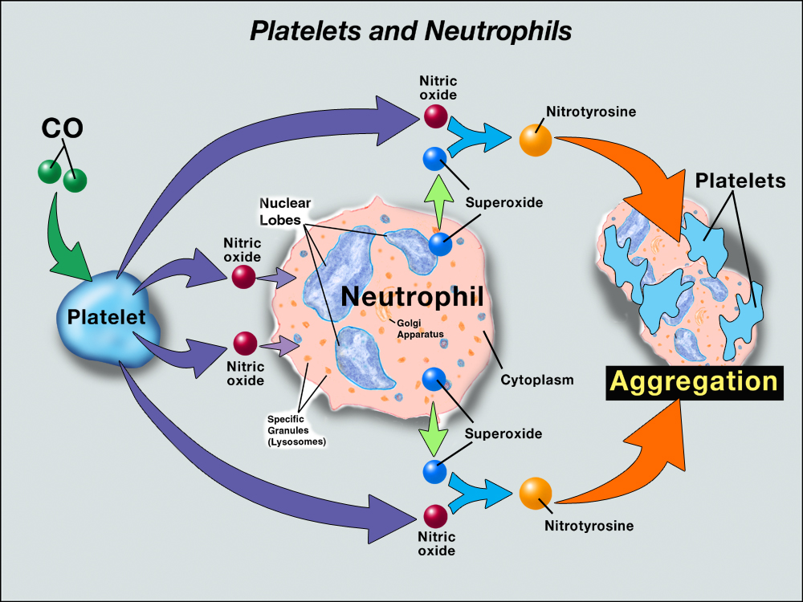
CO Poisoning

Slide 68
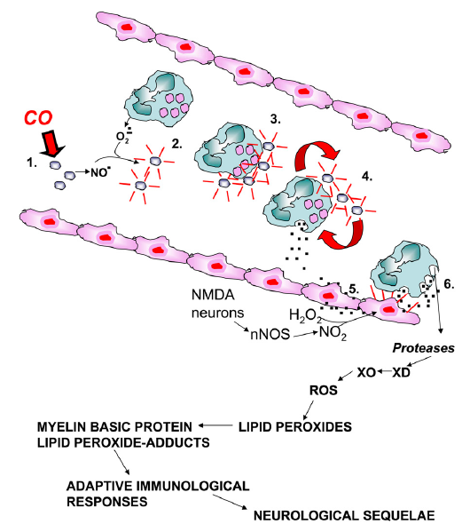
CO binds to platelet hemoproteins and increases NO efflux.
Platelet-derived NO reacts with neutrophil-derived superoxide which activates platelets and causes platelet-neutrophil aggregates.
Reactive products and adhesion molecules promote firm aggregation and stimulate degranulation of neutrophils.
Endothelial cells acitaved by myeloperoxidase facilitating firm neutrophil adhesion and further degranulation.
Reactive oxygen species (ROS) initiate lipid peroxidation and adducts interact with brain myelin basic protein. The altered myelin basic protein triggers an adaptive immunologic response that causes neurologic dysfunction.
Source: Thom SR, Bhopale VM, Han S-T, Clark JM, Hardy KR. “Intravascular Neutrophil Activation Due to Carbon Monoxide Poisoning.” Am J Respir Crit Care Med. 2006;174:1239-1248

Slide 69
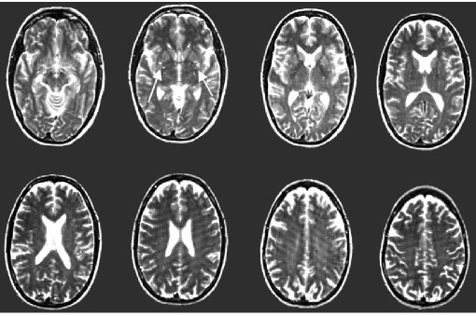
CO Poisoning
Basal ganglia
15 months post-CO exposure

Slide 70
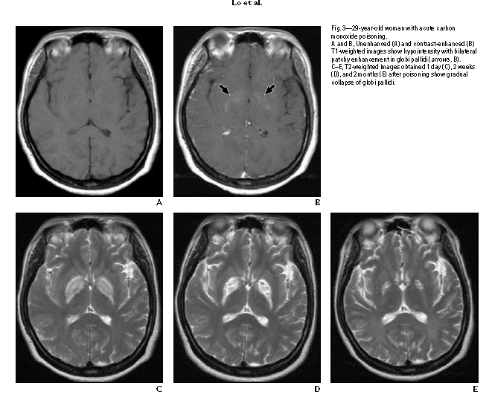
CO Poisoning
29 y.o woman with acute CO exposure (note globus pallidus)
1 Day
2 Weeks
2 Months

Slide 71
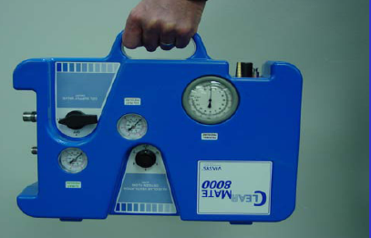
CO Poisoning
Oxygenate, ventilate, or both?
Hyperventilation can eliminate CO as rapidly as HBO.
Increasing CO₂ levels may increase ventilation without oxygenation.

Slide 72
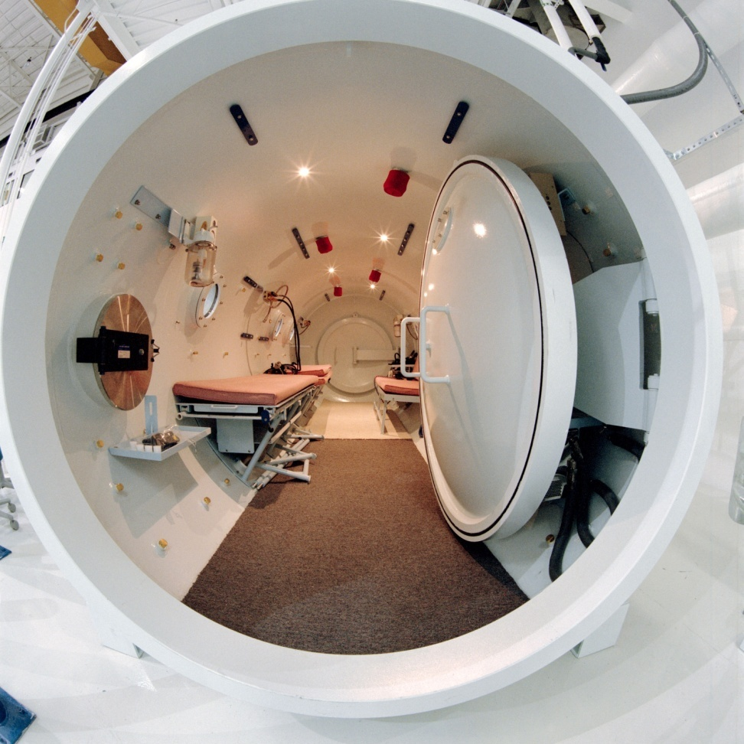
CO Poisoning
What about HBO chambers?

Slide 73
CO Poisoning
In this trial, in which both groups received high doses of oxygen, HBO therapy did not benefit, and may have worsened, the outcome. We cannot recommend its use in CO poisoning.
Scheinkestal CD, Bailey M, Myles PS, et al. Hyperbaric or normobaric oxygen for acute carbon monoxide poisoning: a randomised controlled trial. Med J Aust. 1999;170:203-210.

Slide 74
CO Poisoning
There is conflicting evidence regarding the efficacy of HBO treatment for patients with CO poisoning. Methodological shortcomings are evident in all published trials, with empiric evidence of bias in some, particularly those that suggest a benefit of HBO. Bayesian analysis further illustrates the uncertainty about a meaningful clinical benefit. Consequently, firm guidelines regarding the use of HBO for patients with CO poisoning cannot be established. Further research is needed to better define the role of HBO, if any, in the treatment of CO poisoning.
Buckley NA, Isbister GH, Stokes B, Juurlink JM. Hyperbaric oxygen for carbon monoxide poisoning: a sytematic review and critical analysis of the evidence. Tox Rev. 2005;24:75-92.

Slide 75

Recommendations from the British thoracic society

Slide 76
British Thoracic Society
Do all breathless patients benefit from oxygen therapy?
  Amongst healthcare professionals there is a widespread belief that oxygen relieves breathlessness, yet there is no evidence that this is the case, providing that oxygen levels in the blood are normal (which is true in many serious illnesses, even if breathlessness is present). In fact, giving oxygen when blood saturation levels are normal will produce hyperoxia which may stimulate reflexes that actually reduce the blood flow to organs such as the heart and might therefore reduce the delivery of oxygen to these vital organs.

Slide 77
British Thoracic Society
Can the routine administration of high-dose oxygen to all sick patients have any harmful effects?
  Unnecessary oxygen therapy can hinder the efforts of healthcare professionals by delaying the recognition of patient deterioration due to the false reassurance that can be provided by a high oxygen saturation reading. Additionally, patients with some lung diseases, such as COPD, are sensitive to oxygen and an excess can have harmful consequences.

Slide 78
British Thoracic Society
Oxygen is a treatment for hypoxaemia, not breathlessness. (Oxygen has not been shown to have any effect on the sensation of breathlessness in non-hypoxaemic patients.)

Slide 79
British Thoracic Society
The essence of this guideline can be summarised simply as a requirement for oxygen to be prescribed according to a target saturation range and for those who administer oxygen therapy to monitor the patient and keep within the target saturation range.

Slide 80
British Thoracic Society
The guideline suggests aiming to achieve normal or near-normal oxygen saturation for all acutely ill patients apart from those at risk of hypercapnic respiratory failure or those receiving terminal palliative care.

Slide 81
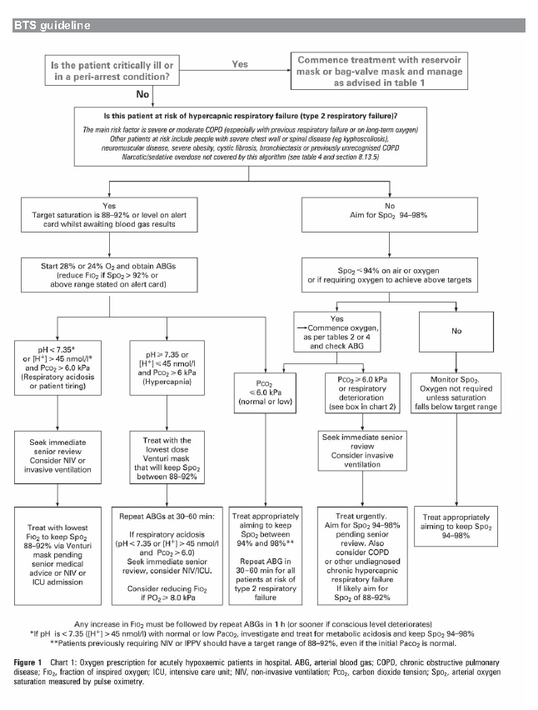

Slide 82
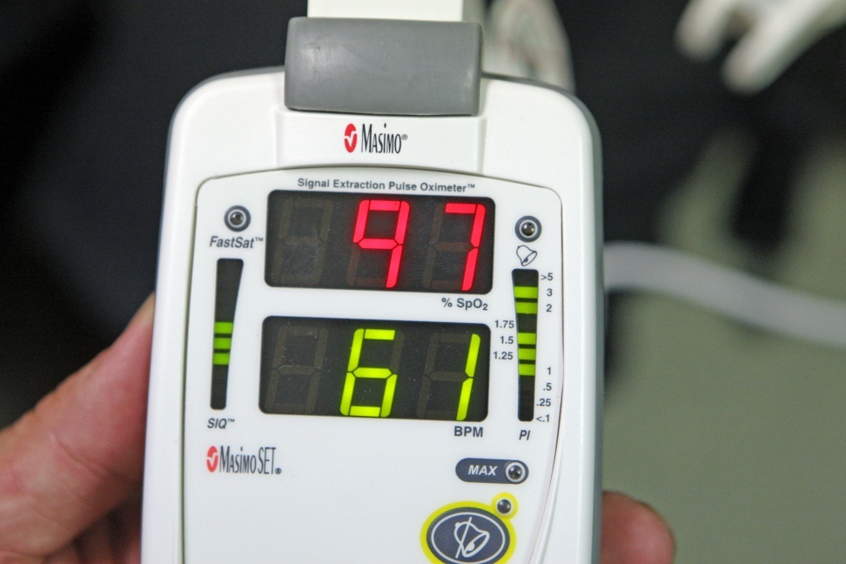
British Thoracic Society
Generally, try to keep SpO₂ between 92-96%.
Treat only documented hypoxemia unless patient critically ill.

Slide 83
PREHOSPITAL IMPLICATIONS

Slide 84
Prehospital Implications
This presentation has presented current and cutting edge information on oxygen usage and oxidative stress.
We don’t know where subsequent science will take us.
Always follow local protocols and policies in regard to patient care!

Slide 85
Prehospital Implications
What is the status of these issues:
Condition | Status | Action
Neonatal Resuscitation | AHA Standard | Room air unless failure after 90 seconds
Stroke | Flux | Use oximetry to guide care
Myocardial infarction | Flux | Use oximetry to guide care
Post-resuscitation management | Flux | Use oximetry to guide care
Trauma | Inadequate Evidence | Practice unchanged. Use pulse oximetry to guide care
Carbon monoxide | Flux | Time dependent

Slide 86
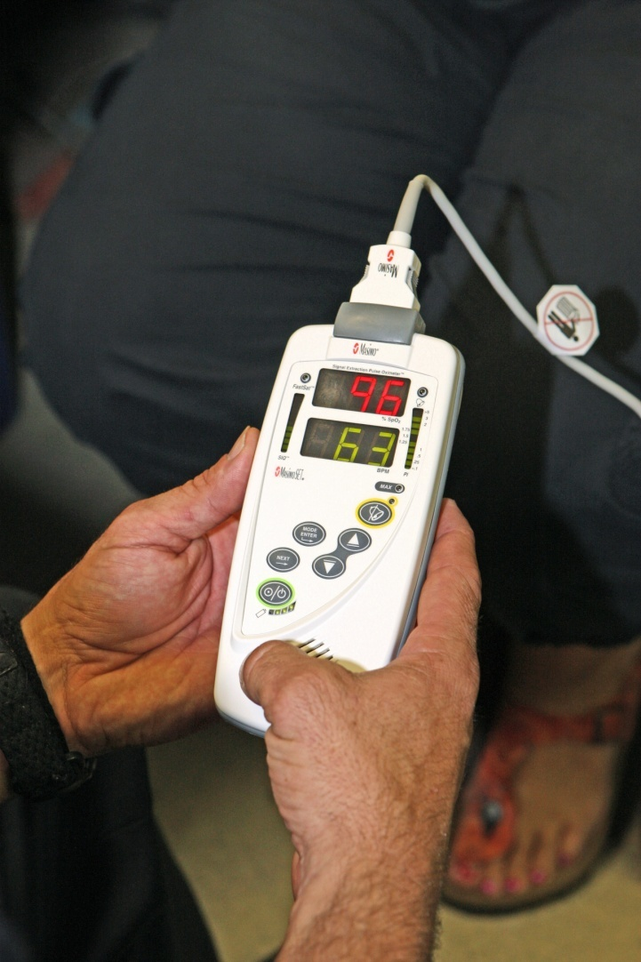
Prehospital Implications
Use pulse oximeters to determine the need for supplemental oxygen and to monitor oxygen levels during care.

Slide 87
Prehospital Implications
Rationalizing the O₂ administration using pulse-oximetry reduces O₂ usage.
Oxygen cost-saving justifies oximeter purchase:
  Where patient volume > 1,750 per year.
  Less frequently for lower call volumes, or
  Mean transport time is < 23 minutes.
Macnab AJ, SusakL, Gagnon FA, Sun C. The cost-benefit of pulse oximeter use in the prehospital environment. Prehosp Emerg Care. 1999:14:245-250.

Slide 88

Use of Oxygen
Hypoxia
Nausea and vomiting
Motion sickness

Slide 89
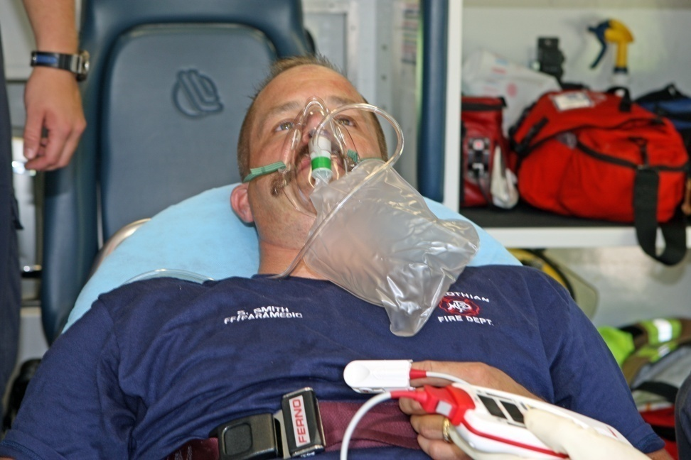
Take Home Message
Oxygen should be treated like any other drug.
It has benefits and risks.
Empiric use is not a good practice.
Use oximetry to guide care.

Slide 90
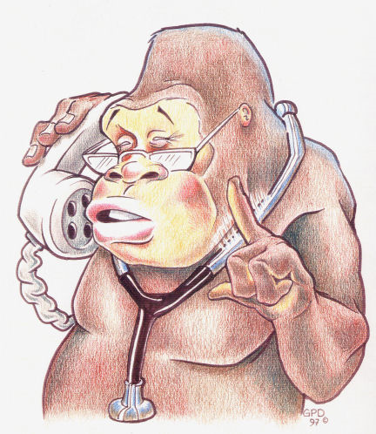
Take Home Message
As this evolves, I suspect that the usage of oxygen will be curtailed in prehospital care.
It is time to change from empiric therapy to focused therapy.

