Slide 1
Carbon Monoxide Poisoning
Bryan E. Bledsoe, DO, FACEP, FAAEM
Professor of Emergency Medicine
University of Nevada School of Medicine

Slide 2


Endorsements
This educational module has been endorsed by the following professional organizations:

Slide 3
Review Board
Roy Alson, MD, PhD, FACEP
James Augustine, MD, FACEP
Edward Dickinson, MD, FACEP
Marc Eckstein, MD, FACEP
Steven Katz, MD, FACEP
Mike McEvoy, PhD, RN, EMT-P
Joe A. Nelson, DO, MS, FACOEP, FACEP
Ed Racht, MD
Mike Richards, MD, FACEP
Keith Wesley, MD, FACEP
Paula Willoughby-DeJesus, DO, MHPE, FACOEP

Slide 4
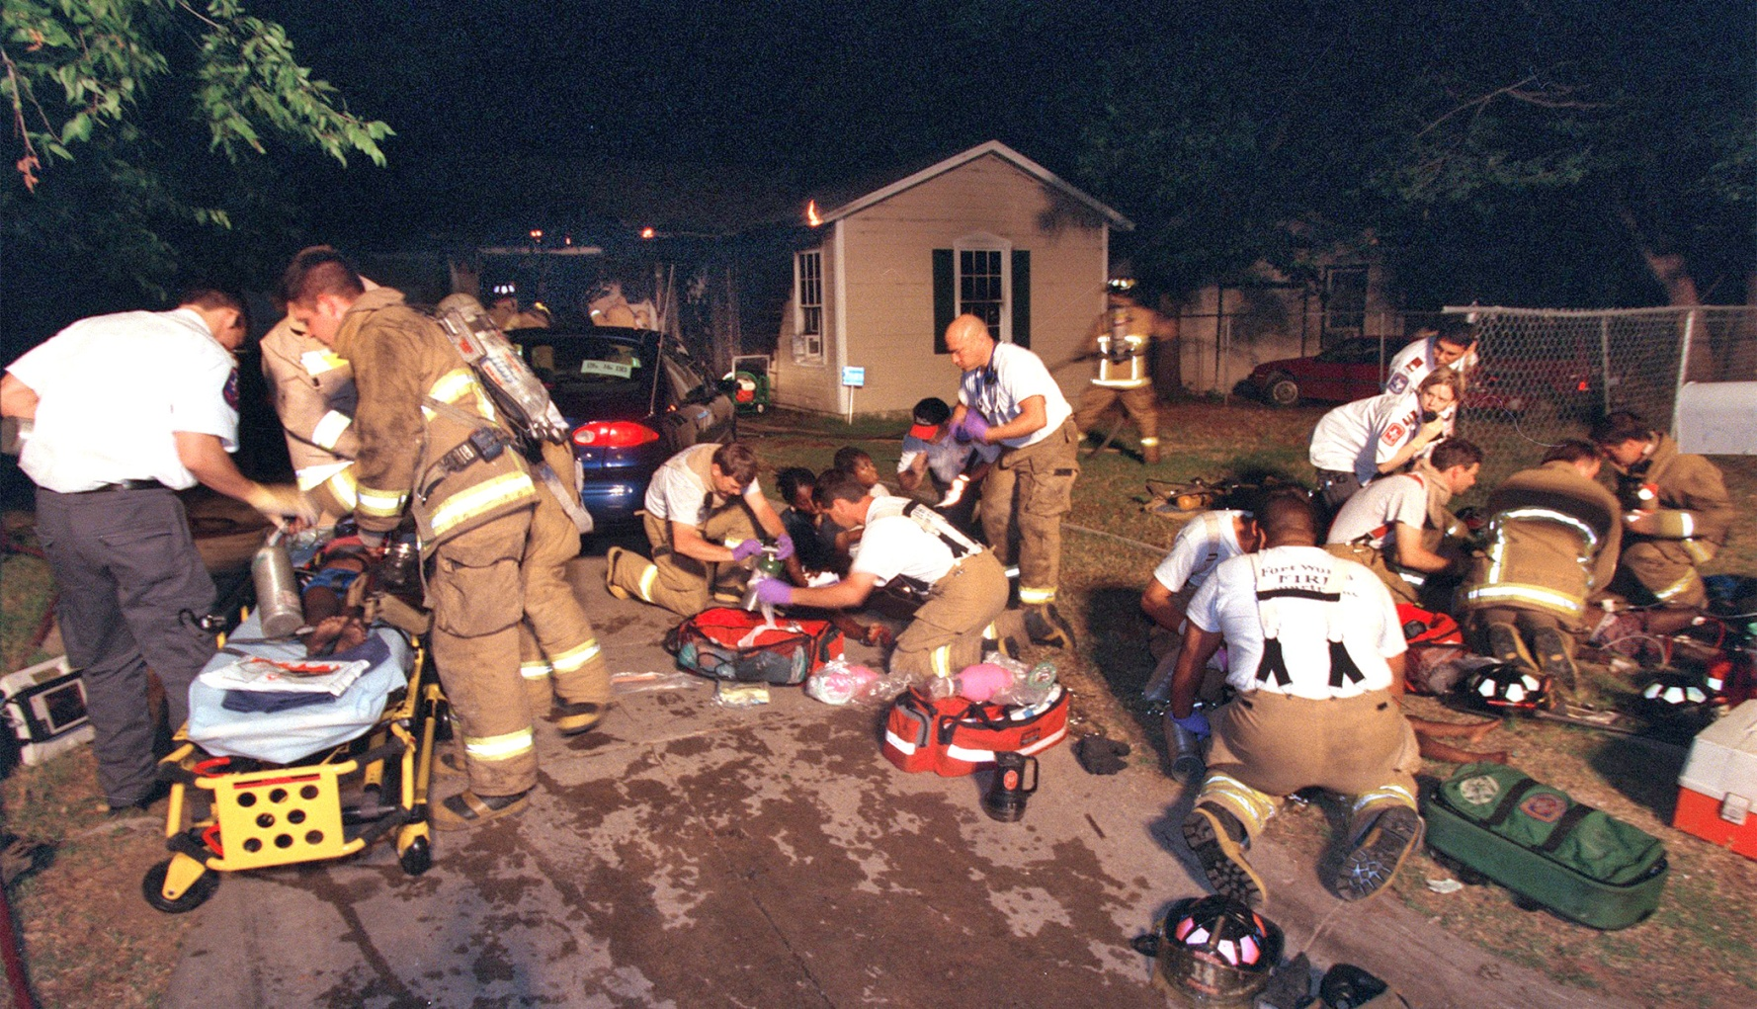
Carbon monoxide is the most frequent cause of poisonings in industrialized countries.

Slide 5
CHEMISTRY

Slide 6
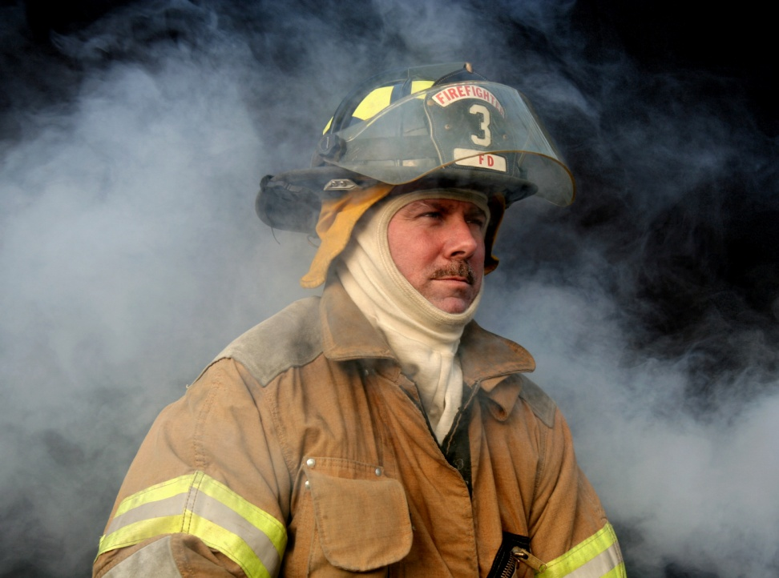
Chemistry of Carbon Monoxide
Gas:
  Colorless
  Odorless
  Tasteless
  Nonirritating
Results from the incomplete combustion of carbon-containing fuels.
Abbreviated “CO”

Slide 7
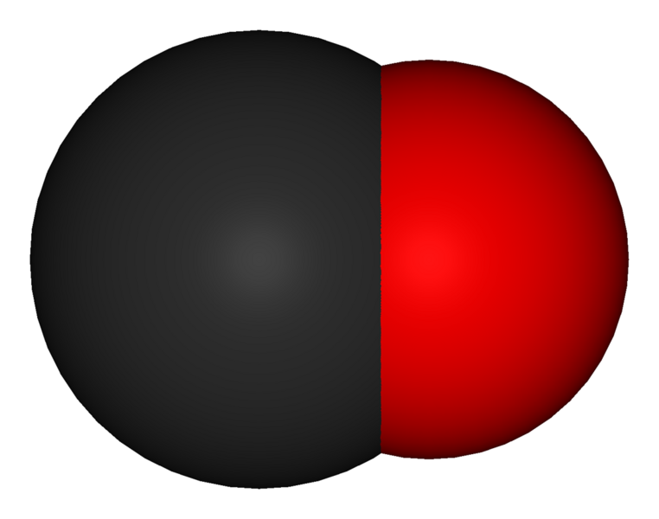
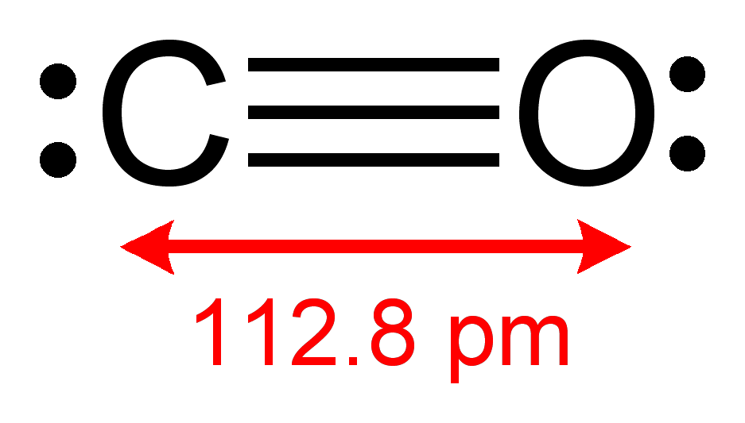
Chemistry of Carbon Monoxide
Molecule consists of one carbon atom joined to one oxygen atom by a triple bond.
Extremely stable molecule.

Slide 8
SOURCES

Slide 9
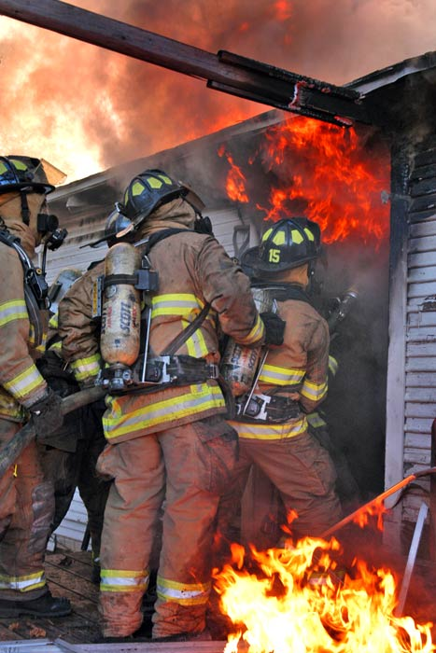
Sources of Carbon Dioxide
Endogenous
Exogenous
Methylene chloride

Slide 10
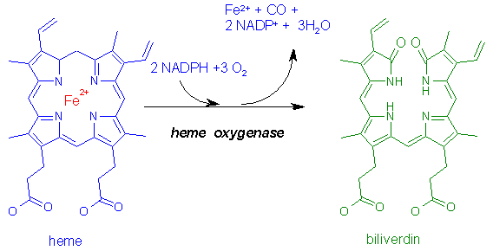
Sources of Carbon Monoxide
Endogenous:
  Normal heme catabolism (breakdown):
    Only biochemical reaction in the body known to produce CO.
  Levels increased in:
    Hemolytic anemia.
    Sepsis

Slide 11
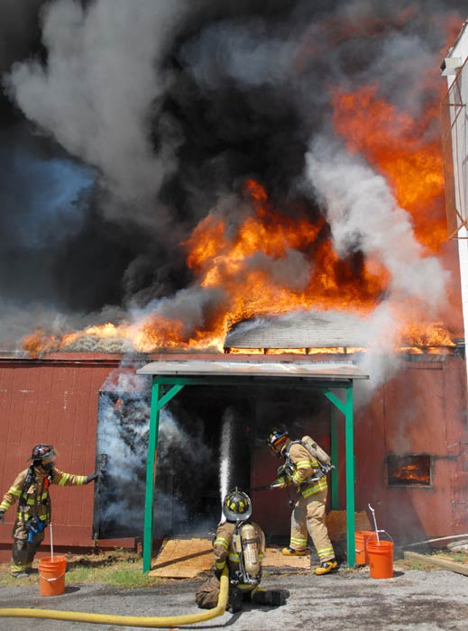
Sources of Carbon Monoxide
Exogenous:
  House fires.
  Gas –powered electrical generators.
  Automobile exhaust.
  Propane-powered vehicles.
  Heaters.
  Camp stoves.
  Boat exhaust.
  Cigarette smoke.

Slide 12
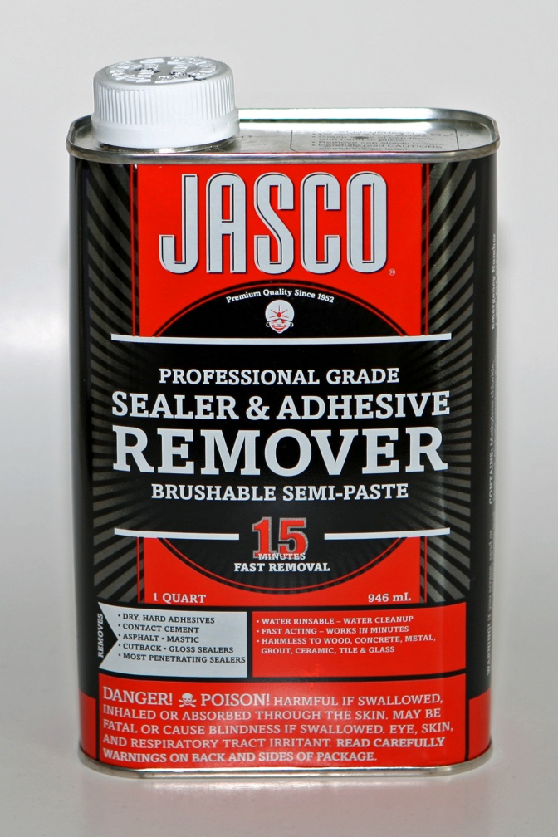
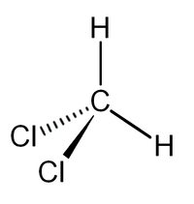
Sources of Carbon Monoxide
Methylene chloride:
  Paint and adhesive remover.
  Converted to CO in the liver after inhalation.

Slide 13
INCIDENCE

Slide 14
Incidence
CO is leading cause of poisoning deaths.
CO may be responsible for half of all poisonings worldwide.
~5,000–6,000 people die annually in the United States as a result of CO poisoning.
~40,000–50,000 emergency department visits annually result from CO poisoning.

Slide 15
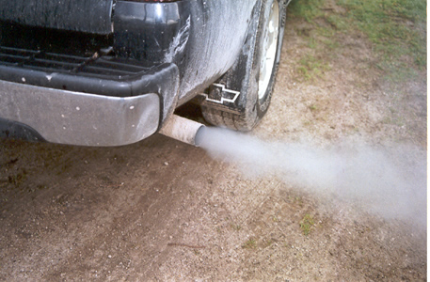
Incidence
Accidental CO poisoning deaths declining:
  Improved motor vehicle emission policies.
  Use of catalytic converters.

Slide 16
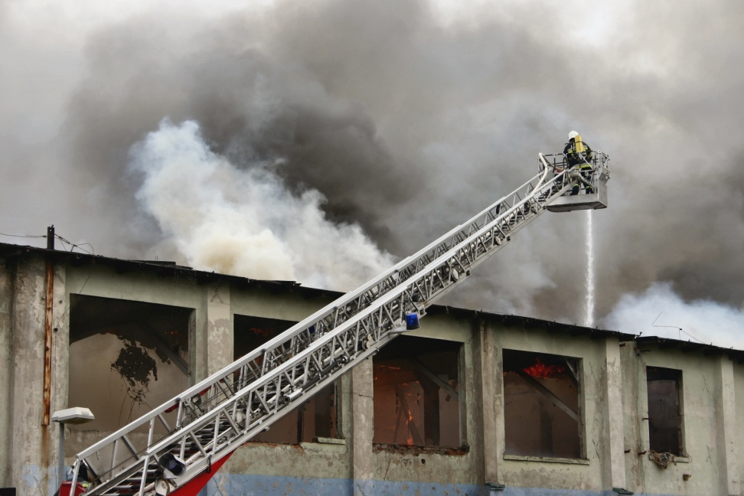
Incidence
Most accidental deaths are due to:
  House fires.
  Automobile exhaust.
  Indoor-heating systems.
  Stoves and other appliances.
  Gas-powered electrical generators
  Charcoal grills.
  Camp stoves.
  Water heaters.
  Boat exhausts.

Slide 17

Incidence
Increased accidental CO deaths:
  Patient > 65 years of age.
  Male
  Ethanol intoxication.
Accidental deaths peak in winter:
  Use of heating systems.
  Closed windows.

Slide 18
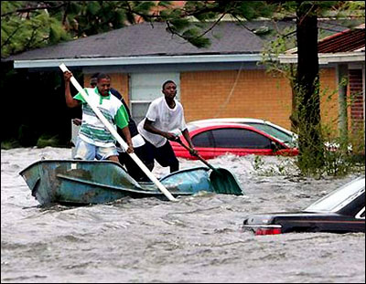
Incidence
Significant increase in CO poisoning seen following disasters.
Primarily relates to loss of utilities and reliance on gasoline-powered generators and use of fuel-powered heaters.

Slide 19
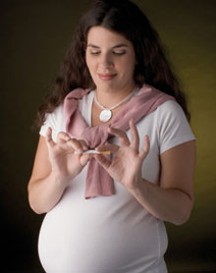
Incidence
Fetal hemoglobin has a much greater affinity for CO than adult hemoglobin.
Pregnant mothers may exhibit mild to moderate symptoms, yet the fetus may have devastating outcomes.

Slide 20
EXPOSURE

Slide 21
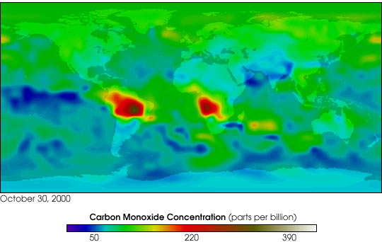
Environmental CO Exposure
Environmental exposure typically <0.001% (10 ppm).
Higher in urban areas.
Sources:
  Volcanic gasses.
  Bush fires.
  Human pollution.

Slide 22
CO Exposure
Source | Exposure (ppm)
Fresh Air | 0.06-0.5
Urban Air | 1-30
Smoke-filled Room | 2-16
Cooking on Gas Stove | 100
Actively Smoking a Cigarette | 400-500
Automobile Exhaust | 100,000

Slide 23
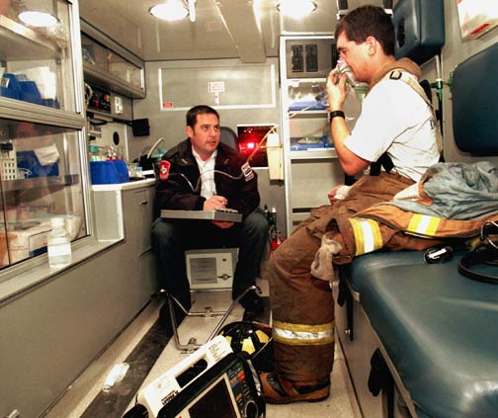
CO Exposure
CO absorption by the body is dependent upon:
  Minute ventilation (V_{min}).
  Duration of exposure.
  Concentration of CO in the environment.
  Concentration of O₂ in the environment.

Slide 24

Exposure Limits
OSHA:
  50 ppm (as an 8-hour time-weighted average).
NIOSH:
  35 ppm (as an 8-hour time-weighted average).

Slide 25
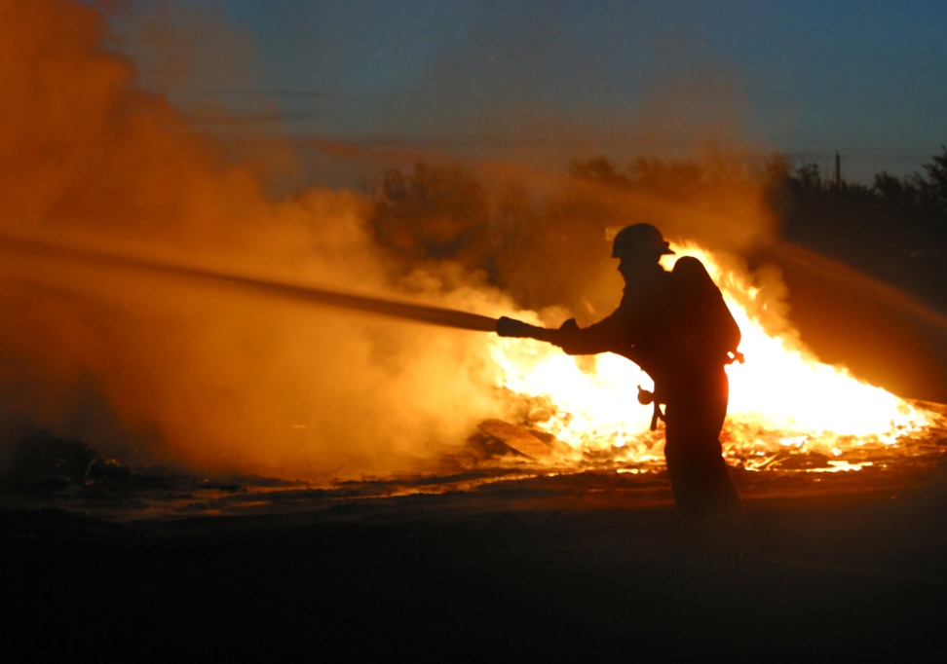
Firefighter Risks
CO is a significant and deadly occupational risk factor for firefighters.
Sources:
  Structure fires
  Apparatus fumes
  Portable equipment fumes
  Underground utility fires
  Closed-space rescue situations
CO is heavier than air and accumulates in lower regions.

Slide 26
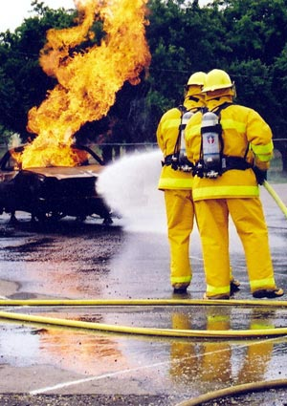
Firefighter Risks
SCBA extremely important in CO prevention.
CO often encountered during overhaul operations.

Slide 27
CO POISONING
PATHOPHYSIOLOGY

Slide 28
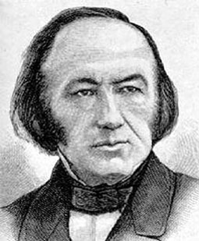
Pathophysiology
Pathophysiology of CO poisoning first described by French physician Claude Bernard in 1857.

Slide 29
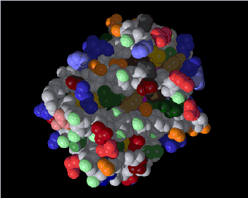
Pathophysiology
CO poisoning actually very complex.
CO binds to hemoglobin with an affinity ~ 250 times that of oxygen.
The combination of CO and hemoglobin is called carboxyhemoglobin (COHb).

Slide 30
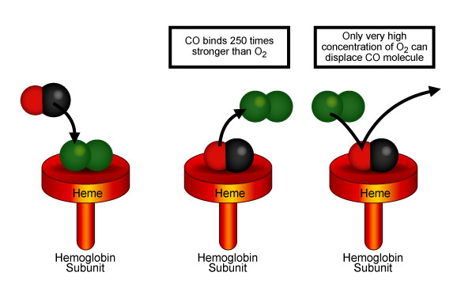
Pathophysiology
CO displaces O₂ from the hemoglobin binding sites.
CO prevents O₂ from binding.
COHb does not carry O₂.
COHb causes premature release of remaining O₂ into the tissues.

Slide 31
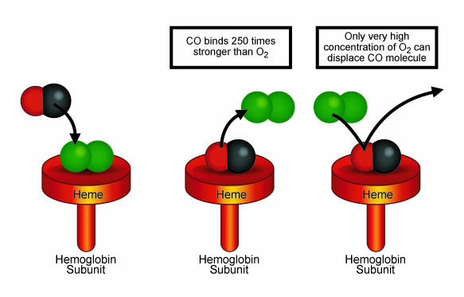

Slide 32
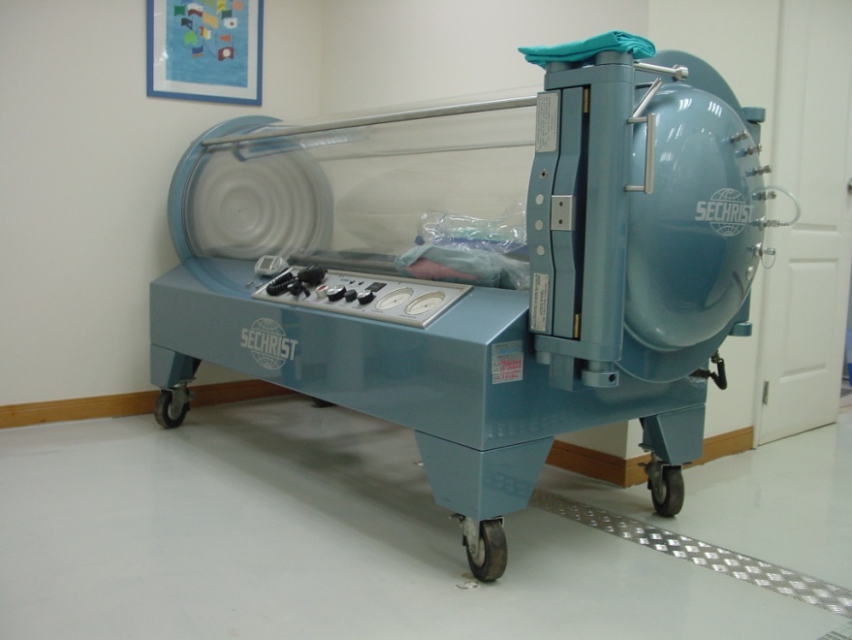
Pathophysiology
COHb ultimately removed from the circulation and destroyed.
Half-life:
  Room air: 240-360 minutes
  O₂ (100%): 80 minutes
  Hyperbaric O₂: 22 minutes

Slide 33
Normal COHb Levels
Source | COHb (%)
Endogenous | 0.4-0.7
Tobacco Smokers: 1 pack/day 2-3 packs/day cigars | 5-6 7-9 Up to 20
Urban Commuter | 5
Methylene chloride (100 ppm for 8 hours) | 3-5

Slide 34
Pathophysiology
CO also binds to other iron-containing proteins:
  Myoglobin
  Cytochrome
Binding to myoglobin reduces O₂ available in the heart:
  Ischemia
  Dysrhythmias
  Cardiac dysfunction

Slide 35
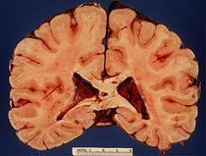
Pathophysiology
Impact of CO on major body systems:
  Neurologic:
    CNS depression resulting in impairment:
      Headache
      Dizziness
      Confusion
      Seizures
      Coma
    Long-term effects:
      Cognitive and psychiatric problems

Slide 36
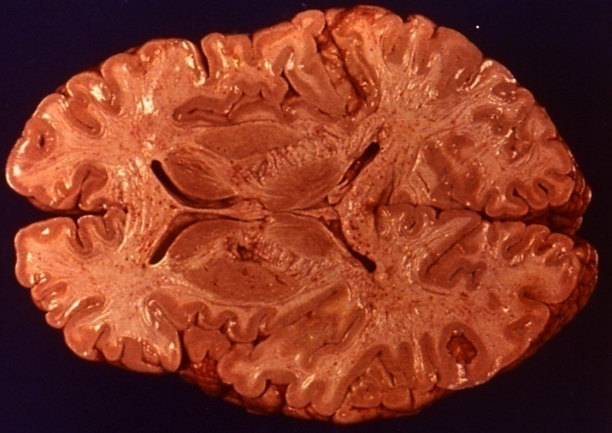
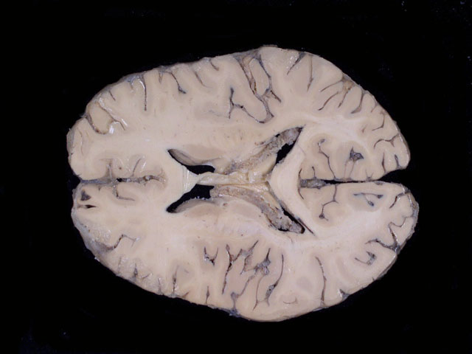
Pathophysiology
46-year-old woman with chronic exposure to CO from old car.
COHb = 46%
Autopsy:
  Cherry-red tissues
  Cerebral edema
Immediate cause of death: ventricular fibrillation due to CO poisoning
CO
Normal

Slide 37
Pathophysiology
Impact of CO on major body systems:
  Cardiac:
    Decreased myocardial function:
      Hypotension with tachycardia
      Chest pain
      Dysrhythmias
      Myocardial ischemia
      Most CO deaths are from ventricular fibrillation.
    Long-term effects:
      Increased risk of premature cardiac death

Slide 38
Pathophysiology
Impact of CO on major body systems:
  Metabolic:
    Respiratory alkalosis (from hyperventilation)
    Metabolic acidosis with severe exposures
  Respiratory:
    Pulmonary edema (10-30%)
      Direct effect on alveolar membrane
      Left-ventricular failure
      Aspiration
      Neurogenic pulmonary edema

Slide 39
Pathophysiology
Impact of CO on major body systems:
  Multiple Organ Dysfunction Syndrome (MODS):
    Occurs at high-levels of exposure
    Associated with a high mortality rate.

Slide 40
Pathophysiology Summary
Limits O₂ transport:
  CO more readily binds to Hb forming COHb.
Inhibits O₂ transfer:
  CO changes structure of Hb causing premature release of O₂ into the tissues.
Tissue inflammation:
  Poor perfusion initiates an inflammatory response.

Slide 41
Pathophysiology Summary
Poor cardiac function:
  ↓ O₂ delivery can cause dysrhythmias and myocardial dysfunction.
  Long-term cardiac damage reported after single CO exposure.

Slide 42
Pathophysiology Summary
Vasodilation:
  Results from nitric oxide (NO) increase.
  Cerebral vasodilation and systemic hypotension causes reduced cerebral blood flow.
  NO is largely converted to methemoglobin.
Free radical formation:
  NO accelerates free radical formation.
  Endothelial and oxidative brain damage.

Slide 43
Patient Groups at Risk
Children.
Elderly.
Persons with heart disease.
Pregnant women.
Patients with increased oxygen demand.
Patients with decreased oxygen-carrying capacity (i.e., anemias, blood cancers).
Patients with chronic respiratory insufficiency.

Slide 44
CO POISONING
SIGNS & SYMPTOMS

Slide 45

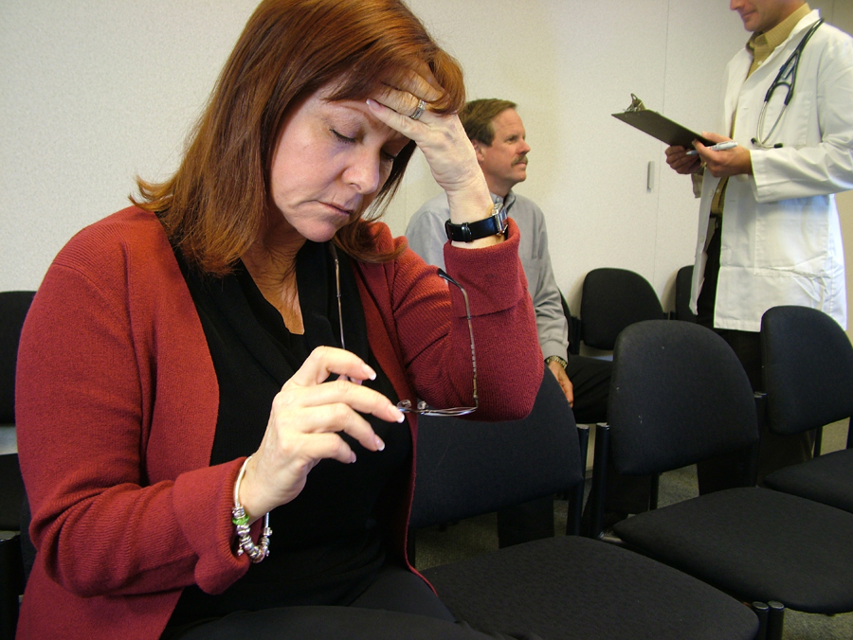
CO Poisoning
Signs and symptoms usually vague and non-specific.
You must ALWAYS maintain a high index of suspicion for CO poisoning!

Slide 46
CO Poisoning
Signs and symptoms closely resemble those of other diseases.
Often misdiagnosed as:
  Viral illness (e.g., the “flu”)
  Acute coronary syndrome
  Migraine
Estimated that misdiagnosis may occur in up to 30-50% of CO-exposed patients presenting to the ED.

Slide 47

Signs and Symptoms
Carbon Monoxide
The
Great Imitator†
† - So is:
Syphilis
Lyme disease
Fibromyalgia
Lupus erythematosis
Multiple sclerosis

Slide 48
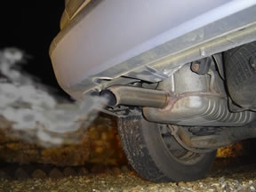
CO Poisoning
Classifications:
  Acute
    Results from short exposure to a high level of CO.
  Chronic:
    Results from long exposure to a low level of CO.

Slide 49
Signs and Symptoms (Acute)
Malaise
Flu-like symptoms
Fatigue
Dyspnea on exertion
Chest pain
Palpitations
Lethargy
Confusion
Depression
Impulsiveness
Distractibility
Hallucination
Confabulation
Agitation
Nausea
Vomiting
Diarrhea
Abdominal pain

Slide 50
Signs and Symptoms (Acute)
Headache
Drowsiness
Dizziness
Weakness
Confusion
Visual disturbances
Syncope
Seizures
Fecal incontinence
Urinary incontinence
Memory disturbances
Gait disturbances
Bizarre neurologic symptoms
Coma
Death

Slide 51
Firefighter Headaches
While CO should always be considered a possible cause of headaches in working firefighters, there are more common causes:
  Tight helmet ratchet
  Too heavy a helmet (especially leather)
  Dehydration

Slide 52
Signs and Symptoms (Chronic)
Signs and symptoms the same as with acute CO poisoning except that onset and severity may be extremely varied.

Slide 53

Signs and Symptoms
Cherry red skin color is not always present and, when present, is often a late finding.
Severity | CO-Hb Level | Signs & Symptoms
Mild | < 15 - 20% | Headache, nausea, vomiting, dizziness, blurred vision.
Moderate | 21 - 40% | Confusion, syncope, chest pain, dyspnea, weakness, tachycardia, tachypnea, rhabdomyolysis.
Severe | 41 - 59% | Palpitations, dysrhythmias, hypotension, myocardial ischemia, cardiac arrest, respiratory arrest, pulmonary edema, seizures, coma.
Fatal | > 60% | Death
COHb levels do not always correlate with symptoms nor predict sequelae.

Slide 54
CO ppm | Duration | Symptoms
50 | 8 hours | OSHA minimum
200 | 2-3 hours | Mild headache, fatigue, nausea, dizziness
400 | 1-2 hours | Serious headache—other symptoms intensify. Life-threatening > 3 hours
800 | 45 minutes | Dizziness, nausea and convulsions. Unconscious within 2 hours. Death within 2-3 hours.
1,600 | 20 minutes | Headache, dizziness and nausea. Death within 1 hour.
3,200 | 5-10 minutes | Headache, dizziness and nausea. Death within 1 hour.
6,400 | 1-2 minutes | Headache, dizziness and nausea. Death within 25-30 minutes.
12,800 | 1-3 minutes | Death

Slide 55

Signs and Symptoms
CO may be the cause of the phenomena associated with haunted houses:
  Strange visions
  Strange sounds
  Feelings of dread
  Hallucinations
  Inexplicable deaths

Slide 56
Long-Term Complications
Delayed Neurologic Syndrome (DNS):
  Recovery seemingly apparent.
  Behavioral and neurological deterioration 2-40 days later.
  True prevalence uncertain (estimate range from 1-47% after CO poisoning).
  Patients more symptomatic initially appear more apt to develop DNS.
  More common when there is a loss of consciousness in the acute poisoning.

Slide 57
Delayed Neurologic Syndrome
Signs and Symptoms:
  Memory loss
  Confusion
  Ataxia
  Seizures
  Urinary incontinence
  Fecal incontinence
  Emotional lability
Signs and Symptoms:
  Disorientation
  Hallucinations
  Parkinsonism
  Mutism
  Cortical blindness
  Psychosis
  Gait disturbances
  Other motor disturbances

Slide 58
Long-Term Complications
Cardiac Complications:
  230 sequential patients with moderate to severe CO poisoning treated with HBO.
CO Myocardial Injury | Patients (n) | Died (%) | 5-year Survival (%)
Myocardial injury from CO | 85 | 37.6 | 71.6
No Myocardial injury from CO | 145 | 15.2 | 88.3
Henry CR, Satran D, Lindgren B, et al. Myocardial injury and long-term mortality following moderate to severe carbon monoxide poisoning. JAMA. 2006;295:398-402

Slide 59
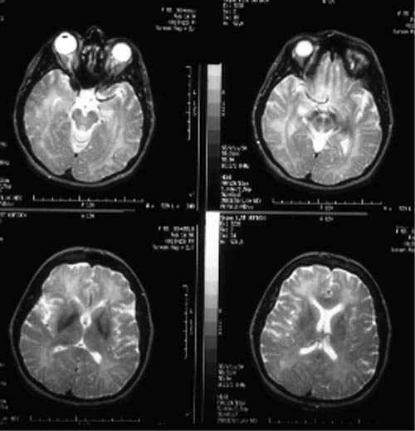
Long-Term Complications
Depression and anxiety can exist up to 12 months following CO exposure.
Higher at 6 weeks in patients who attempted suicide by CO.
No differences in rates between accidental and suicide-attempt at 12 months.

Slide 60
CO DETECTION

Slide 61
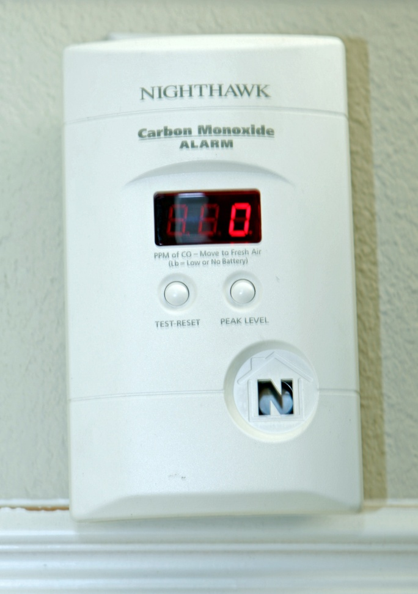
Carbon Monoxide Detection
CO detectors have been widely-available for over a decade.
Still vastly underutilized.
Underwriters Laboratories (UL) revised guidelines for CO detectors in 1998.
Units manufactured before 1998 should be replaced.

Slide 62
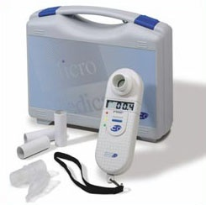
Carbon Monoxide Detection
Biological detection of CO limited:
  Exhaled CO measurement.
  Hospital-based carboxyhemoglobin levels (arterial or venous).

Slide 63
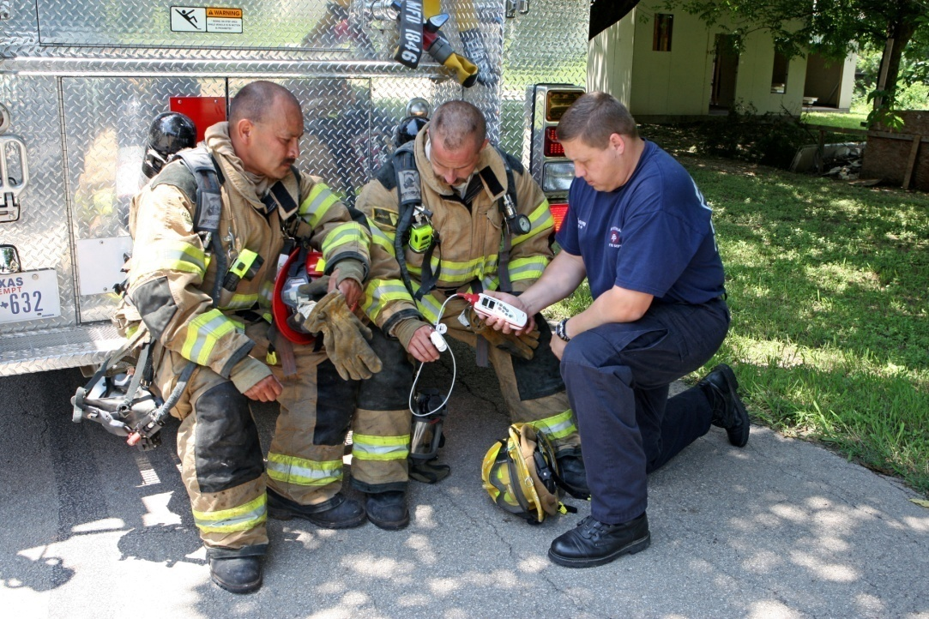
Carbon Monoxide Detection
Technology now available to detect biological COHb levels in the prehospital and ED setting.
Referred to as CO-oximetry

Slide 64
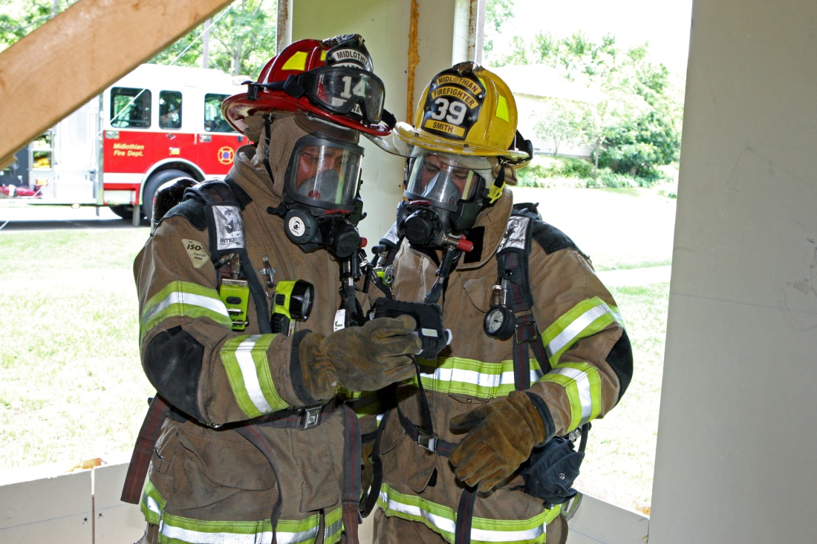
Carbon Monoxide Detection
Hand-held devices now available to assess atmospheric levels of CO.
Multi-gas detectors common in the fire service:
  Combustible gasses
  CO
  O₂
  H₂S

Slide 65
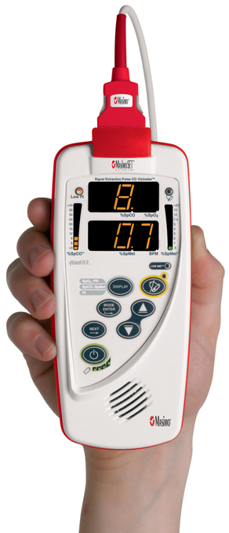
Carbon Monoxide Detection
New generation oximeter/CO-oximeter can detect 4 different hemoglobin forms.
  Deoxyhemoglobin (Hb)
  Oxyhemoglobin (O₂Hb)
  Carboxyhemoglobin (COHb)
  Methemoglobin (METHb)
Provides:
  SpO₂
  SpCO
  SpMET
  Pulse rate

Slide 66
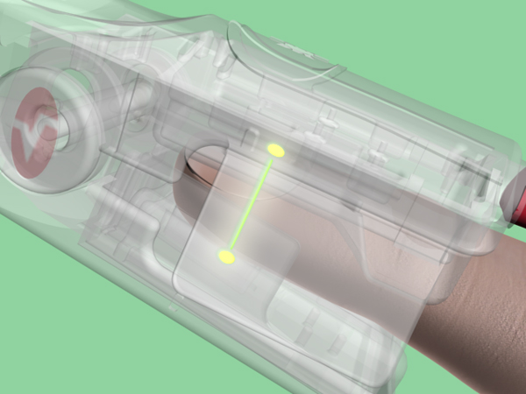
CO-Oximetry
Uses finger probe similar to that used in pulse oximetry.
Uses 8 different wavelengths of light (instead of 2 for pulse oximetry).
Readings very closely correlate with COHb levels measured in-hospital.

Slide 67
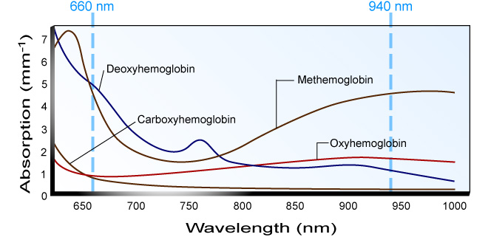
CO-Oximetry

Slide 68
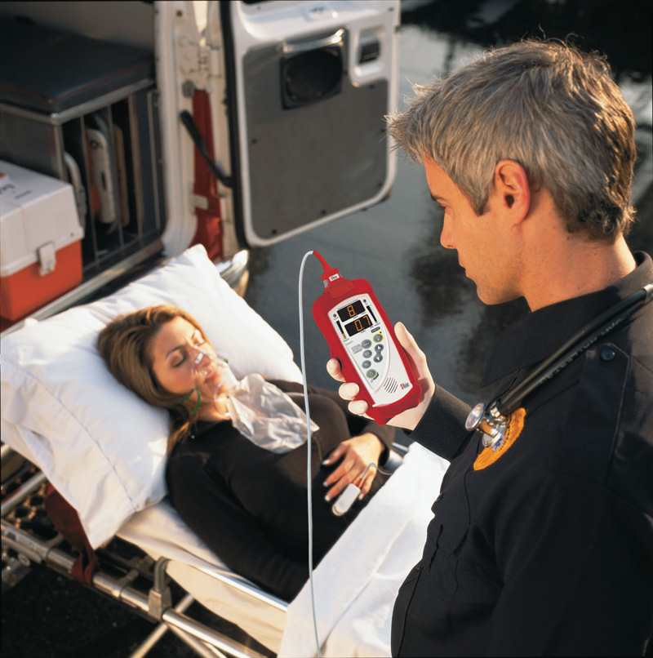
CO-Oximetry
CO evaluation should be routine at all levels of EMS and the fire service.
All field personnel should be educated in use of the oximeter and CO-oximeter.
Missed CO poisoning is a significant area of legal liability for EMS and fire personnel.

Slide 69
CO POISONING
TREATMENT

Slide 70
Diagnostic Criteria
Biologic:
  COHb > 5% in nonsmokers.
  COHb > 10% in smokers.
Environmental:
  No confirmatory test.

Slide 71
Diagnostic Criteria
Suspected:
  Potentially-exposed person, but no credible threat exists.
Probable:
  Clinically-compatible case where credible threat exists.
Confirmed:
  Clinically-compatible case where biological tests have confirmed exposure.

Slide 72
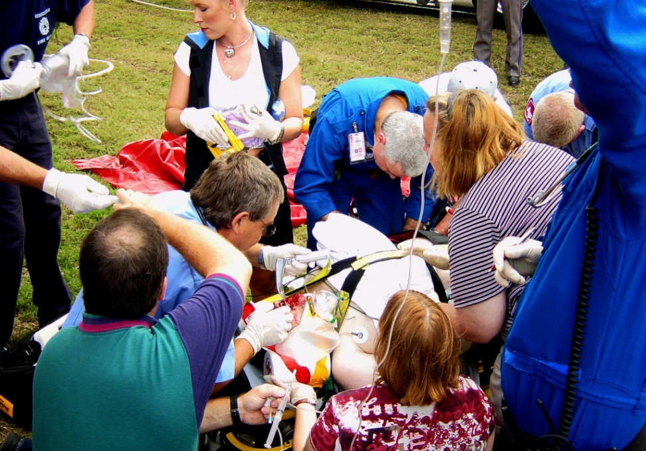
Treatment
Treatment is based on the severity of symptoms.
Treatment generally indicated with SpCO > 10-12%.
Be prepared to treat complications (i.e., seizures, dysrhythmias, cardiac ischemia).

Slide 73

Treatment
Administer high-concentration oxygen.
Maximizes hemoglobin oxygen saturation.
Can displace some CO from hemoglobin.
Associated with improvements in neurological and cardiac complications.
The importance of early administration of high-concentration oxygen CANNOT be overemphasized!

Slide 74
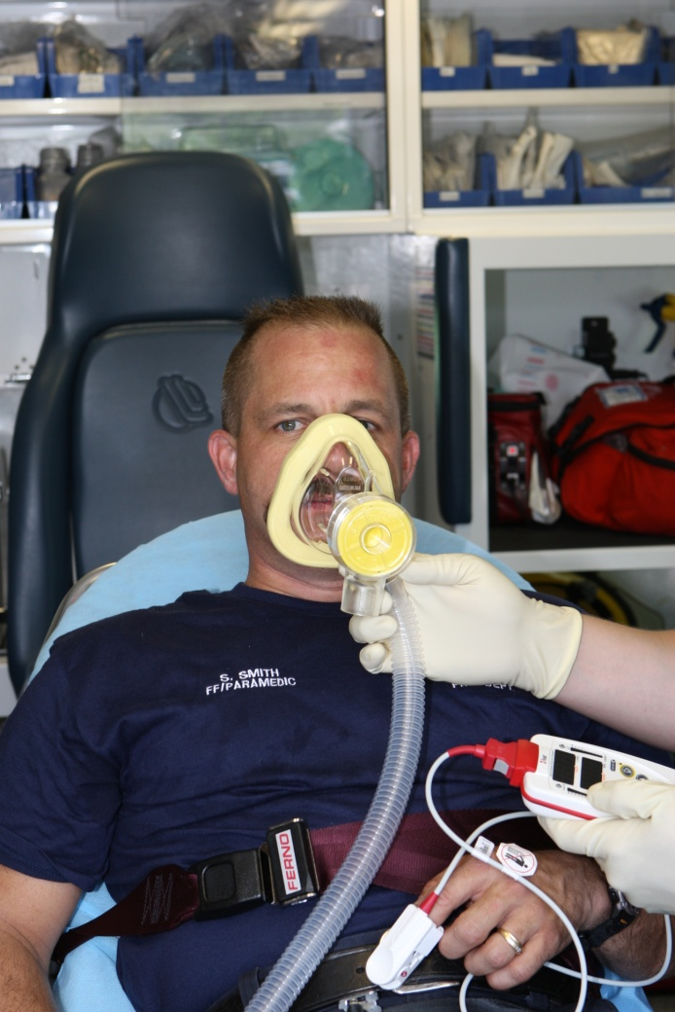
Treatment
Prehospital CPAP can maximally saturate hemoglobin and increase oxygen solubility.
Strongly suggested for moderate to severe poisonings.

Slide 75
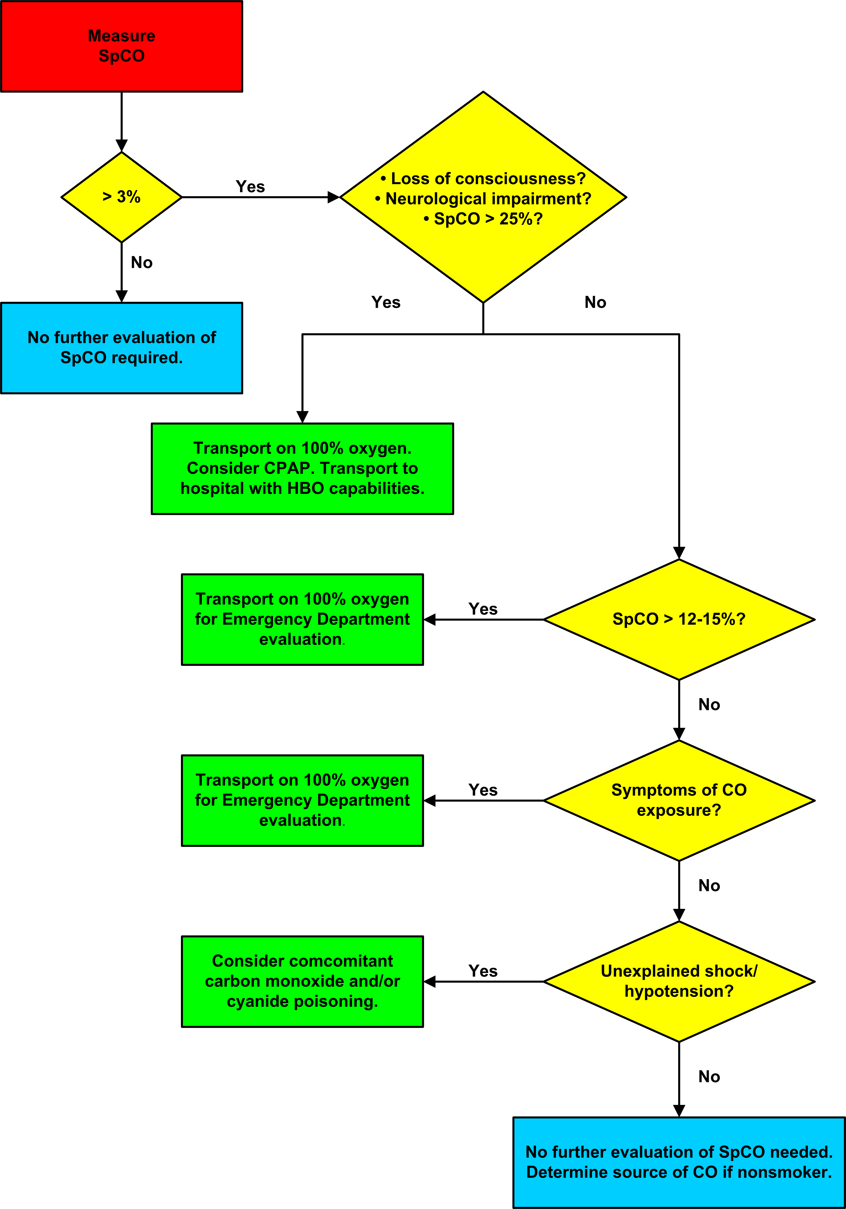
Treatment Algorithm

Slide 76
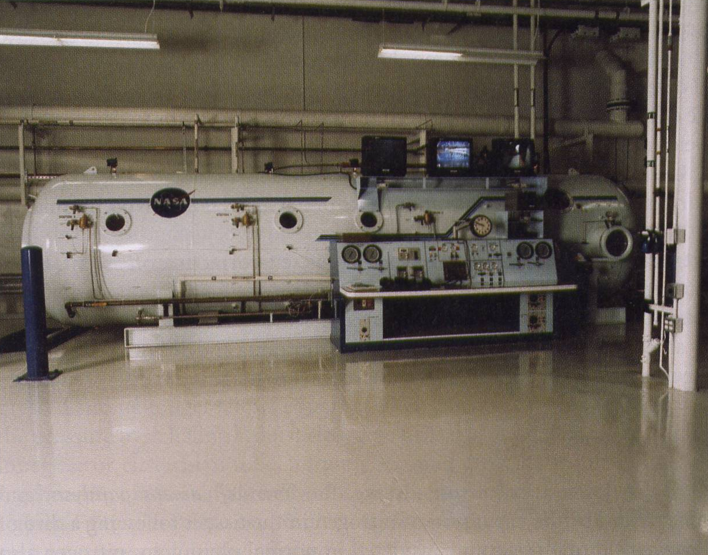
Treatment
Efficacy of hyperbaric oxygen therapy (HBO) is a matter of conjecture although still commonly practiced.
Generally reserved for severe poisonings.
May aid in alleviating tissue hypoxia.
Significantly decreases half-life of COHb.

Slide 77
Indications for HBO Therapy
Strongly consider for:
  Altered mental status
  Coma
  Focal neurological deficits
  Seizures
  Pregnancy with COHb>15%
  History of LOC

Slide 78
Indications for HBO Therapy
Possibly consider for:
  Cardiovascular compromise (e.g., ischemia, dysrhythmias).
  Metabolic acidosis.
  Extremes of age.

Slide 79
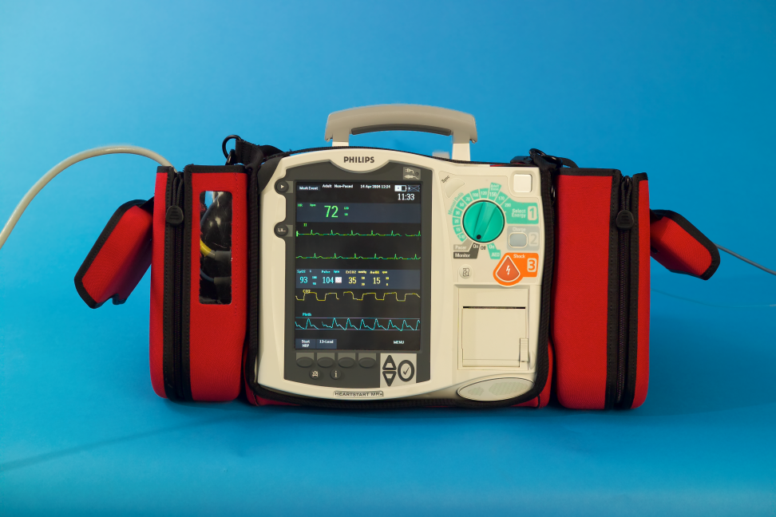
Treatment
Continue to monitor SpO₂ and SpCO levels throughout treatment.
Obtain 12-lead ECG (if ALS) and monitor ECG.
Document findings and plot trends.

Slide 80
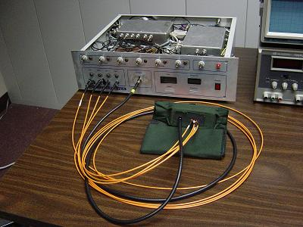
Treatment
First-generation pulse oximeters may give falsely elevated SpO₂ levels in cases of carbon monoxide poisoning.
Cannot distinguish between O₂Hb and COHb.

Slide 81
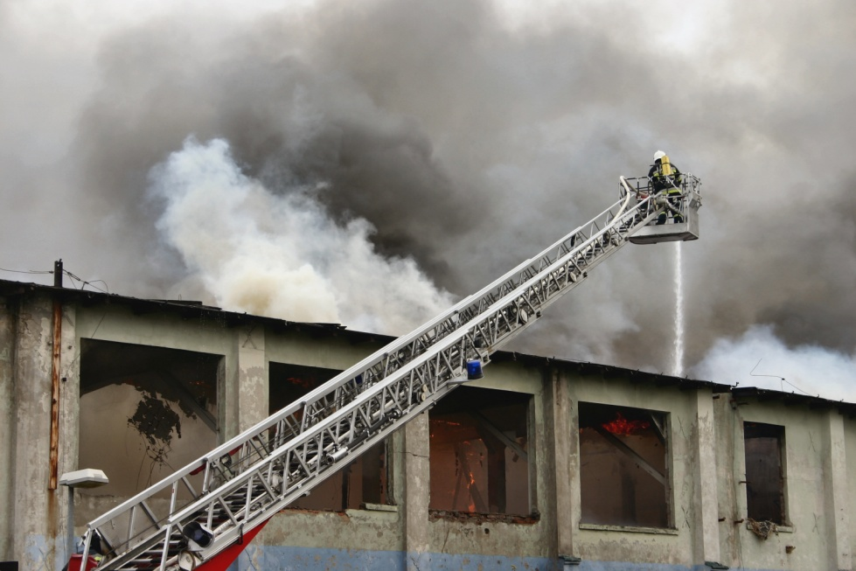
CO Poisoning
Remember, CO poisoning is the great imitator.
Missed CO exposure often leads to death and disability.
CO is a particular risk for firefighters.
A simple COHb reading can save a life and possibly prevent long-term complications.

Slide 82
METHYLENE CHLORIDE

Slide 83
Methylene Chloride Exposure
Methylene chloride slowly metabolized to CO.
Victims do not pose contamination risks to rescuers.
Victims with contaminated clothing or skin can secondarily contaminate response personnel by direct contact or through off-gassing vapor.
Methylene chloride vapor may also off-gas from the toxic vomitus of victims who have ingested methylene chloride.

Slide 84
Methylene Chloride Exposure
Methylene chloride can cause:
  Acute CNS depression.
  Respiratory depression.
  Cardiac dysrhythmias.
  Respiratory tract irritation (at high levels).
  Non-cardiogenic pulmonary edema (at high levels).

Slide 85
Methylene Chloride Exposure
Treatment:
  No antidote for methylene chloride.
  Support respiratory and cardiovascular functions.
  Administer O₂ (O₂ is an antagonist of metabolically-produced carbon monoxide).

Slide 86
DOUBLE TROUBLE: CO and CYANIDE

Slide 87
Carbon Monoxide and Cyanide
Cyanide more often encountered in fires than once thought.
The effects of CO and cyanide are cumulative.
Symptoms of cyanide toxicity often attributed to CO because of lack of a high index of suspicion.

Slide 88
Chemistry of Cyanide
Gas:
  Colorless
  Faint bitter almond smell
Nearly 40% of the population cannot smell cyanide.
Sodium cyanide (NaCN) and potassium cyanide (KCN) are both white powders.

Slide 89
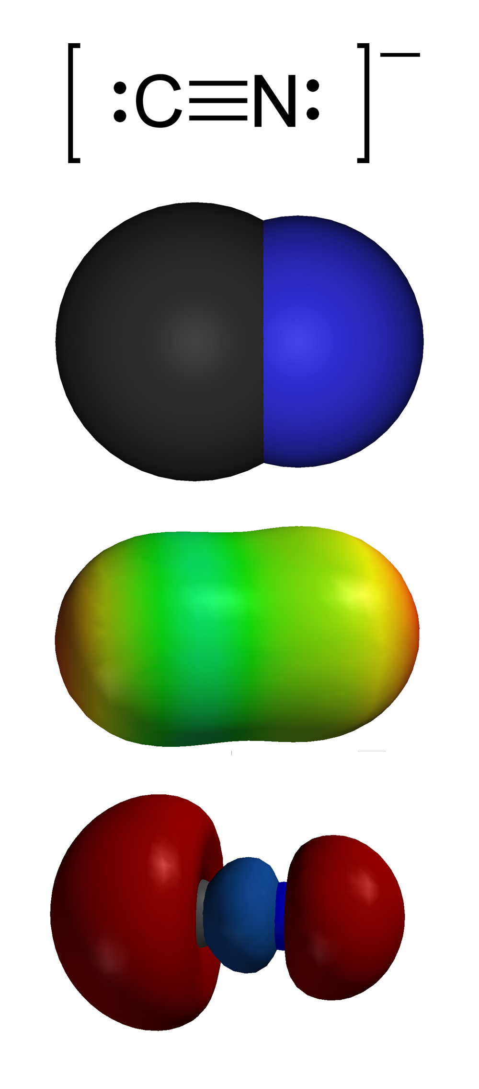
Chemistry of Cyanide
Molecule consists of one carbon atom joined to one nitrogen atom by a triple bond.
Cyanide anion is extremely toxic.

Slide 90
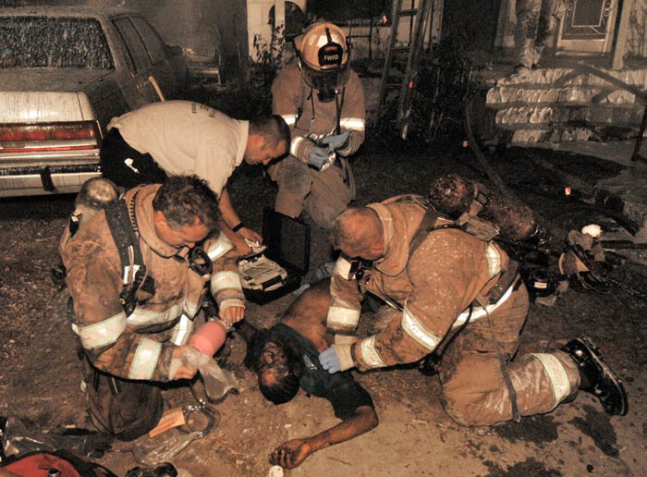
Cyanide
Hydrogen cyanide is a product of combustion.
High in:
  Plastics
  Wool
  Silk
  Synthetic rubber
  Polyurethane
  Asphalt.

Slide 91
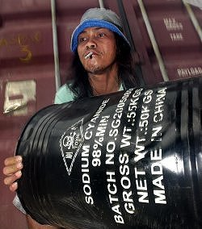
Cyanide
Toxicity varies with chemical form.
Hydrogen cyanide (HCN) gas at concentrations of 130 ppm can be fatal within an hour.
OSHA permissible exposure levels are 10 ppm as an 8-hour time-weighted average.

Slide 92
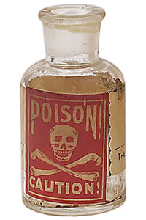
Pathophysiology
Cyanide can be inhaled of ingested.
Ingestion more common with suicide or murders.

Slide 93
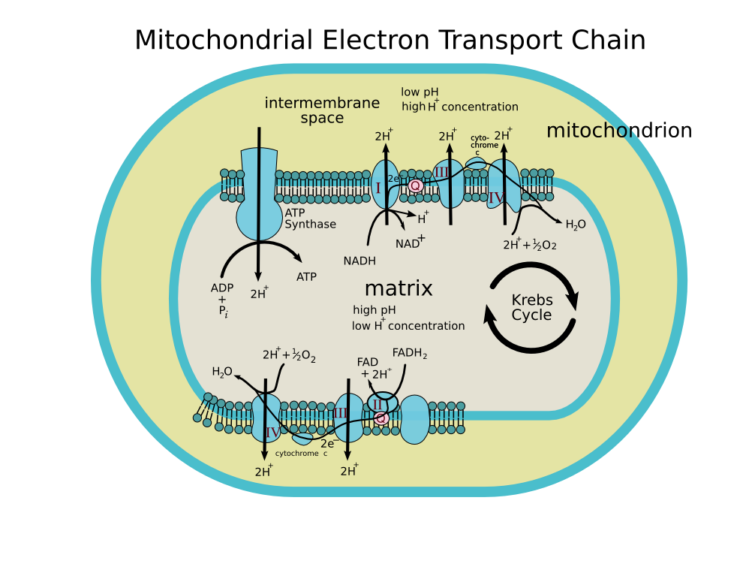
Pathophysiology
Cyanide is an irreversible enzyme inhibitor:
  Cytochrome c oxidase (aa₃).
  Part of the 4th complex of the electron transport chain.
  Found in the shelves (cristae) of the mitochondria in the cells.

Slide 94
Pathophysiology
Cyanide deactivates this enzyme

Slide 95
Pathophysiology
Cyanide stops the electron transport chain and stops energy production (ATP) in the cell.
Tissues that primarily depend on aerobic respiration are particularly affected:
  Heart
  Central nervous system
Cyanide and CO both primarily affect the heart and CNS thus multiplying the ill-effects!

Slide 96
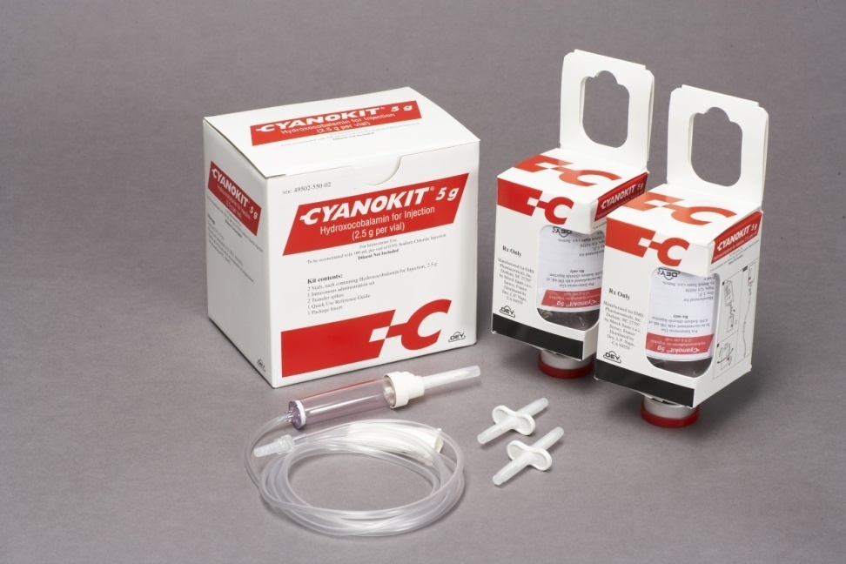
Cyanide Treatment
Antidotes available:
  Cyanide Antidote Kit:
    Amyl nitrite
    Sodium nitrite
    Sodium thiosulfate
  Hydroxocobalamin

Slide 97
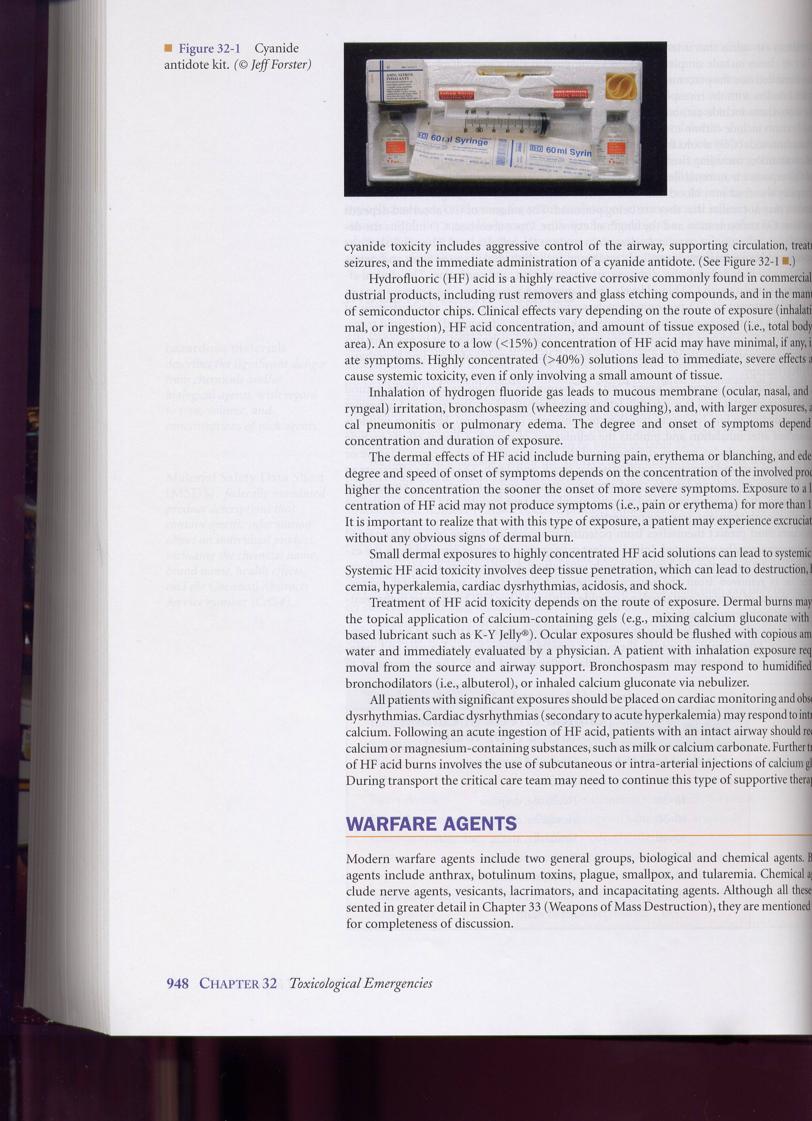
Cyanide Poisoning
Amyl nitrite is administered via inhalation or ventilation.
Sodium nitrite is administered intravenously.
Sodium thiosulfate is administered intravenously.

Slide 98
Cyanide Treatment
The nitrites promote the formation of methemoglobin.
Cyanide has a greater affinity for methemoglobin (METHb) than the cytochrome oxidase enzyme.
The binding of cyanide to METHb frees cytochrome oxidase so that energy production is resumed.

Slide 99

Cyanide Treatment
Sodium thiosulfate binds to cyanide and forms thiocyanate.
Thiocyanate much less toxic than cyanide anion and excreted through the kidneys.

Slide 100
Cyanide Treatment
Hydroxocobalamin
  Precursor to cyanocobalamin (Vitamin B₁₂).
  Hydroxocobalamin combines with cyanide to form cyanocobalamin which is excreted through the kidneys.
  FDA approval in US obtained in December 2006.
  Marketed as Cyanokit™.

Slide 101
Cyanide Treatment
Problems (related to nitrites):
  METHb does not transport O₂.
  The conversion of HB to METHb changes the state of the heme molecule where O₂ binds.
  METHb has heme in the ferric (Fe³⁺) state and not the ferrous state (Fe²⁺).
  O₂ can only bind to heme when in the Fe²⁺ state.

Slide 102

Cyanide Treatment

Slide 103
Cyanide Treatment
100% Hb
Concomitant CO and cyanide poisoning can significantly decrease the O₂-carrying capacity of the blood.
Combination of COHb and METHB can significantly reduce the O₂-carrying capacity of the blood.
20% COHb
80% Hb
20% METHb
60% Hb
O₂-carrying capacity nearly halved!

Slide 104


Cyanide Treatment
Children are particularly at risk for hypotension and adverse effects from methemoglobinemia.

Slide 105
CO and Cyanide Poisoning
Hydroxocobalamin is the cyanide antidote of choice for mixed cyanide and CO poisonings.
Parts of cyanide antidote kit (amyl nitrite, sodium nitrite) induce methemoglobinemia.
Cyanide antidotes and CO poisoning can lead to elevated COHb and METHb significantly reducing O₂ capacity of blood.
Sodium nitrite should be avoided for combination cyanide/CO poisonings when SpCO >10%.
Hydroxocobalamin converts cyanide to cyanocobalamin (Vitamin B₁₂) which is renally-cleared.

Slide 106

Financial Disclosure
This program was prepared with an unrestricted grant from Masimo. Masimo did not control content.

Slide 107
Credits
Content: Bryan Bledsoe, DO, FACEP
Art: Robyn Dickson (Wolfblue Productions)
Power Point Template: Code 3 Visual Designs
The following companies allowed use of their images for this presentation:
  Brady/Pearson Education
  Scripps/University of California/San Diego
  JEMS/Brook Wainwright
  Glen Ellman
  Bryan Bledsoe, DO, FACEP
  Masimo, Inc.

Slide 108
Credits
This is a product of Cielo Azul Publishing.

