Slide 1

Crashing Care in the Air: Elevating HEMS Usage
Benjamin Lawner, DO, MS, EMT-P
Douglas Floccare, MD, MPH
University of Maryland School of Medicine
Department of Emergency Medicine
Section of Prehospital and Disaster Medicine

Slide 2
Objectives
Understand indications of the use of HEMS
Identify time sensitive conditions that might benefit from HEMS
Describe the capabilities of HEMS aircraft operating within MD
Review controversies surrounding implementation of HEMS

Slide 3
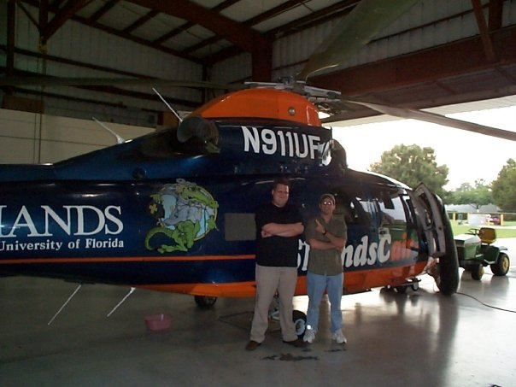
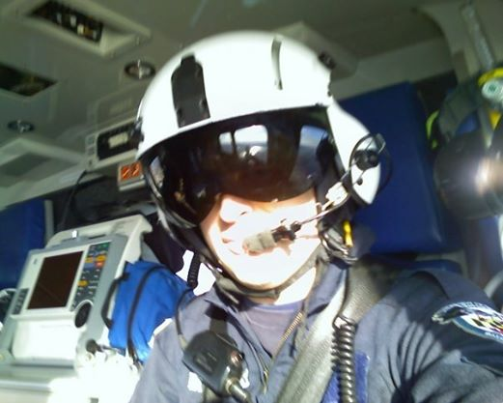
Introductions and Flight Medicine Disclosures

Slide 4

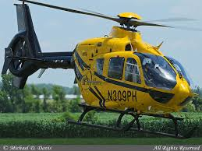
PHI ExpressCare 1, an EC-135
University of Maryland Medical Center

Slide 5
Trooper, AW-139
Maryland State Police Aviation Command

Slide 6
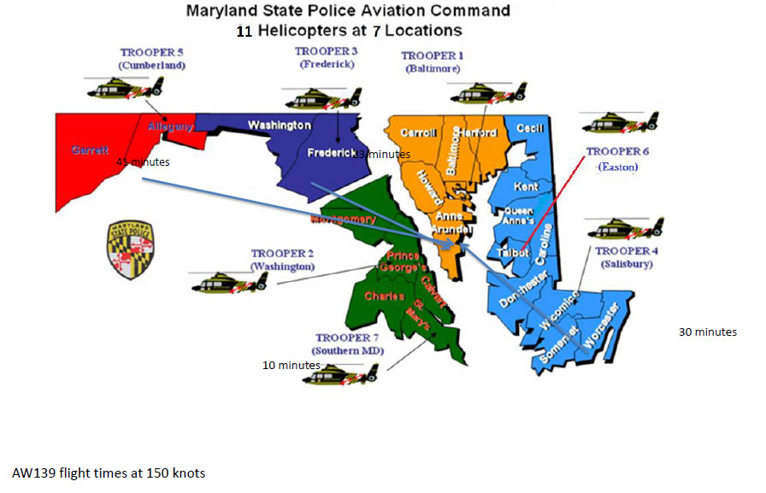

Slide 7
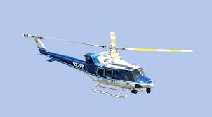
Bell UH-412
Unites States Park Police

Slide 8
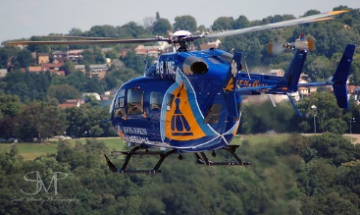
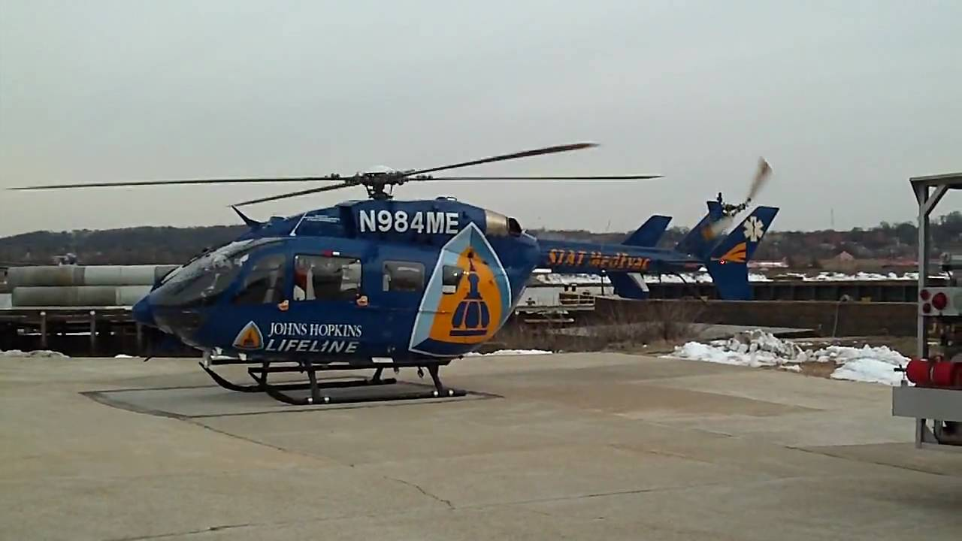
Stat Medevac 10, EC-145
Johns Hopkins Hospital

Slide 9
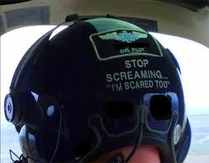
Why HEMS ?
Expedited access to definitive care
Expert skill set
Specialized equipment
Retrieval

Slide 10

Specialized Skill Set
ECMO
Neonatal transport
Chest tube maintenance
Blood product administration
Rapid sequence intubation
Vasopressor
Invasive hemodynamic monitoring
Transport ventilation

Slide 12
HEMS Indications

Slide 13
HEMS Indications

Slide 14

HEMS Considerations
HEMS must be fully integrated into the EMS system
HEMS should not operate independently
HEMS must have appropriate oversight

Slide 15
The Decision to Utilize HEMS
Medically appropriate
Risk vs benefit
→ Risk to patient
→ Risk to provider/crew
Specific patient population
→Trauma
→ STEMI
→ Stroke
→ Critical illness
→ Time sensitive condition

Slide 16
Helicopter EMS for Trauma

Slide 17


Slide 18
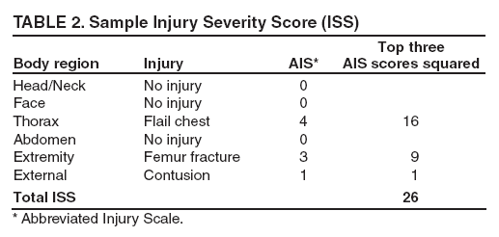
Galvagno (2012) JAMA
Over 200,000 patients over 15
ISS > 15
Retrospective cohort study
Blunt and penetrating trauma victims
Transport to Level I or Level II centers
Survival and condition at discharge
National Trauma Data Bank entries 2007-9
Notes:
Study used the NTDB, the most robust source of trauma related data. Previous studied did not incorporate regression analyses. Over 900 centers participate in NTDB. ISS used because higher scores associated with need for specialized trauma services. 3 analytic models: (1) a multivariate logistic regression (2) a multivariate logistic regression with estimating equations to control for clustering and (3) a logistic regression model using propensity scores. Variables included in final modeling were selected after calculating correlation coefficients, examing scatterplot matrixes, and ensuring a low proportion of missing data. Final variables: Systolic BP, RR,HR, motor component of GCS, age, sex, blunt vs penetrating trauma. Motor GCS selected due its predictive value and total GCS missing. Casual inference wasn’t possible because there was not a posited mechanism for assignment. Previous studies did also not control for missing data

Slide 19

HEMS at First Glance
Primary intervention: helicopter transport
Higher unadjusted mortality for HEMS group
Fever patients in HEMS group discharged home without services
Higher injury severity for patient in HEMS group
Notes:
Propensity matching used- 1 way of creating subgroups of treated units. Simular with respect to distribution of observed background characteritics and pre-existing confounders. Propensity scores reflect the likelihood of being assigned to a particular treatment group. Score can then be used in a multivariate model as an independent variable. Age, sex, ISS, SBP, RR, HR, type of trauma, mech of injury all factored into propensity matching. Removes 90% of bias when used correctly.

Slide 21
Limitations and Considerations
Specific characteristic of HEMS that accounts for survival unclear
Crew configuration not available from NTSB
Specific components of HEMS care require investigation (total prehospital time, distance)
Cost-effectiveness not studied
Effective pre-hospital triage tools based upon ISS lacking
Estimated 325,000 to save one life (NNT =65, HEMS @ 5,000)
Notes:
Several limitations exist- the authors attempted to analyze total call time in a sensitivity analysis but a significant amt of data was missing. Helicopter survival is likely a combination of crew expertise, speed, and transport to specialized facility. NTDB is also a convenience sample with incorporates a disproportionate number of larger hospitals, younger, and more severely injured patients. Authors acknowledge that heath care related quality of life must be considered because disability is an important part of the equation. Helicopters are hugely expensive and specific components of HEMS should be studied against controls

Slide 22
HEMS in Trauma
Regression analysis revealed improved survival
HEMS patients more likely to have an ISS > 24
1.5% increased absolute survival rate for pts transported to Level I via HEMS
NNT 65 for patients transported by HEMS to Level 1 centers
Greater # of HEMS patients discharged to rehabilitation centers
Notes:
The association between HEMS and improved survival persisted upon exam of Level I and Level II centers. All regression models revealed improved survival.

Slide 23

NNT in Perspective (thennt.com)
NNT for defibrillation in cardiac arrest?
2.5
NNT for aspirin in STEMI?
42
NNT for non invasive ventilation in the setting of pulmonary edema?
13

Slide 24
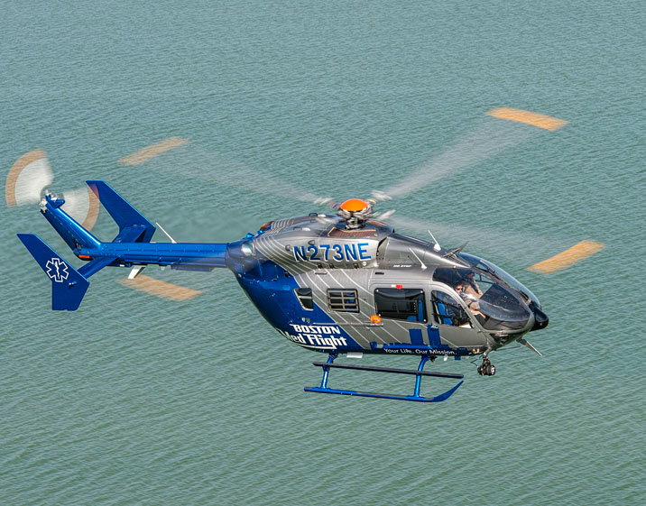
HEMS in Trauma

Slide 25
HEMS Guidelines

Slide 26




Slide 27
Injury Severity
Time savings

Slide 28
CDC Field Triage Scheme

Slide 30
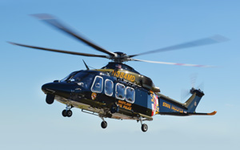
Maryland Specific Considerations (2014 MMP’s)

Slide 31
HEMS Indications: Key Points
Severe injury: anatomic considerations
Severe injury: physiologic considerations
Time savings
Specialized capabilities

Slide 32

Controversies in HEMS
Operating costs
Mortality benefit
Indications for use
Increased risk to patients and crew

Slide 33
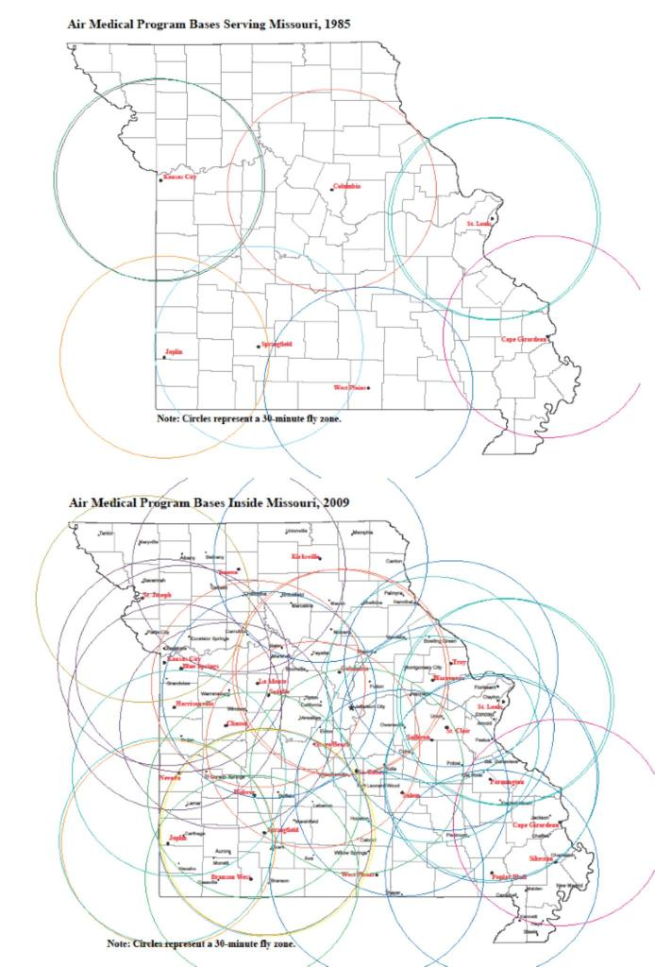
Explosive Growth
Thirty minute fly zones

Slide 34
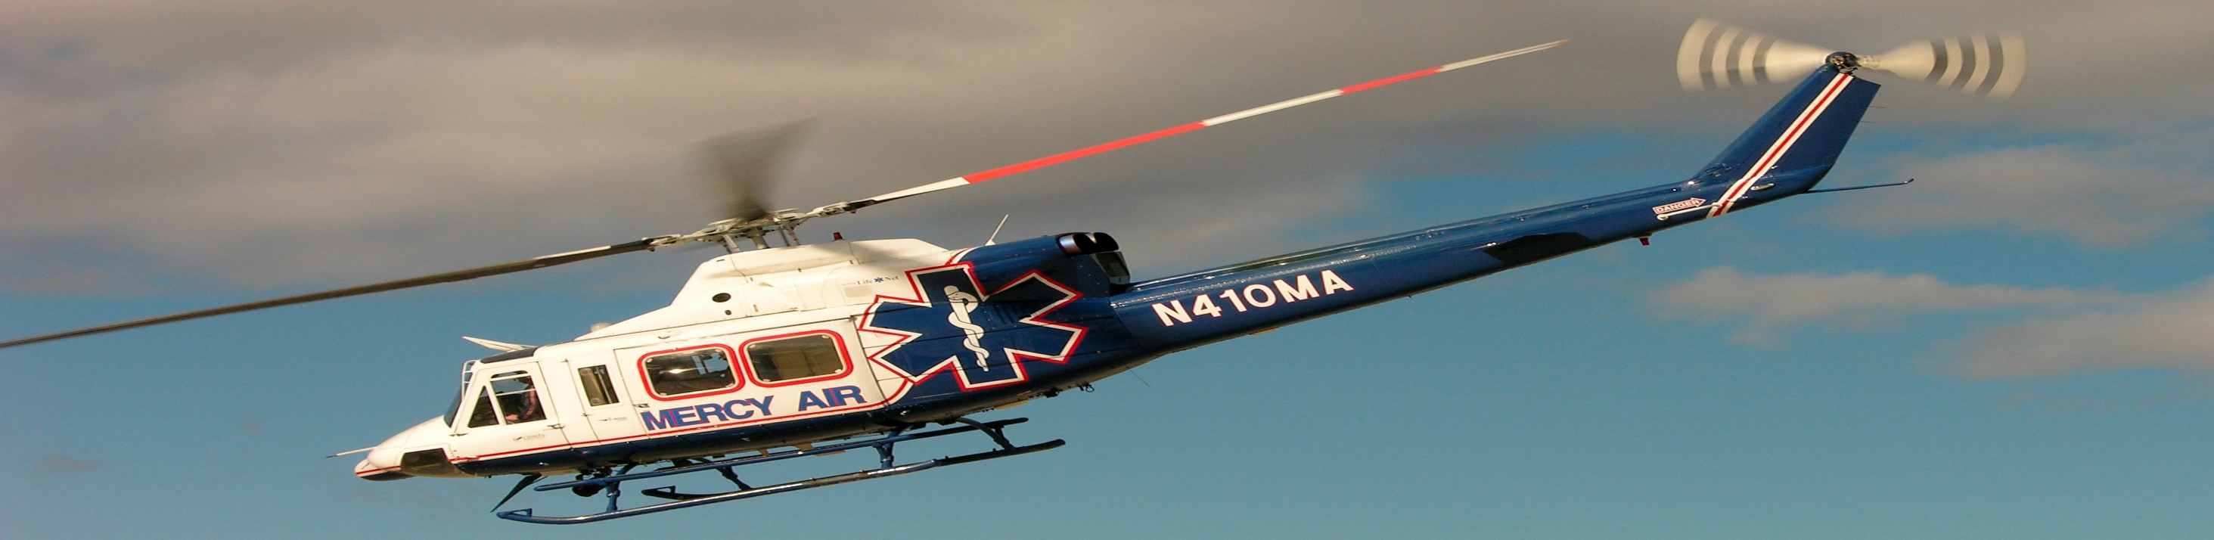
Annals of EM October 2013
Notes:
Study

Slide 35
HEMS Demographics
Over 69000 HEMS transports for trauma to US level I and II centers
Insurance reimburse 5K-6K more for HEMS transport
Many patients with non life threatening injuries flown
29 fatalities in 2008 provoked federal review

Slide 36
HEMS Assumptions
HEMS needs to provide 15% reduction in mortality for pts with serious injuries
Benchmark of 1.3 lives saved / 100 transports
To cost less than 50,000 per quality adjusted life year, HMS would need to save 3.3 lives/100 transports
Notes:
This study developed a decision analytic model to compare costs and outcome of HEMS vs GEMS. Clinica data and cost inputs were derived from the National Study on the Costs and Outcomes of Trauma and supplemented by the NTDB, medicare reimbursemetns, and the literature. Nationally representative population model (age 18 to 85) was applied as was a nationally representative distribution of injury severity. Model followed patients from injury through transport, hospitalization, and first year post discharge. Primary outcome was threshold relative risk reduction in inhospital mortality b HEMS needed to achieve an incremental cost effectiveness ration compared with ground EMS below 100,000 per quality adjusted life year. QUALYs measure both quality and quantity of life years lived after intervention. 100,000 dollars is the threshold at which health care interventions are generally considered cost effective in high income countries. The model calculates the difference in costs and outcomes related to the decision of choosing HEMS as opposed to GEMS at the scene of ground transport to a trauma center. Markov model calculated remaining life expetencany and remaining health care expenditures for patients surviving to discharge
Assumes mortality of 7%
-15% RR reduction equates to a 1.3% reduction in absolute mortality

Slide 37
Conclusions
Notes:
To be cost effective, HEMS would have to reduce the number of patients transported with minor injuries and demonstrate improvements in long term disability.
MANY limitations:
1. Assumptions and used data from numerous published studies
2. Results not stratified by age and injury severity
3. Base cost assumptions assume equal availability for GEMS and HEMS
4. Not excluding GEMS patients injured close to the trauma center who are less likely to die in the field than those who are injured far away and survive to be transported likely biases outcomes in favor of HEMS
5. Study has significant impact on particular area- costs MIGHT be offset in rural areas if the most seriously injured patients are transpoted by HEMS to a trauma center. In other words, areas with low flight volume could offset the HEMS cost by encouraging direct transport to trauma centers

Slide 38
HEMS Controversy
Notes:
Great editorial which discusses limitations of stats. First, the article assumes a baseline 7.6% mortality from US trauma. This may conflict with existing NTDB studies which put mortality at closer to 4%. The author also takes issue with combining blunt and penetrating trauma into the same equation. The author questions mortality as the primary measure- what benefit does hems offer to the remaining 94% of the population? QUALYs also lack sensitivity because trauma typically affects a younger population. Helos may represent the sole response resource in several areas of the country. Urges caution in the era of cost consciousness and enourages use of other outcomes.

Slide 39
Significant limitations on using QALY as primary outcome measure
Disability not directly measured in study
Penetrating and blunt trauma represent distinctly different disease mechanisms
Agree that “overtriage” should be examined and minimized, if possible

Slide 40
Fatal Crashes per Million Flight Hours (2001)
Source: AMPA, A Safety Review and Risk Assessment in
Air Medical Transport (2002)

Slide 41
Medical Helicopter Accidents
Source: NTSB
Source: NTSB

Slide 42
Case Studies from the University of Maryland Medical Center Base Station

Slide 43
Case 1: 16 yo female, found unconscious
16 yo female found unconscious in a car. Suspected suicide attempt. Pt responds to verbal stimuli.
BP: 120/70, R: 8, Sp02: 100% on NRBM
No visible signs of trauma
ETA: 2.5 hours by ground to STC, 12 minute ETA for HEMS

Slide 44
Case 2: Seizure
73 yo female, last seen normal 30 minutes prior to call
Witnessed seizure, followed by unconsciousness
BP: 180/100, R: 6/irreg, P: 52, Sp02: 83%
Exam: Pupils 3mm and sluggish. Pt non verbal
ETA for medevac 15 minutes. ETA to community hospital 6 minutes by ground
EMS crew states, “no neurosurgeon at local facility”

Slide 45
Case 3: STEMI
56 yo male, chest pain and SOB
Inferior wall STEMI on 12 lead ECG
VS: BP: 170/100, P: 100, R: 16, Sp02: 96%
15 minutes to closest facility (lytic capable)
30 minutes to closest PCI facility

Slide 46

Thank you!
blawn001@umaryland.edu

