Slide 1

Myths in
Disaster Planning

Slide 2


Assumption Five
Casualties will be transported to hospitals appropriate to their needs and in such a manner that no hospital receives a disproportionate number
Most casualties are transported to the closest or most familiar hospitals
Implications
  Patients often choose
may not be possible to prevent
  inefficient casualty distribution
Notes:
All hospitals must be prepared to do decon
Mya not be able to prevent inefficient casualty distribution, but but it may be possible to influence

Slide 3


Slide 4
Assumptions
1. Dispatchers will hear of the disaster and send emergency response units to the scene
2. Trained emergency personnel will carry out field search and rescue
3. Trained EMS personnel will do triage, first aid/ stabilizing care and decon before patient transport
4. Casualties will be transported to hospitals by ambulance

Slide 5
Assumptions
5. Casualties will be transported to hospitals appropriate to their needs and in such a manner that no hospital receives a disproportionate number
6. Field authorities will promptly notify area hospitals about the numbers, types and severities of casualties to be transported
7. The most serious casualties will be the first to be transported hospitals

Slide 6

1. Dispatchers will hear of the disaster and send emergency response units to the scene
Local/distant Emergency response units will self dispatch
Implications
  inter-community response
  communication
  more help than needed will arrive
Notes:
Planning not just at the jurisdictional level (intercommunity)
Whos covering the rest of the community
How will you talk to them, different radios? Where to put them?

Slide 7
1. Dispatchers will hear of the disaster and send emergency response units to the scene
Interventions
  coordinate and use of unsolicited responders
    Staging/check-in areas
  security perimeters
    Law enforcement
  County/statewide training

Slide 8

2. Trained emergency personnel will carry out field search and rescue
Initial search and rescue
  carried out by the scene survivors
Implications
  Uncoordinated search and rescue
  Survivors may have best information about locations
Notes:
Planners assume

Slide 9

2. Trained emergency personnel will carry out field search and rescue
Interventions
  Coordinate with survivors
  Train first responders
    law enforcement
  Urban Search and Rescue
Notes:
First responders.. Including le
Whos the first? Fellow people injured

Slide 10
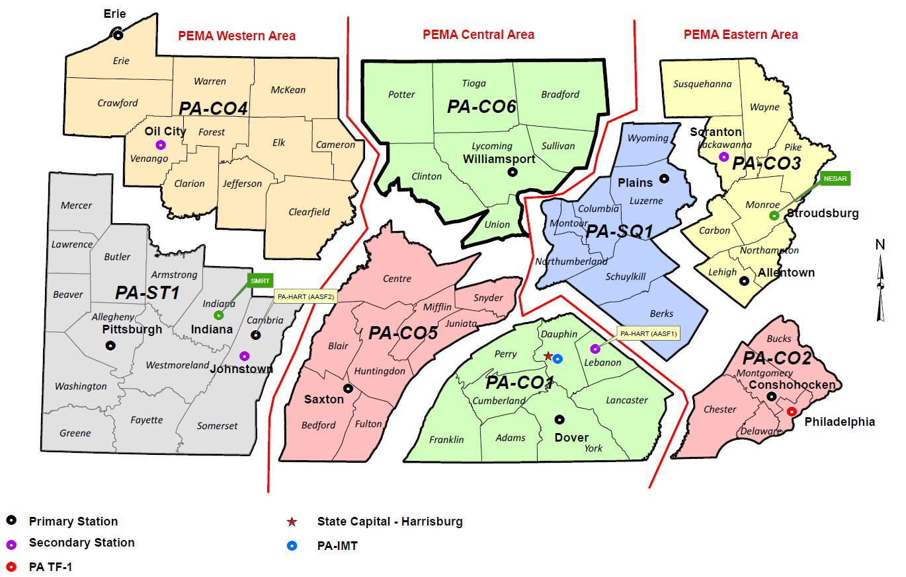
USAR

Slide 11
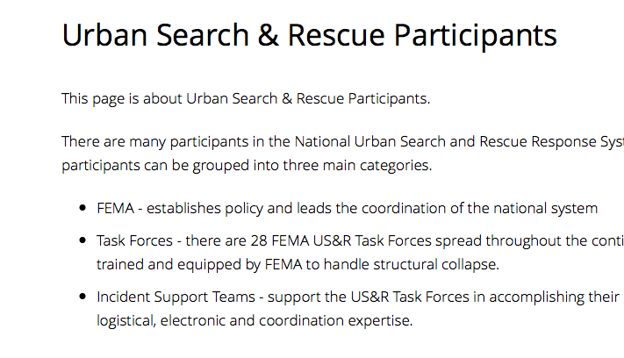
FEMA

Slide 12
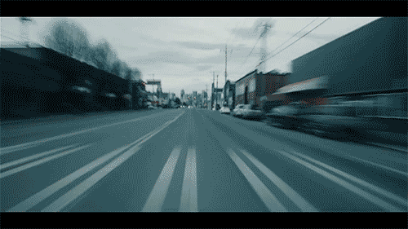
3. Trained EMS personnel will do triage, first aid / stabilizing care and decon before patient transport
Victims are likely to bypass on-site care
  directly to local hospitals
Implications
  Hospitals should not assume that victims will have been treated in the field
Notes:
Victims likely to bypass on site triage, first aid and econ

Slide 13
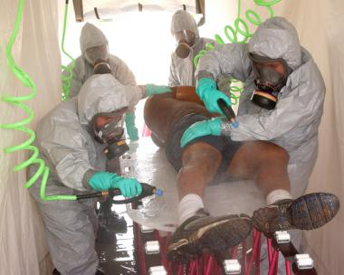
3. Trained EMS personnel will do triage, first aid / stabilizing care and decon before patient transport
Interventions
  Real-time instructions
    self-protection
    first aid
  Community Outreach
    CPR
    first aid

Slide 14

4. Casualties will be transported to hospitals by ambulance
Most arrive in non-ambulance
  private cars
  police vehicles
  buses/taxis
  walking
Implications
  little control over transport
  patient-tracking challenges
Notes:
Just said they will most likely bypass triage and therefore ambulances
Little control over transport time or destination for casualties
How will they arrive?

Slide 15

4.Casualties will be transported to hospitals by ambulance
Interventions
Public Education
      Precautions
Data Acquisition
  collect “after the fact”
    Hospitals
    EMS
Notes:
Precuations while transporting
Who should/shouldn’t be transported

Slide 16

5. Casualties will be transported to hospitals appropriate to their needs in such a manner that no hospital receives a disproportionate number
Interventions
  Have EMS bypass closest hospitals
Use “first wave” protocol
  divide initial casualties
Notes:
Aurora, farthest out first

Slide 17

6. Field authorities will promptly notify area hospitals about the numbers, types and severities of casualties
Initial notification from
  arriving victims
  media
Implications
  Initial response depend on in-house resources
  Time consumption are not practical
    PPE
    Tent set up
Notes:
Rather than from the field

Slide 18

6. Field authorities will promptly notify area hospitals about the numbers, types and severities of casualties to be transported
Interventions
  initial response on in-house resources
  authority to activate EOP
Plan for expedient decon causalities
  Fire hoses
  “Rapid Decon”
Notes:
Any one can activate EOP

Slide 19
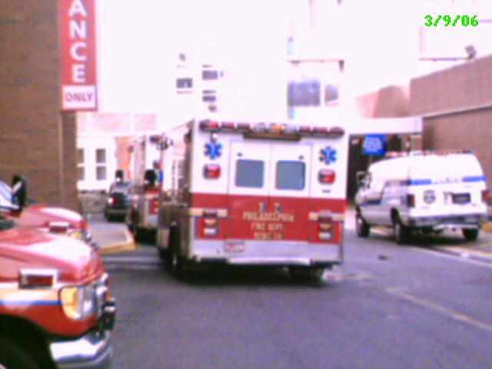
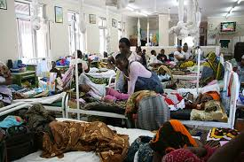

7. The most serious casualties will be the first to be transported hospitals
The least serious casualties often arrive first
Implication
  Beds filled
Notes:
Beds filled with less serious

Slide 20

7. The most serious casualties will be the first to be transported hospitals
Intervention
  Field to communicate casualty information
  Hospitals hold open beds
Proper Triage
Transport Less injured to FARTHER away hospitals

Slide 21
Assumptions
Dispatchers will hear of the disaster and send emergency response units to the scene
  Self dispatch
2. Trained emergency personnel will carry out field search and rescue
  Survivors
3. Trained EMS personnel will do triage, first aid / stabilizing care and decon before patient transport
  Self transport
4. Casualties will be transported to hospitals by ambulance
  Self transport

Slide 22
Assumptions
5. Casualties will be transported to hospitals appropriate to their needs and in such a manner that no hospital receives a disproportionate number
closer hospitals get the most and least severe
6. Field authorities will promptly notify area hospitals about the numbers, types and severities of casualties to be transported
unreasonable if self transport
7. The most serious casualties will be the first to be transported hospitals
maybe by EMS, but most will self transport

Slide 23
Disaster Education Myths
People need to know “special things” for disasters
  Common Sense
We are smart; hearing it once is enough
  Repetition is the key to adult learning
A drill now and then is enough
  Repetition is the key to adult learning
The government will take care of it
  Katrina
It is impossible to be prepared
  Repetition is the key to adult learning
The Myths of Disaster Education, Burstein, ,Annals of Emerg Med, January 2006

Slide 24

Questions
erswatdoc@gmail.com

