Slide 1
Management of the Emergent Airway
Josh Bucher, MD

Slide 2
Objectives
Appreciate the pertinent airway anatomy
To
Perform basic airway maneuvers
Perform surgical cricothyroidotomy
Advanced airway techniques
Some slides are from Reuben Strayer’s Lecture from Mount Sinai

Slide 3
Disclosures
I will say almost anything if you pay me to

Slide 4
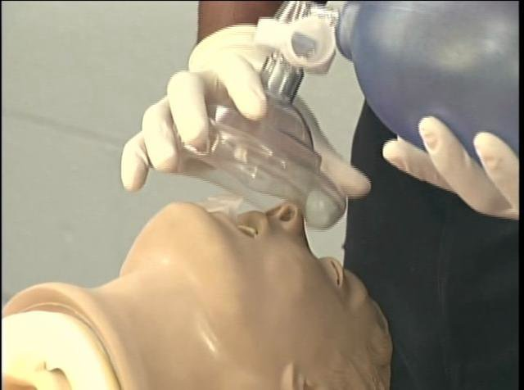
What is the problem here?
http://vimeo.com/56704003
Notes:
bvm is not on his face
this is what happens when respiratory bags

Slide 5
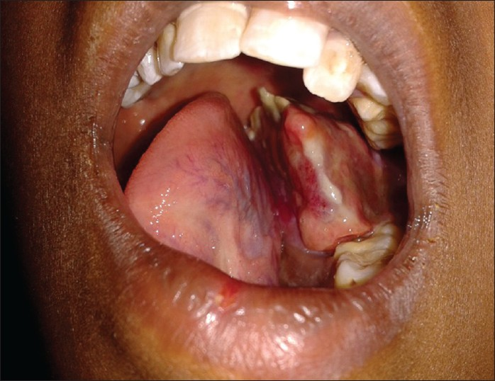
Notes:
any problems here?

Slide 7
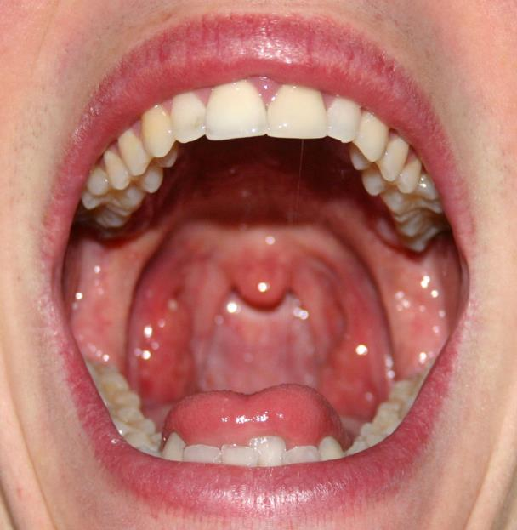

Slide 8
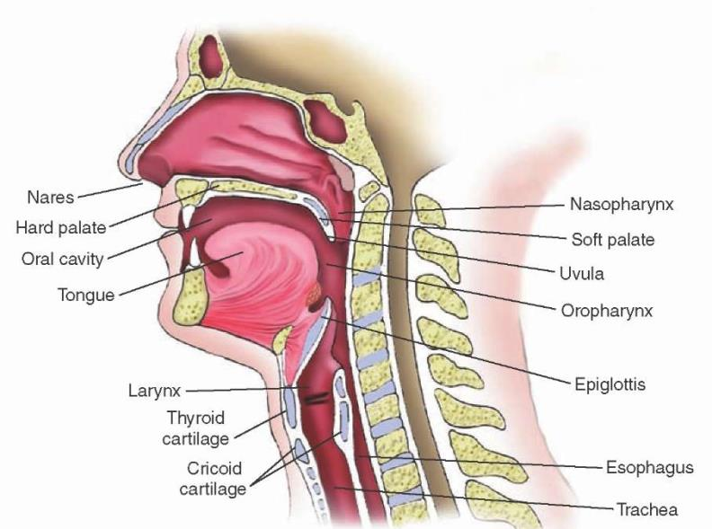

Slide 9
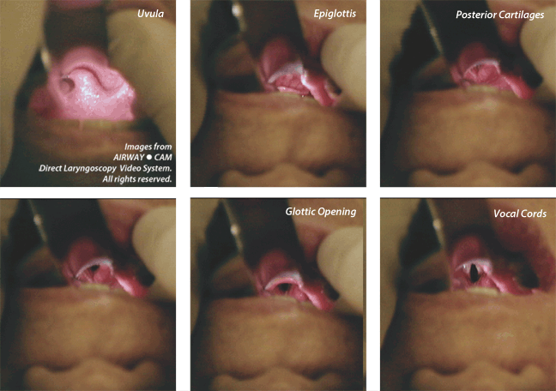
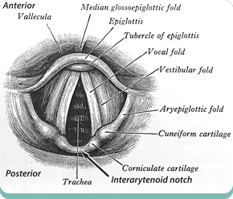

Slide 10
Ventilation
not
Intubation

Slide 11
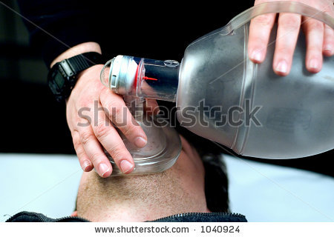
Notes:
is a one handed seal good?

Slide 12
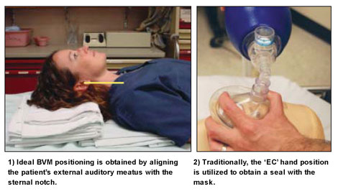
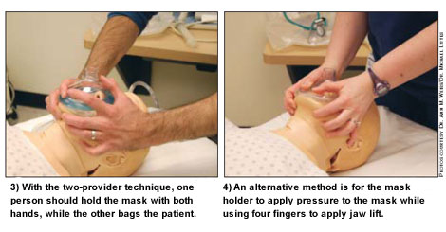
http://www.acep.org/Clinical---Practice-Management/Focus-On---Bag-Valve-Mask-Ventilation/

Slide 13
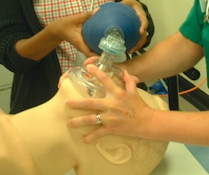
http://www.outsidetheprotocols.com/2012_06_01_archive.html
Notes:
2 handed seal. this is much more efficient. dont forget.

Slide 14
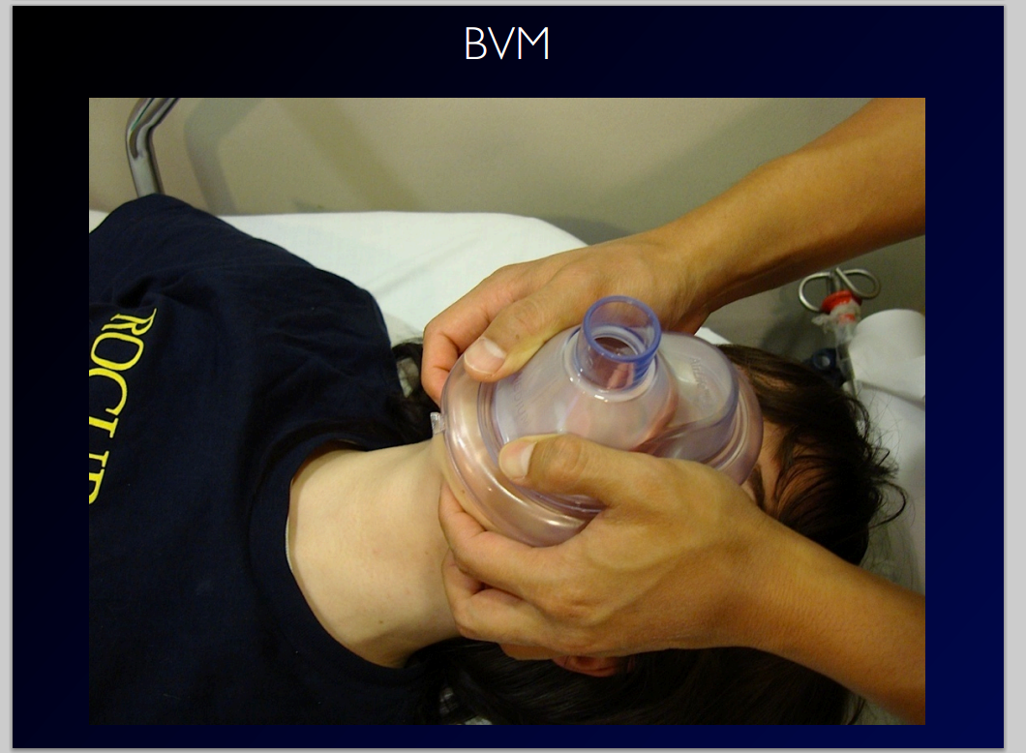

Slide 15
Can other people ventilate?
Nursing
Respiratory
CCTs
Medical Student
Pharmacy Student
Pre-med volunteer
Notes:
yes other people can ventiulate.
how frequently? 1 every 6 seconds
how much in a bvm? 1 L
how much squeeze? until chest rise.
what if more - you get gastric insufflation

Slide 16
Basic Airway Maneuvers
Head tilt-chin lift
Jaw thrust
Oropharyngeal
Nasopharyngeal airways
Positioning

Slide 17
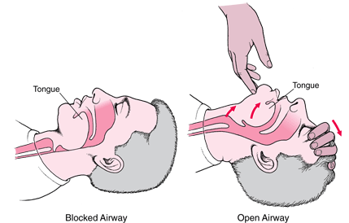
From merck manual
Notes:
this explains it all/
what about babies?
hyperextension actually closes the airway

Slide 18
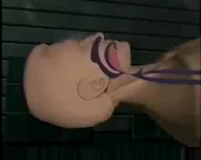

Slide 19
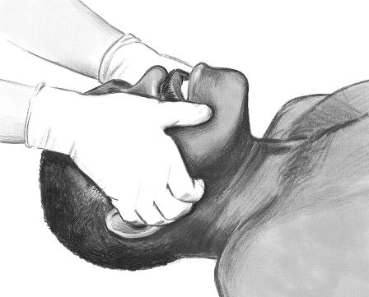
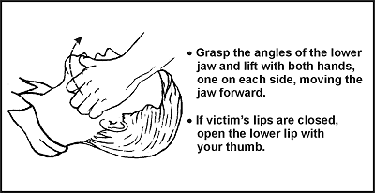
Jaw-Thrust
Maneuver
http://circ.ahajournals.org/content/102/suppl_1/I-22.figures-only

Slide 20
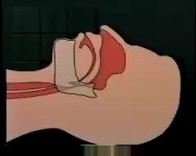

Slide 21
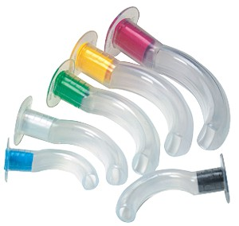
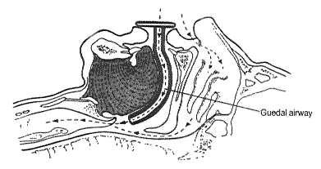
Oropharyngeal Airway
http://www.simulaids.com/sb35197.htm
http://www.dr-green.co.uk/teaching%20topics/Chapter%209%20Airway%20drips%20and%20ECG.htm

Slide 22
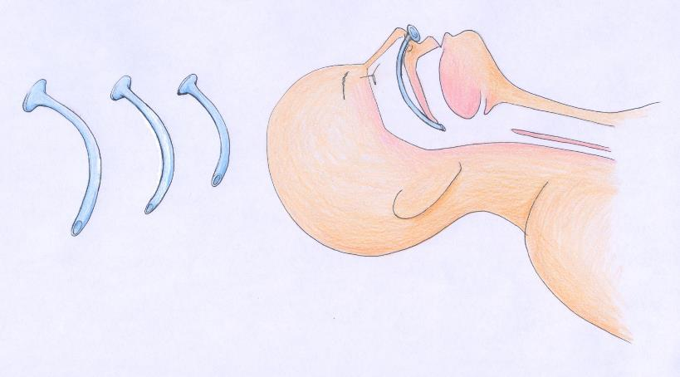
Nasopharyngeal Airway
http://www.aic.cuhk.edu.hk/web8/Nasopharyngeal%20airway.htm

Slide 23
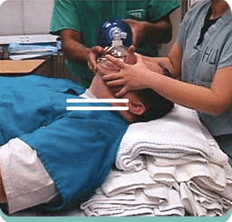
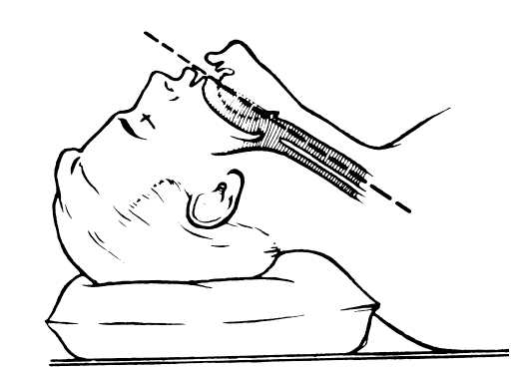
Sniffing Position
http://www.outsidetheprotocols.com/2012_06_01_archive.html

Slide 24
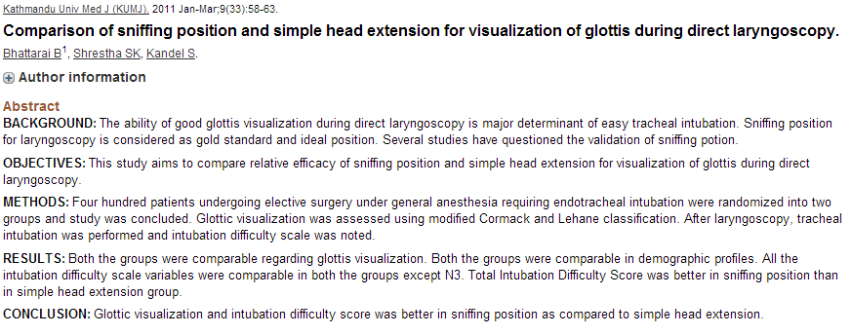
Notes:
1st study and 2nd study both report that anesthesiologists found sniffing position is superior to head extension for both view and passing of an ET tube.

Slide 25
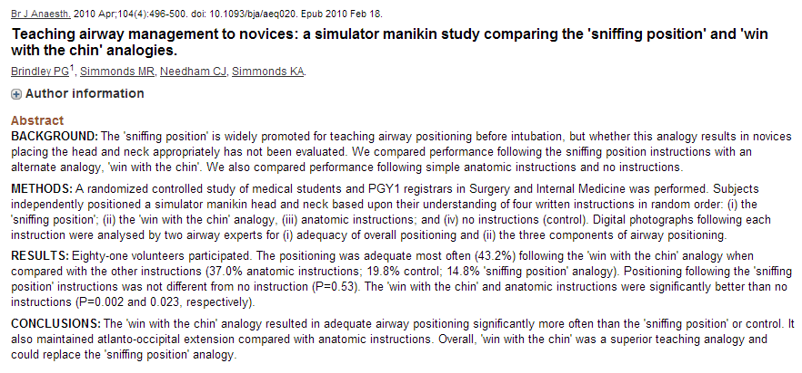
Notes:
head tild chin lift > sniffing. also maintained atlanto-occiptal extension. mannikin study.

Slide 26
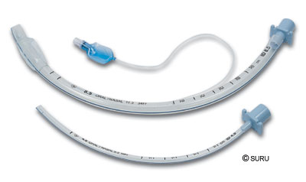
Endotracheal Intubation

Slide 27
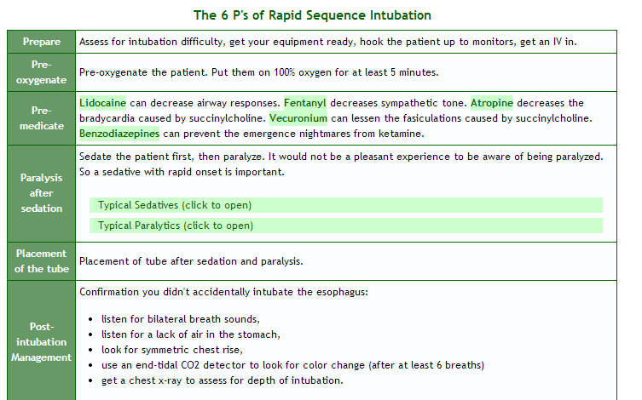
Notes:
How do we prepare to intubate?

Slide 28
Can we predict difficulty with ventilation?
http://crashingpatient.com/wp-content/images/part1/mandible.jpg
Notes:
Have you heard about this? I hadnt prior to doing this talk. Essentially if you are in class C, it predicts difficulty. Why? Harder to ventilated bc of seal and harder to intubate bc of airway being anterior and limited jaw mobility.

Slide 29
The mandibular protrusion test may be an essential element of the airway examination. (Anesthesiology 105(5), November 2006, pp 885-891)
Beard
Obesity
No teeth
> 55 yrs of age
Snoring
Mallampati III or IV
Limited jaw protrusion
Thyromental distance < 6cm
Limited neck mobility
Notes:
Other predictors of difficulty with ventilation

Slide 31
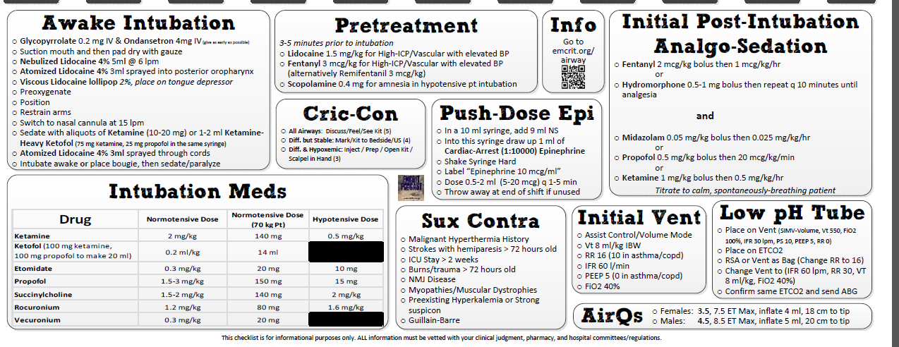

Slide 32
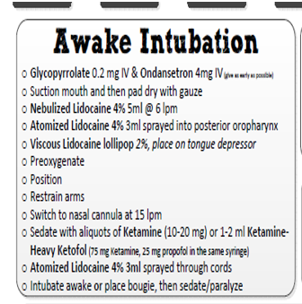
Awake?
Who?
When?
Notes:
Steps for awake?
Dry secretions
Suction secretions
Lidocaine neb
Atomized lidocaine
Viscous lido on a tongue depressor and gauze
Light sedation
Access trachea then give sedation and paralysis

Slide 33
Notes:
Very quick and easy to use
Always prepare for failure
Ventilation is more important
EARLY CRIC – DO NOT WAIT UNTIL THEY ARE HYPOXIC AND ARRESTED

Slide 34
Notes:
After HR of 120, we lose fine motor management.
We should never let it get to the end of here.

Slide 35
(Lee BJ, Kang JM, Kim DO (2007) Laryngeal exposure during laryngoscopy is better in the 25 degrees back-up position than in the supine position. Br J Anaesth 99:581586)
Notes:
Some advanced tips.
Ear to sternal notch helps to align the airway axis.
That is why I elevate the head of the bed to 15 – 20 degrees when I intubate – look at the reference.

Slide 36
Notes:
1. grade 3 views. assitant did cricoud + lifted the head. improved the view in 19/21 patients to a better view. may be necessary
2. again, another study, on cadavers by levitan and hollander. laryngoscopy plus head elevation and neck flexion with the laryngoscopy angle. increasing head elevation improved the pogo (percentage of glottic opening) score soignificantly for all cadaver models involved.

Slide 37
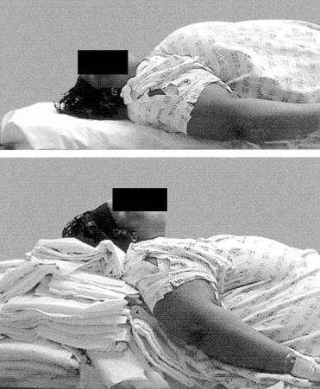
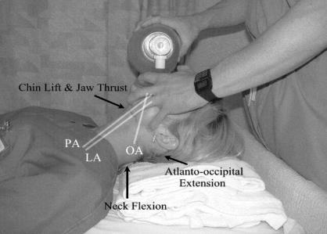
http://crashingpatient.com/resuscitation/airway/airway.htm/
Notes:
All of these are in sniffing position
All of these axes need to be in alignment in order to obtain good laryngoscopic view
Look at the woman in the middle. Looks like an airway disaster. But if you align the axes, it is not as difficult.

Slide 38
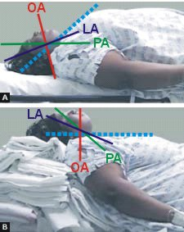
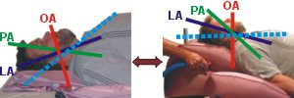
Notes:
There are the axes in alignment

Slide 39
Notes:
Why? Bc tube should be advanced from the right side of the mouth

Slide 40
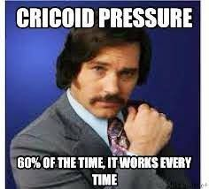
What about cricoid pressure??????

Slide 41
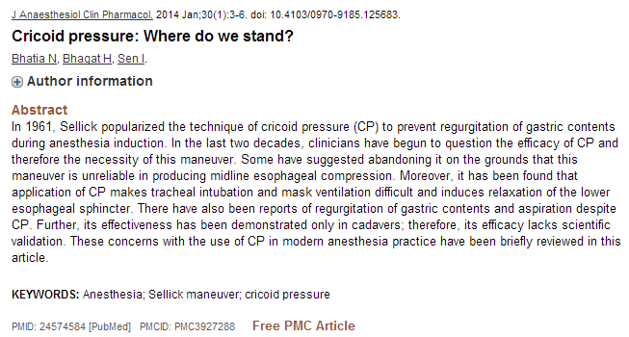
Notes:
It is only theoretical. Cadaver studies.
Human studies have not borne out.

Slide 42
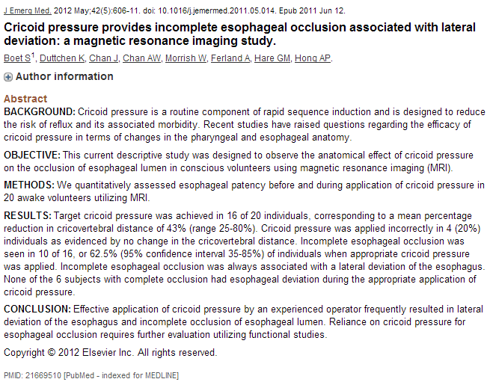
Notes:
MRI study
20 awake patients
Cricoid pressure applied by a person
20% incorrect applied
Results in lateral deviation of esophagus and incomplete occlusion
Needs more studies
But on humans! Alive!

Slide 43
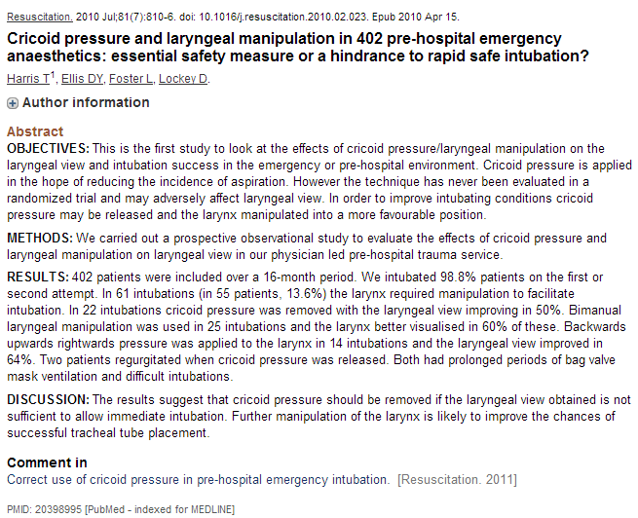
Notes:
402 patients intubated. 2 regurg after long BVM and difficult intubation.
Bottom line – remove cricoid if you have a bad view and use BURP/bimanual manipulation

Slide 44
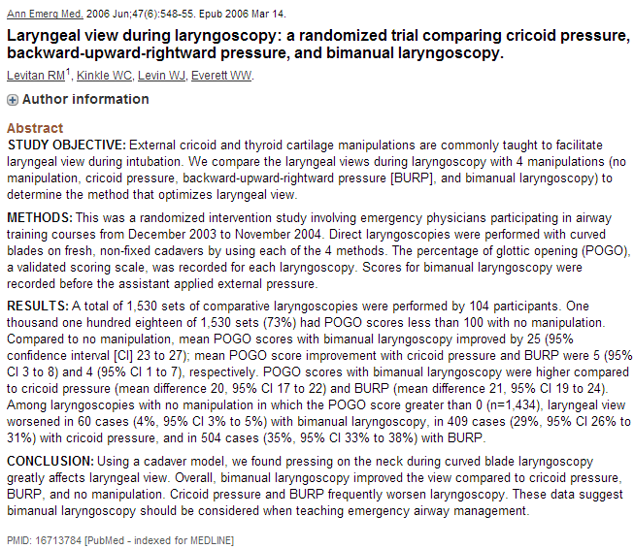
Notes:
Bimanual > none > BURP > cricoid

Slide 45
Notes:
BURP maneuver – backward, upward, rightward pressure
Or bimanual laryngeal manipulation – use your hand and then have someone hold it there.

Slide 46
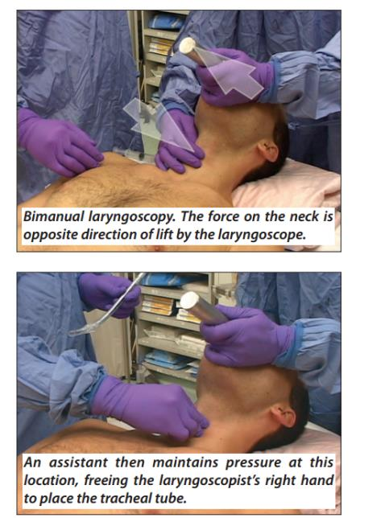
The AIRWAY•CAM
Pocket Guide to Intubation
Richard M. Levitan, MD
Notes:
Another example of bimanual laryngoscopy.

Slide 47
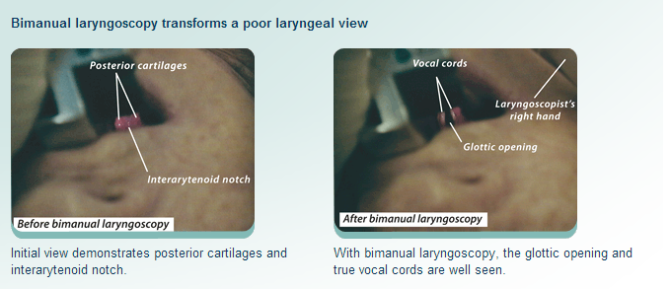
The AIRWAY•CAM
Pocket Guide to Intubation
Richard M. Levitan, MD
Notes:
This brings the cords into view.
I will not talk about cricoid pressure.
The citation - Bimunal is better. Use on individual basis. If not needed, don’t do.

Slide 49
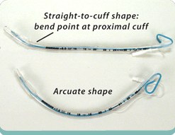
Straight to cuff with 35 degree bend probably is best (ACADEMIC EMERGENCY MEDICINE2006;13:12551258
Notes:
Straight to cuff gets the bend required to intubate anterior airways

Slide 50
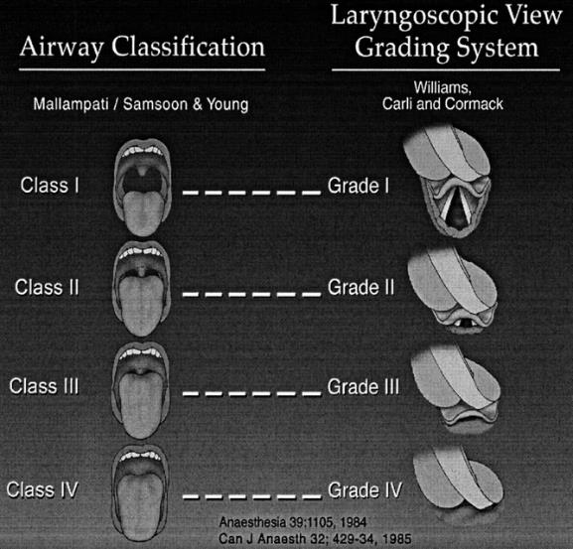
http://crashingpatient.com/wp-content/images/part1/mallamclehane.jpg
Notes:
The malampati scoring is related to intubation conditions.
If you are class iv – what do you want to prepare?

Slide 51
Contraindications to roc?
Notes:
What paralyzing agent?
I would add risk of hyperkalemia to existing hyperkalemia
Maybe esrd

Slide 52
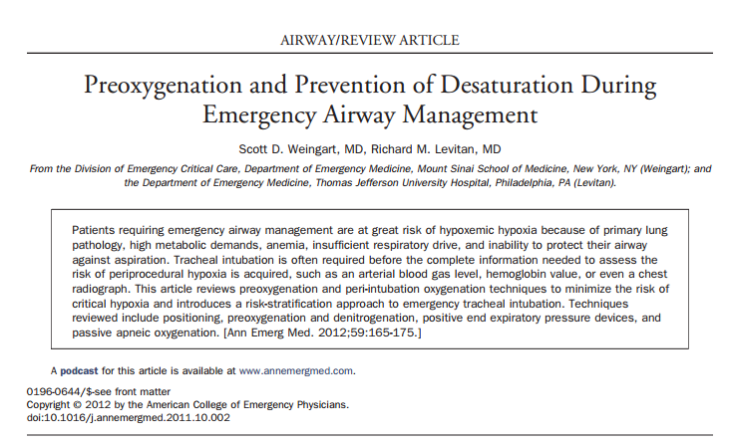

Slide 53
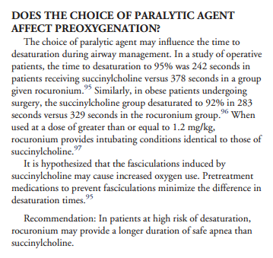
Weingart S. Preoxygenation and Prevention of Desaturation During Emergency Airway Management
Notes:
Rocuronium – without defasciculation – less desaturation!!

Slide 54
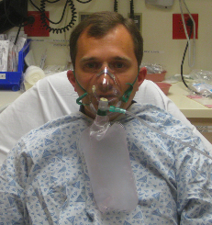
Preoxygenation?

Slide 55
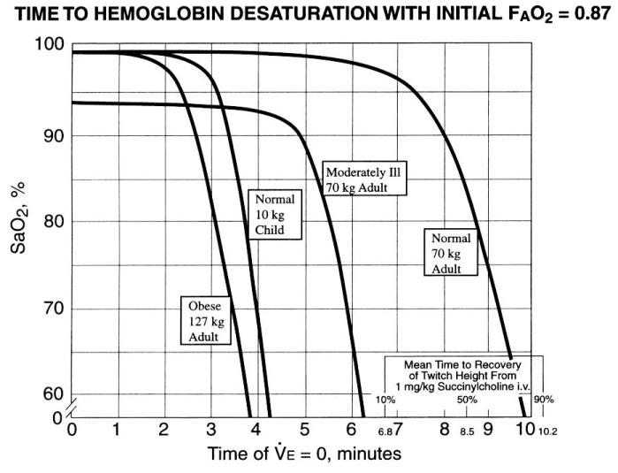
http://crashingpatient.com/resuscitation/airway/airway.htm/
Notes:
How many minutes it takes for desaturation? Depends on their saturation and initation of paralysis.

Slide 56
Notes:
Essentially if you use succhinylcholine if you are afraid of not being able to ventilate, you shouldn’t be. They will die anyway before sux wears off.

Slide 57
Is NRB the best?
Patient breathing adequately?
NRB at 15 lpm?
70 – 80%
Much longer time to desat in the obese if you preoxygenate in sitting position (British Journal of Anaesthesia 2005 95(5):706-709)
Notes:
Maybe all patients should be upright for preoxygenation

Slide 58
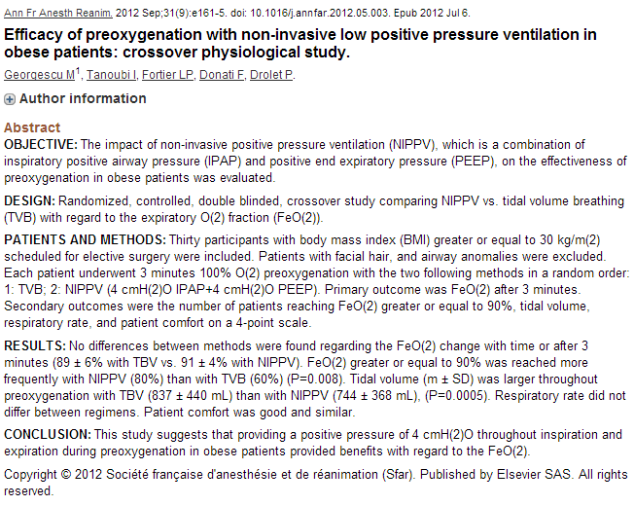
Notes:
Obesewith cpap vs nrb. Higher FE02 = higher Pao2 by association.
Assumption that longer period of time before deoxygenation and desaturation

Slide 60
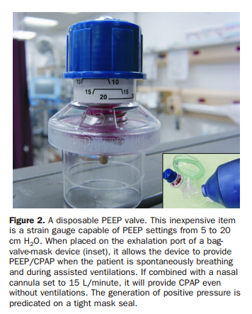

Slide 61
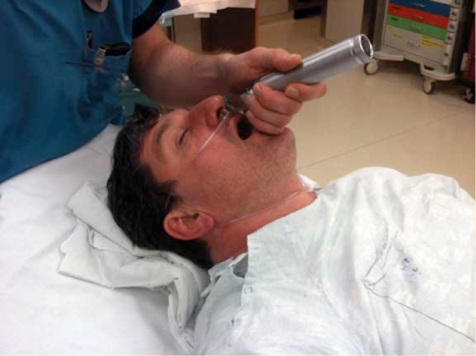
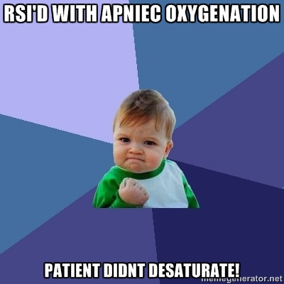

Slide 63
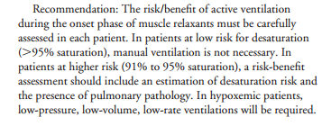
= DON’T BAG (MOSTLY)
Notes:
Do we need to bag everyone? The answer is no. Only if needed.

Slide 64
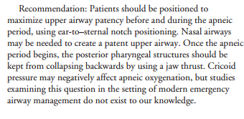
Notes:
Cricoid still sucks.
Do a jaw thrust and head tilt.

Slide 65
Notes:
Prevented critical desaturation.
There are more
If no shunt = best based on most recent literature

Slide 66
Notes:
ROC ROCKS SUX SUCKS.

Slide 69
Can’t Intubate/Can’t Ventilate or three failed attempts
Best Attempt Definition:
Performed by a reasonably experienced laryngoscopist
No significant muscle tone
Use of optimal sniff position
Use of external laryngeal manipulation
One change in length of blade
One change in type of blade
http://crashingpatient.com/resuscitation/airway/airway.htm/

Slide 70
http://www.rushemergencymedicine.com/2011_site/index.php/lectures/show_lecture/airway_advanced
Notes:
Crash airway algorithim. Essentially all ends wtith quick intubation or cric.

Slide 71
[Stephens CT, Kahntroff S, Dutton RP. The success of emergency endotracheal intubation in trauma patients: a 10-year experience at a major adult trauma referral center. Anesth Analg. 2009 Sep;109(3):866-72.]

Slide 72
Something goes wrong…
Displaced tube
Obstruction
Pneumothorax
Equipment
Notes:
DOPE PNEUMONIC

Slide 73
The AIRWAY•CAM
Pocket Guide to Intubation
Richard M. Levitan, MD

Slide 74
Digital Intubation

Slide 75
LMA

Slide 76
ILMA

Slide 77
Cricothyrotomy

Slide 78
What do you need?

Slide 81
Notes:
The laryngeal handshake.

Slide 82
https://www.youtube.com/watch?v=I6wodB2S0uc

Slide 83
Joshua.T.Bucher@gmail.com

