Slide 1
Non-Invasive Respiratory Gas Monitoring
Bryan E. Bledsoe, DO, FACEP
The George Washington University Medical Center

Slide 2


Endorsements
This educational module has been endorsed by the following professional organizations:

Slide 3
Review Board
Roy Alson, MD, PhD, FACEP
James Augustine, MD, FACEP
Edward Dickinson, MD, FACEP
Marc Eckstein, MD, FACEP
Steven Katz, MD, FACEP
Mike McEvoy, PhD, RN, EMT-P
Joe A. Nelson, DO, MS, FACOEP, FACEP
Ed Racht, MD
Mike Richards, MD, FACEP
Keith Wesley, MD, FACEP
Paula Willoughby-DeJesus, DO, MHPE, FACOEP

Slide 4
RESPIRATORY GAS PHYSIOLOGY

Slide 5

Respiratory Gasses
Normal Atmospheric Gasses:
  Oxygen (O₂)
  Carbon Dioxide (CO₂)
  Nitrogen (N₂)
  Water Vapor (H₂O)
  Trace gasses:
    Argon (Ar)
    Neon (Ne)
    Helium (He)

Slide 6

Respiratory Gasses
Most important respiratory gasses:
  Oxygen (O₂)
  Carbon Dioxide (CO₂)

Slide 7
Respiratory Gasses
Respiratory gasses often represented based upon their partial pressures.
Dalton’s Law:
“The total pressure in a container is the sum of partial pressures of all gasses in the container.”

Slide 8
Respiratory Gasses
Determining partial pressures:
  P_{A} = X_{A} × P
    Where:
      P_{A} = pressure of the gas
      X_{A} = mole fraction of the gas
      P = total pressure of the mixture
  PO₂ = 0.2095 × 760 mm Hg
  PO₂ = 159.22 mm Hg
  Partial pressure of oxygen in atmosphere at sea level = 159 mm Hg

Slide 9
Atmospheric Gasses
GAS† | PRESSURE (mm Hg) | PERCENTAGE (%)
Nitrogen (N₂) | 593.408 | 78.08
Oxygen (O₂) | 159.220 | 20.95
Argon (Ar) | 7.144 | 0.94
Carbon Dioxide (CO₂) | 0.288 | 0.03
Neon (Ne) | 0.013 | 0.0018
Helium (He) | 0.003 | 0.0005
TOTAL | 760 | 100
† = dry air at sea level.

Slide 10
Respiratory Gasses
GAS | Atmospheric Air (mm Hg) | % | Humidified Air (mm Hg) | % | Alveolar Air (mm Hg) | % | Expired Air (mm Hg) | %
N₂ | 597.0 | 78.6 | 563.4 | 74.0 | 569.0 | 74.9 | 566.0 | 74.5
O₂ | 159.0 | 20.8 | 149.3 | 19.7 | 104.0 | 13.6 | 120.0 | 15.7
CO₂ | 0.3 | 0.04 | 0.3 | 0.04 | 40.0 | 5.3 | 27.0 | 3.6
H₂O | 3.7 | 0.50 | 47.0 | 6.20 | 47.0 | 6.2 | 47.0 | 6.2
TOTAL | 760 | 100 | 760 | 100 | 760 | 100 | 760 | 100

Slide 11
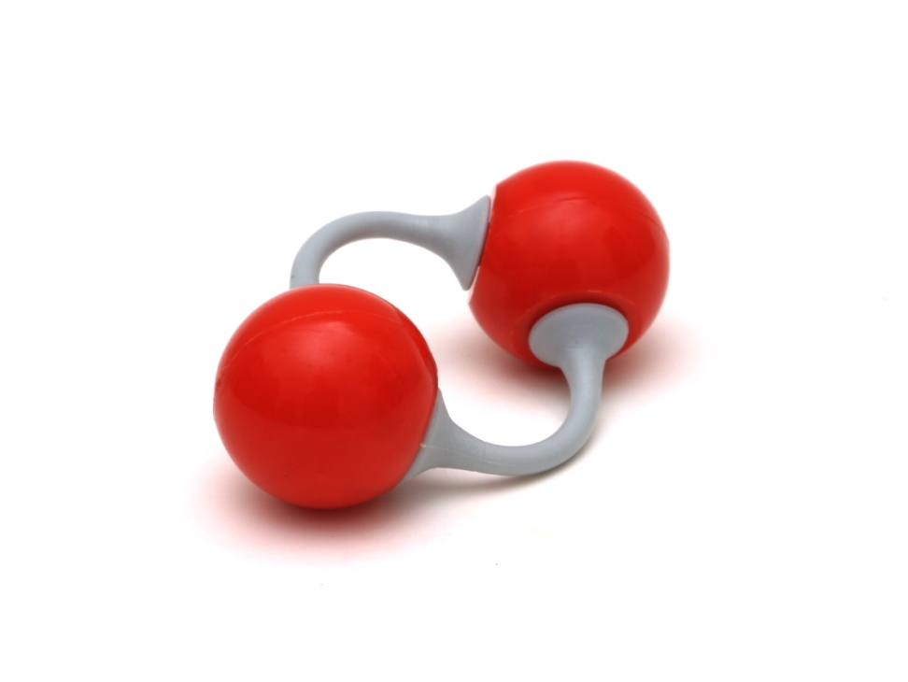
Oxygen
Odorless.
Tasteless.
Colorless.
Supports combustion.
Present in the atmosphere as a diatomic gas (O₂).
Necessary for animal life.

Slide 12
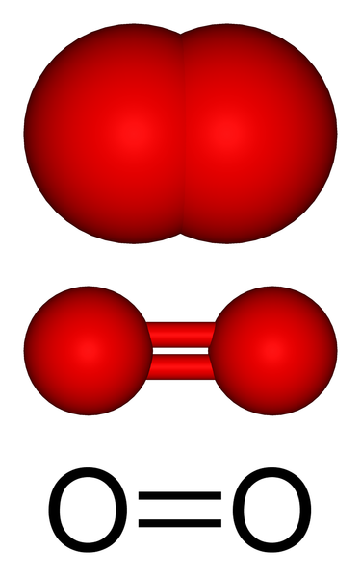
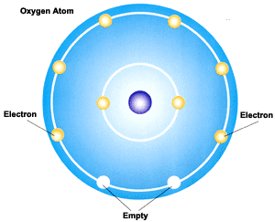
Oxygen
Derived from plant photosynthesis:
  Algae (75%).
  Terrestrial Plants (25%).
Oxygen atom must share electrons for stability.

Slide 13
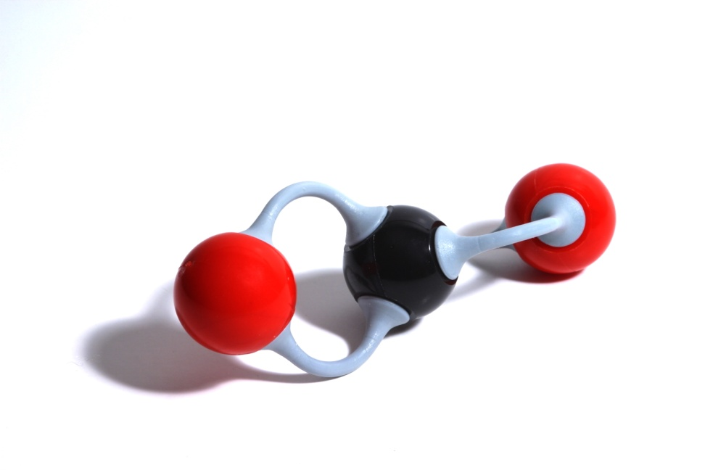
Carbon Dioxide
Colorless.
Sour taste at high concentrations.
Found in very low concentrations in fresh air.
Asphyxiant.

Slide 14
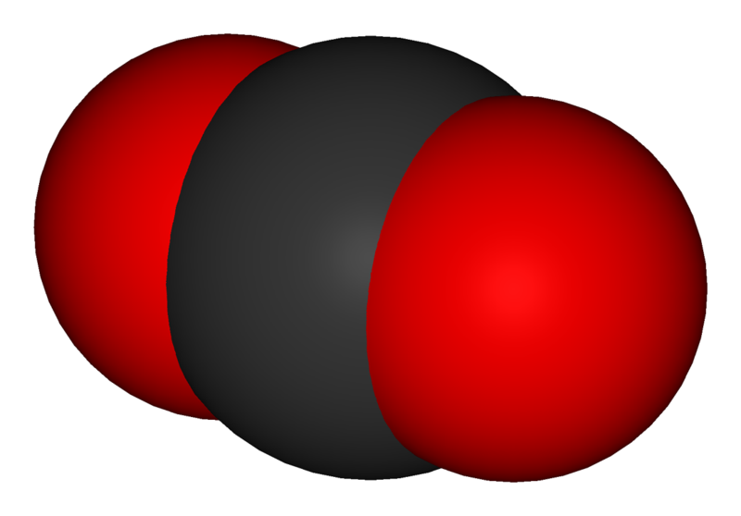
Carbon Dioxide
Waste product of animal life (carbohydrate and fat metabolism).
Contains 2 atoms of oxygen and 1 atom of carbon.

Slide 15
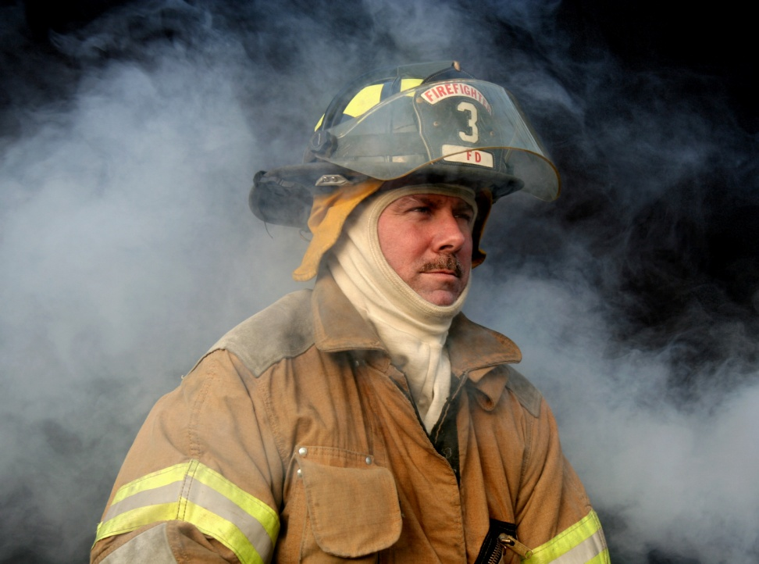
Abnormal Respiratory Gasses
Carbon monoxide (CO)

Slide 16
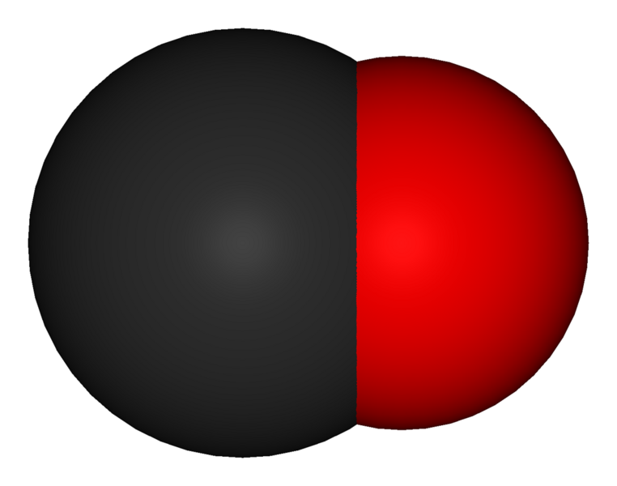
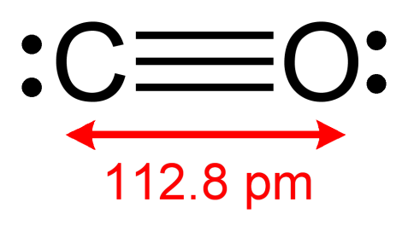
Carbon Monoxide
Colorless
Odorless
Tasteless
Results from incomplete combustion of carbon-containing compounds.
Heavier than air.

Slide 17
Respiratory Gas Transport
Oxygen
  97% reversibly bound to hemoglobin.
  3% dissolved in plasma.
Carbon Dioxide
  70% as bicarbonate (HCO₃⁻).
  23% reversibly bound to hemoglobin.
  7% dissolved in plasma.

Slide 18
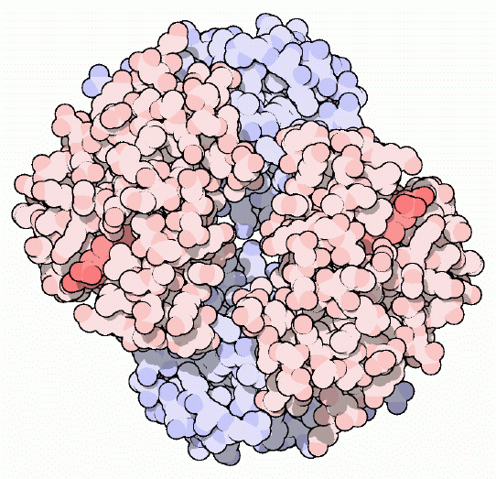
Hemoglobin
Protein-Iron Complex.
Transports oxygen to peripheral tissues.
Removes a limited amount of carbon dioxide from the peripheral tissues.

Slide 19
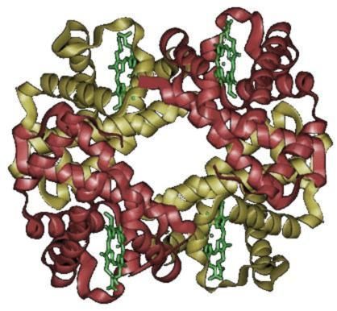
Hemoglobin
Human hemoglobin is made of various sub-units:
  2 α sub-units
  2 β sub-units
  4 iron-containing heme structures.

Slide 20
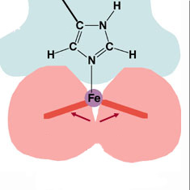
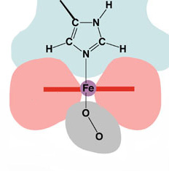
Hemoglobin Binding Sites
Deoxyhemoglobin
Oxyhemoglobin
Heme is in Fe²⁺ state and domed. Can bind oxygen. Also called the “T” state.
Heme is in Fe³⁺ state and planar. Oxygen bound. Also called the “R” state.

Slide 21
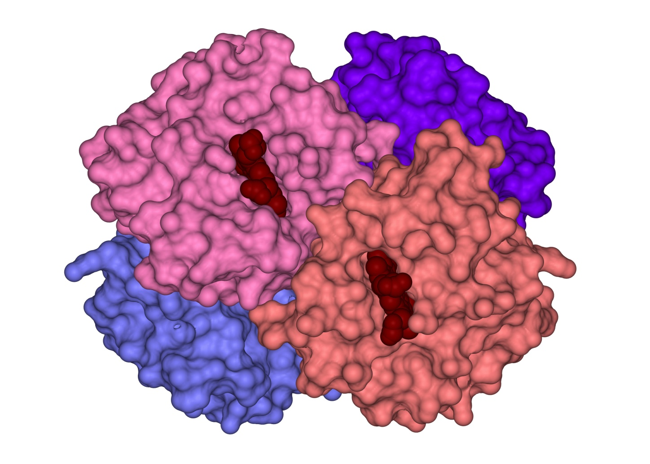
Hemoglobin Binding Sites

Slide 22
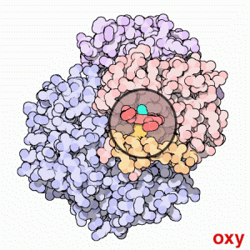
Hemoglobin
The binding of oxygen changes the conformation (shape) of the hemoglobin molecule.
Deoxyhemoglobin is converted to oxyhemoglobin.

Slide 23
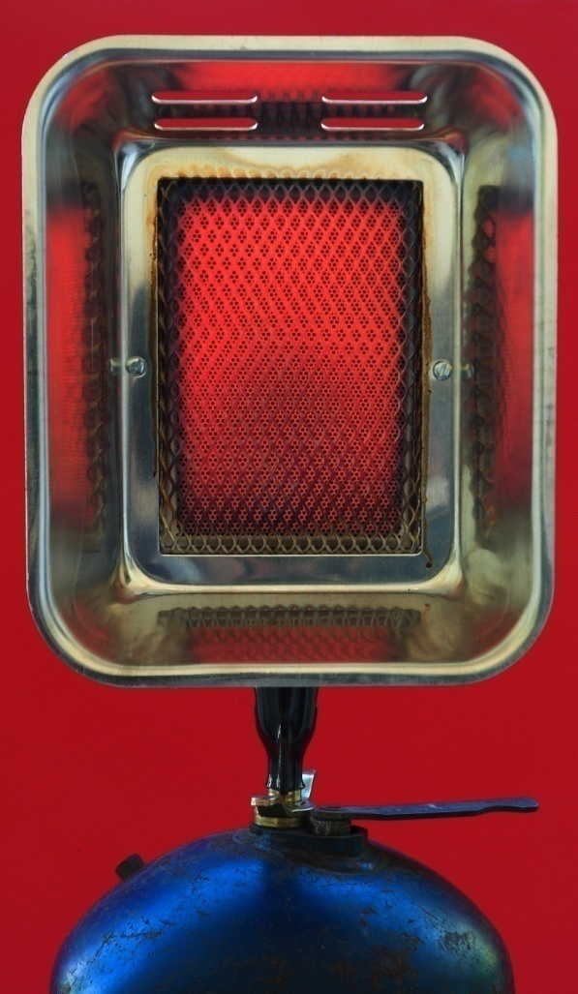
Abnormal Hemoglobin States
Carboxyhemoglobin
Methemoglobin

Slide 24
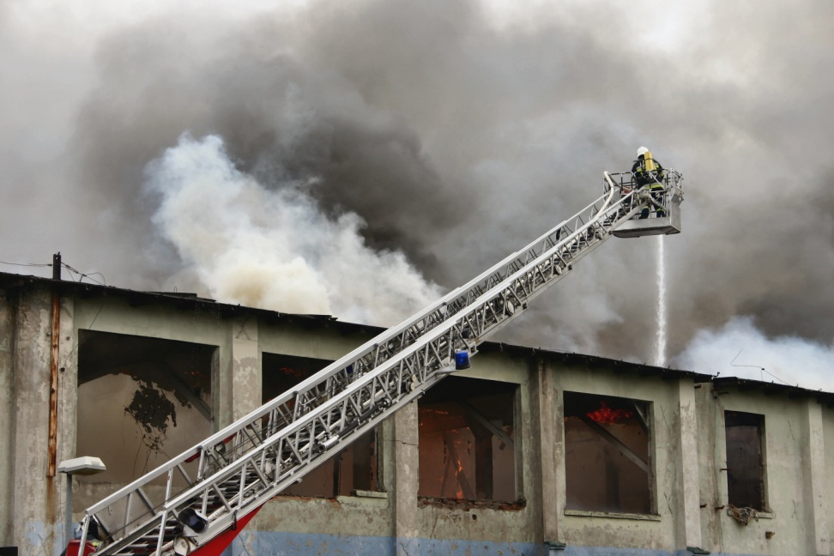
Carboxyhemoglobin (COHb)
Results from the binding of CO to hemoglobin following CO exposure.
Some always present in smokers.

Slide 25
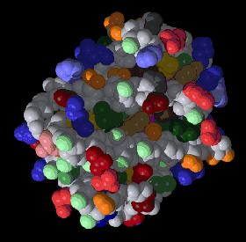
Carboxyhemoglobin (COHb)
CO has 250 times the affinity for hemoglobin as does O₂.
CO displaces O₂ from hemoglobin.
CO can be displaced by high-concentration O₂.
Half-life is 4-6 hours.

Slide 26
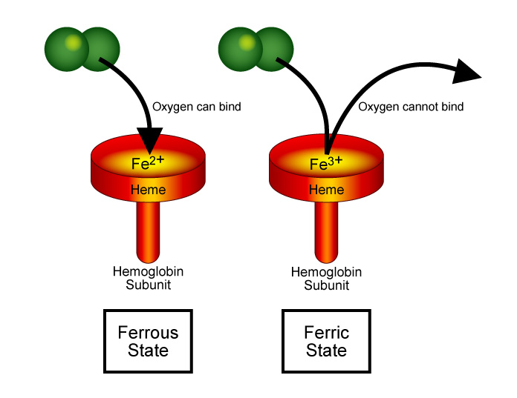
Methemoglobin
Heme must be in the ferrous (Fe²⁺) state to bind O₂.
Methemoglobin is hemoglobin in the ferric (Fe³⁺) state and cannot bind O₂.
Normally < 1% of hemoglobin is methemoglobin.
High levels lead to hypoxemia.

Slide 27
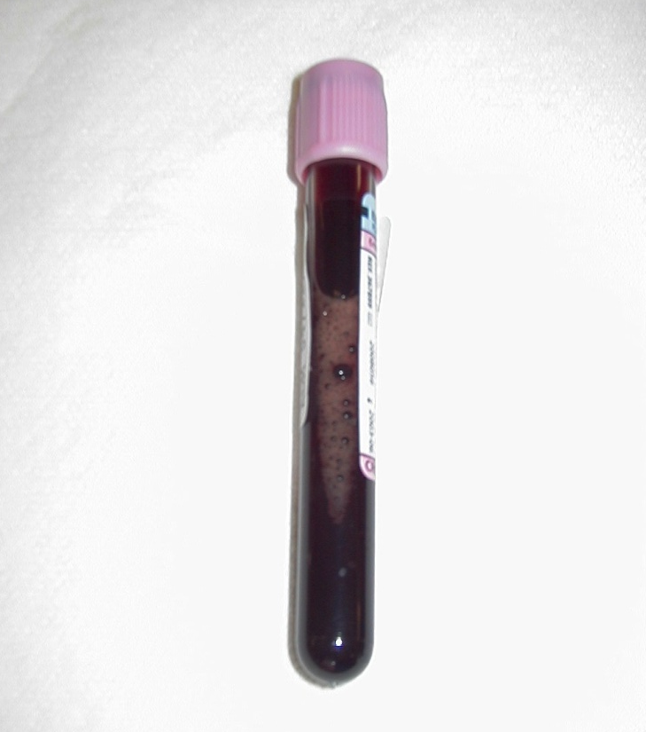
Methemoglobin
Hereditary:
  Hemoglobin M
  Enzyme deficiency
Acquired:
  Nitrates
  Nitrites
  Dyes
  Sulfonamides
  Lidocaine
  Benzocaine

Slide 28
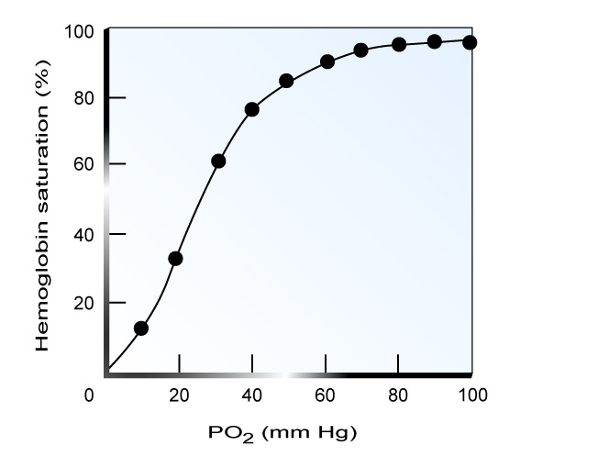
Oxygen Saturation
Hemoglobin oxygen saturation is directly related to the partial pressure of oxygen in the blood (PO₂).
Venous blood saturation.
Arterial blood saturation.

Slide 29
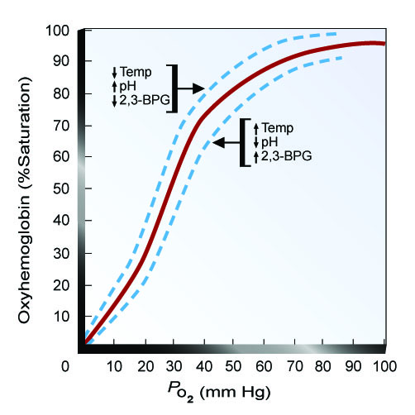
Factors Affecting Saturation
Decreased saturation.
  Decreased pH (acidosis).
  Increased CO₂.
  Increased temperature.
  Increased BPG (2,3-biphosphoglycerate)
Increased saturation.
  Increased pH (alkalosis)
  Decreased CO₂.
  Decreased temperature.
  Decreased BPG (2,3-biphosphoglycerate)

Slide 30
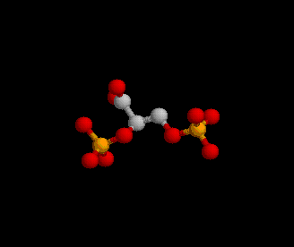
2,3-biphosphoglycerate
Aids in oxygen release in the peripheral tissues.
Higher levels found in people who live at high altitudes.
Helps mitigate the effects of hypoxia.

Slide 31
Carbon Dioxide Transport
Majority of CO₂ transported in the form of bicarbonate ion (HCO₃⁻).
CO₂ + H₂O → H₂CO₃ → H⁺ + HCO₃⁻
Carbonic Anhydrase increases speed of reaction 5,000 fold.

Slide 32
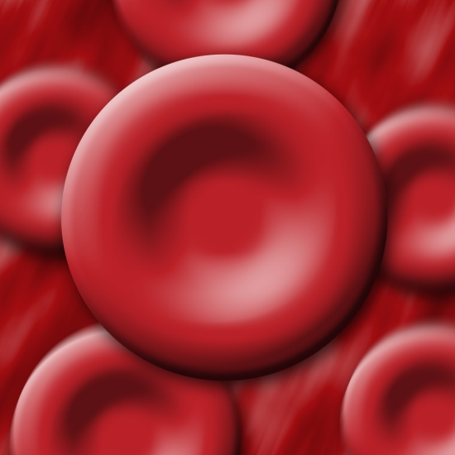
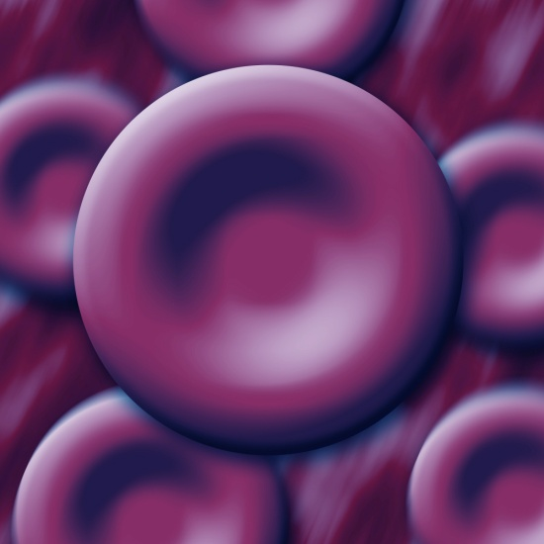
Carbon Dioxide Transport
Some CO₂ is transported on hemoglobin.
Binds to a different site than O₂ (binds to an amino acid).
Resultant compound is called carbaminohemoglobin (CO₂Hb).

Slide 33
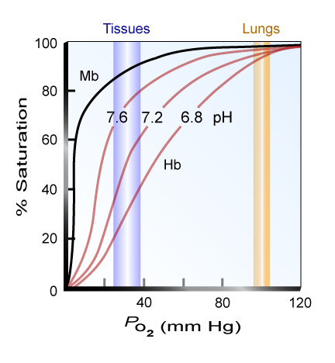
Bohr Effect
Increases in CO₂ levels in the blood cause oxygen to be displaced from hemoglobin.
Increases oxygen transport.

Slide 34
Haldane Effect
Binding of oxygen to hemoglobin tends to displace CO₂.
Oxyhemoglobin is more acidic than deoxyhemoglobin:
  Promotes removal of CO₂ in the alveoli.
  Promotes release of hydrogen ions which combine with bicarbonate ions to form H₂O and CO₂ which are eliminated.

Slide 35
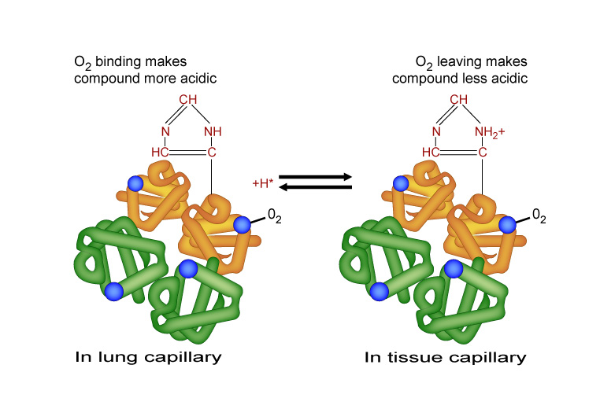
Haldane Effect

Slide 36
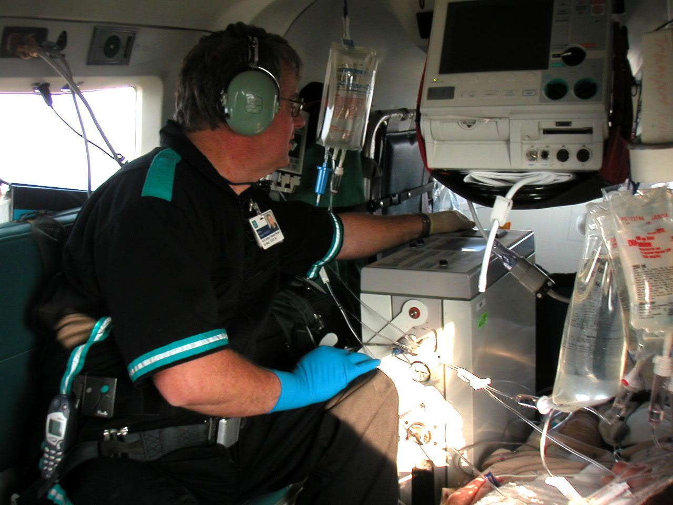
Respiratory Gas Measurement
Arterial Blood Gas Sampling
Pulse Oximetry
Capnography
Transcutaneous CO₂ Monitoring

Slide 37
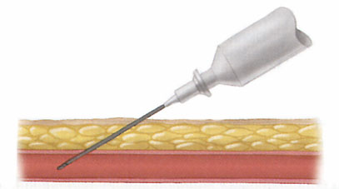
Arterial Blood Gasses
Gold standard for respiratory gas monitoring.
Invasive
Expensive
Painful
Difficult

Slide 38
Arterial Blood Gasses
Excellent diagnostic tool.
Impractical in the prehospital setting.
Parameter | Normal
pH | 7.35-7.45
PO₂ | 80-100 mm Hg
PCO₂ | 35-45 mm Hg
HCO₃⁻ | 22-26 mmol/L
BE | -2 - +2
SaO₂ | > 95%

Slide 39
OXYGEN

Slide 40
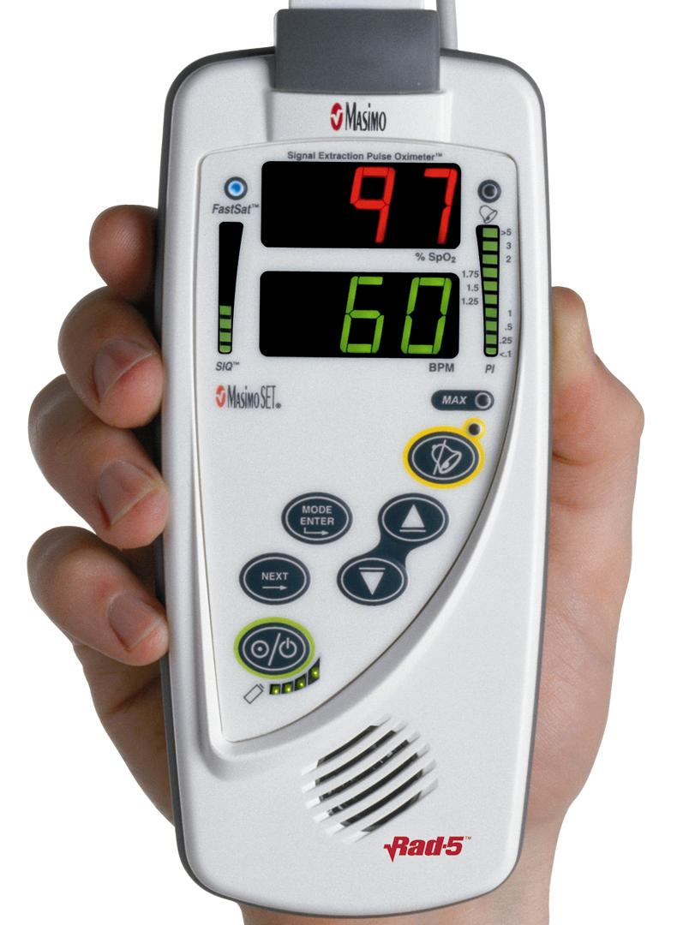
Pulse Oximetry
Introduced in early 1980s.
Non-invasive measurement of oxygen saturation.
Safe
Inexpensive

Slide 41
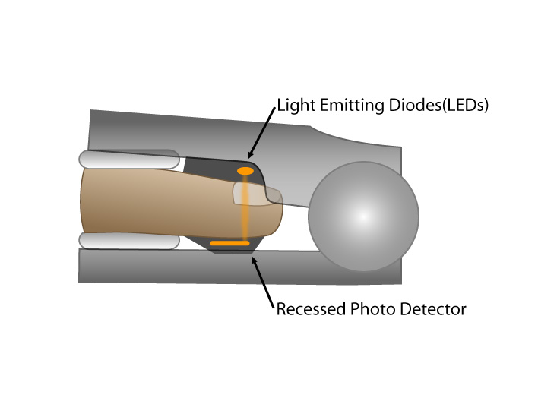
Pulse Oximetry
How it works:
  Probe is placed over a vascular bed (finger, earlobe).
  Light-emitting diodes (LEDs) emit light of two different wavelengths:
    Red = 660 nm
    Infrared = 940 nm

Slide 42
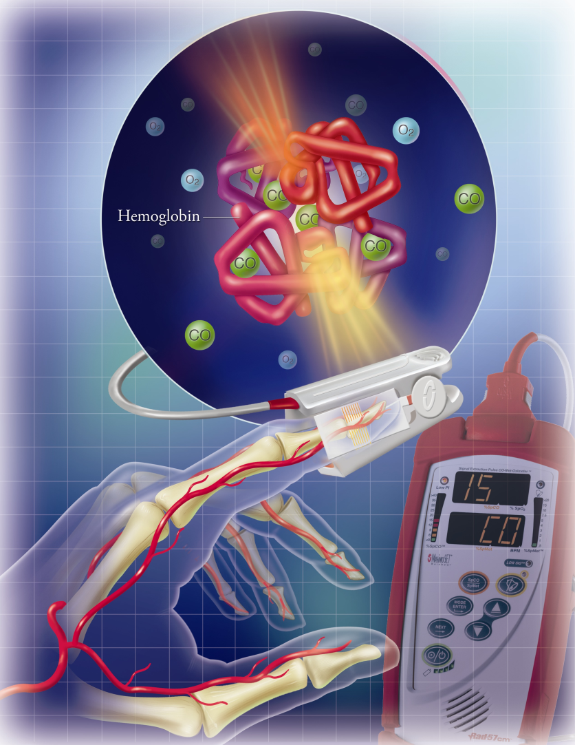
Pulse Oximetry
Some light is absorbed by:
  Arterial blood
  Venous blood
  Tissues
Light that passes through the tissues is detected by a photodetector.
© Brook Wainwright

Slide 43
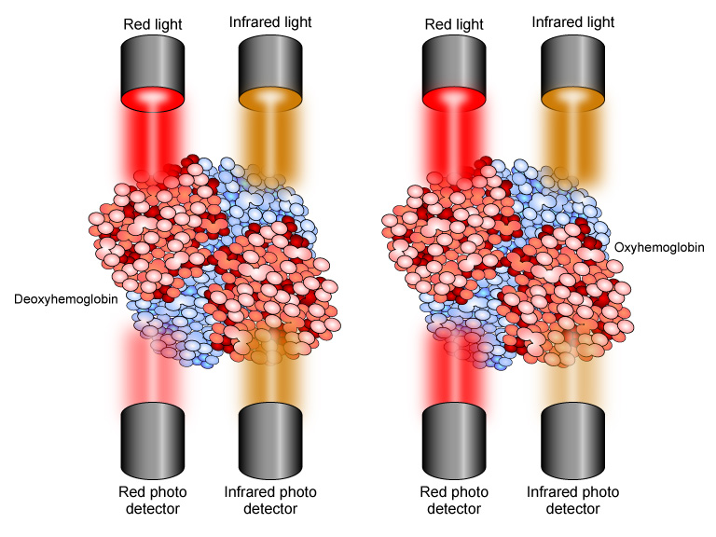

Slide 44
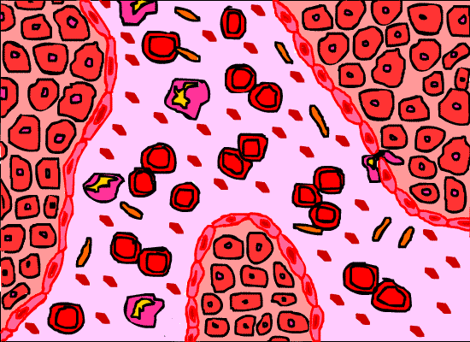
Pulse Oximetry
Only inflow of blood is used to determine SpO₂.
Hence the name “Pulse Oximetry”
Hb and HbO₂ absorb light and different rates due to color and conformation.

Slide 45
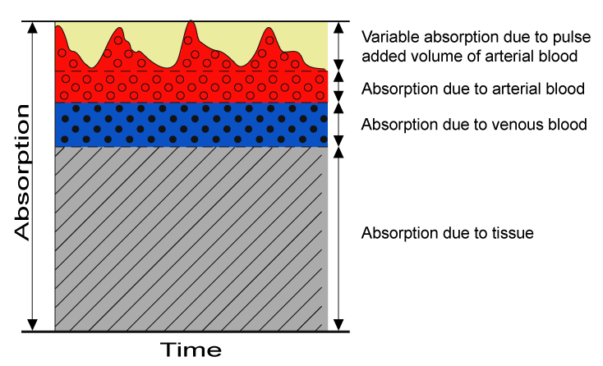
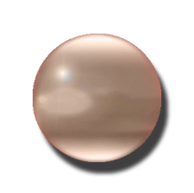
Pulsatile Flow
This is the band used to measure SpO₂.

Slide 46
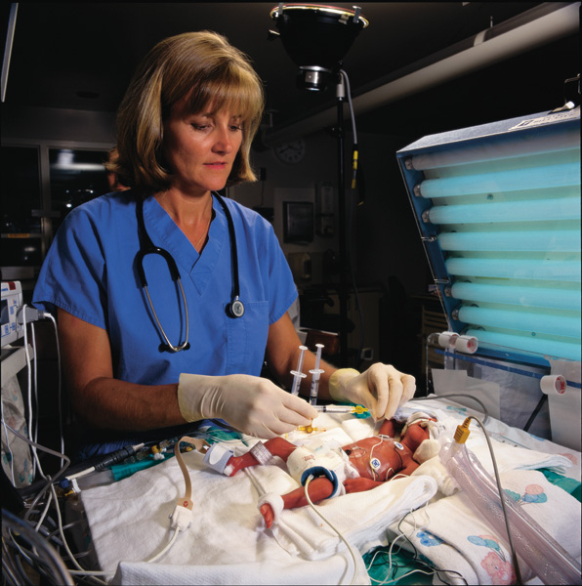
Oximetry Probe Placement
Finger
Earlobe
Heel (neonates)

Slide 47
Oximetry Probe Placement
Accuracy falls when LEDs and photoreceptors poorly aligned.
Accuracy decreases with lower pulse oximetry readings.

Slide 48
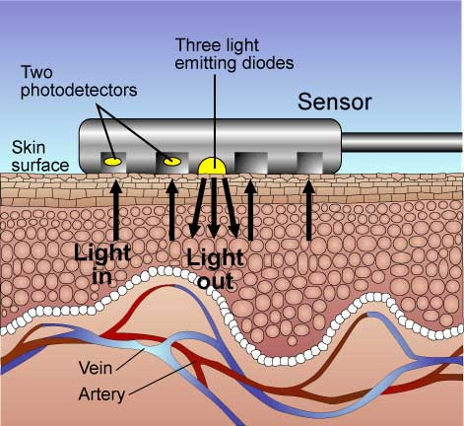
Pulse Oximetry
Some manufacturers use reflective oximetry for monitoring.
LEDs and photodetectors in same electrode.
Light reflected from the tissues and detected by photodetectors and findings interpreted by the software in the oximeter.
Can be used on forehead or back.

Slide 49
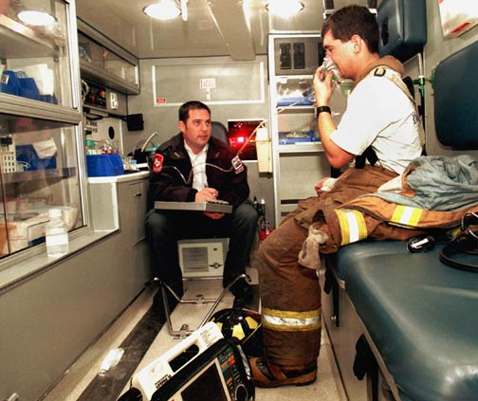
Pulse Oximetry
HbO₂ absorbs more infrared light than Hb.
Hb absorbs more red light than HbO₂.
Difference in absorption is measured.
Ratio of absorbance matched with SpO₂ levels stored in the microprocessor.

Slide 50
Perfusion Index
Reflects the pulse strength at the monitoring site.
Ranges from 0.02% (very weak pulse strength) to 20% (very strong pulse strength).
Helps determine best site to place probe.

Slide 51
Pulse Oximetry
SaO₂ or SpO₂?
SaO₂ used for oxygen saturation readings derived from arterial blood gas analysis.
SpO₂ used for oxygen saturation readings from pulse oximetry.
SpO₂ and SaO₂ are normally very close.

Slide 52
Pulse Oximetry
Pulse oximetry tells you:
  SpO₂
  Pulse rate
Pulse oximetry cannot tell you:
  O₂ content of the blood
  Amount of O₂ dissolved in blood
  Respiratory rate or tidal volume (ventilation)
  Cardiac output or blood pressure.

Slide 53

Who Should Use?
Any level of prehospital care provider who administers O₂.
  First Responders
  EMTs
  EMT-Intermediates
  Paramedics

Slide 54
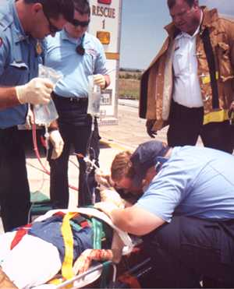
Prehospital Indications
1. Monitor the adequacy of arterial oxyhemoglobin saturation (SpO2)
2. To quantify the SpO₂ response to an intervention.
3. To detect blood flow in endangered body regions (e.g., extremities)

Slide 55
Limitations
Oximetry is NOT a measure of ventilation (EtCO₂ a better measure of ventilation).
Oximetry may lag behind hypoxic events.
Oximetry is not a substitute for physical examination.
Very low saturation states may be inaccurate due to absence of measured SpO₂ levels in the database.

Slide 56
First-Generation Oximeter Problems
False Readings:
  Hypotension.
  Hypothermia.
  Vasoconstriction.
  Dyes/pigments (e.g., nail polish).
  Movement may cause false reading in absence of pulse.
Abnormal hemoglobin:
  COHb.
  METHb.
Oximeter can’t perform:
  Bright ambient lighting.
  Shivering.
  Helicopter transport.

Slide 57
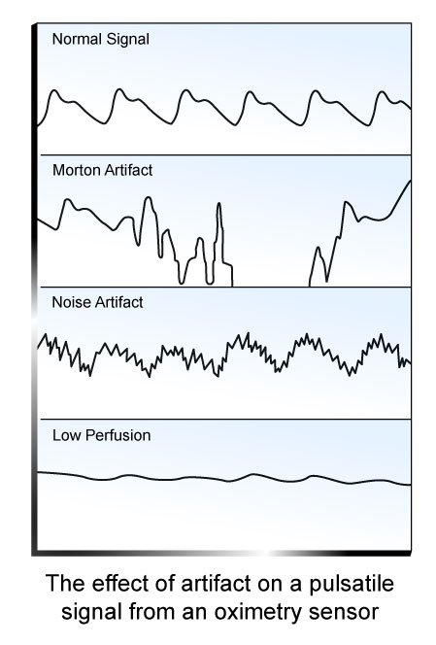
First-Generation Oximeter Problems
Motion, noise, and low perfusion states can cause artifacts and false oximetry readings.
These have been eliminated or minimized in second-generation oximeters.

Slide 58
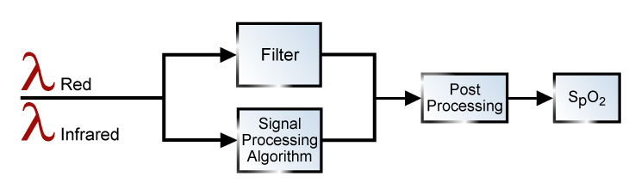
Second-Generation Technology
Newer technology uses signal processing to minimize artifacts and false readings:
  Adaptive Filters
  Signal Processing Algorithms
  Improved Sensors

Slide 59
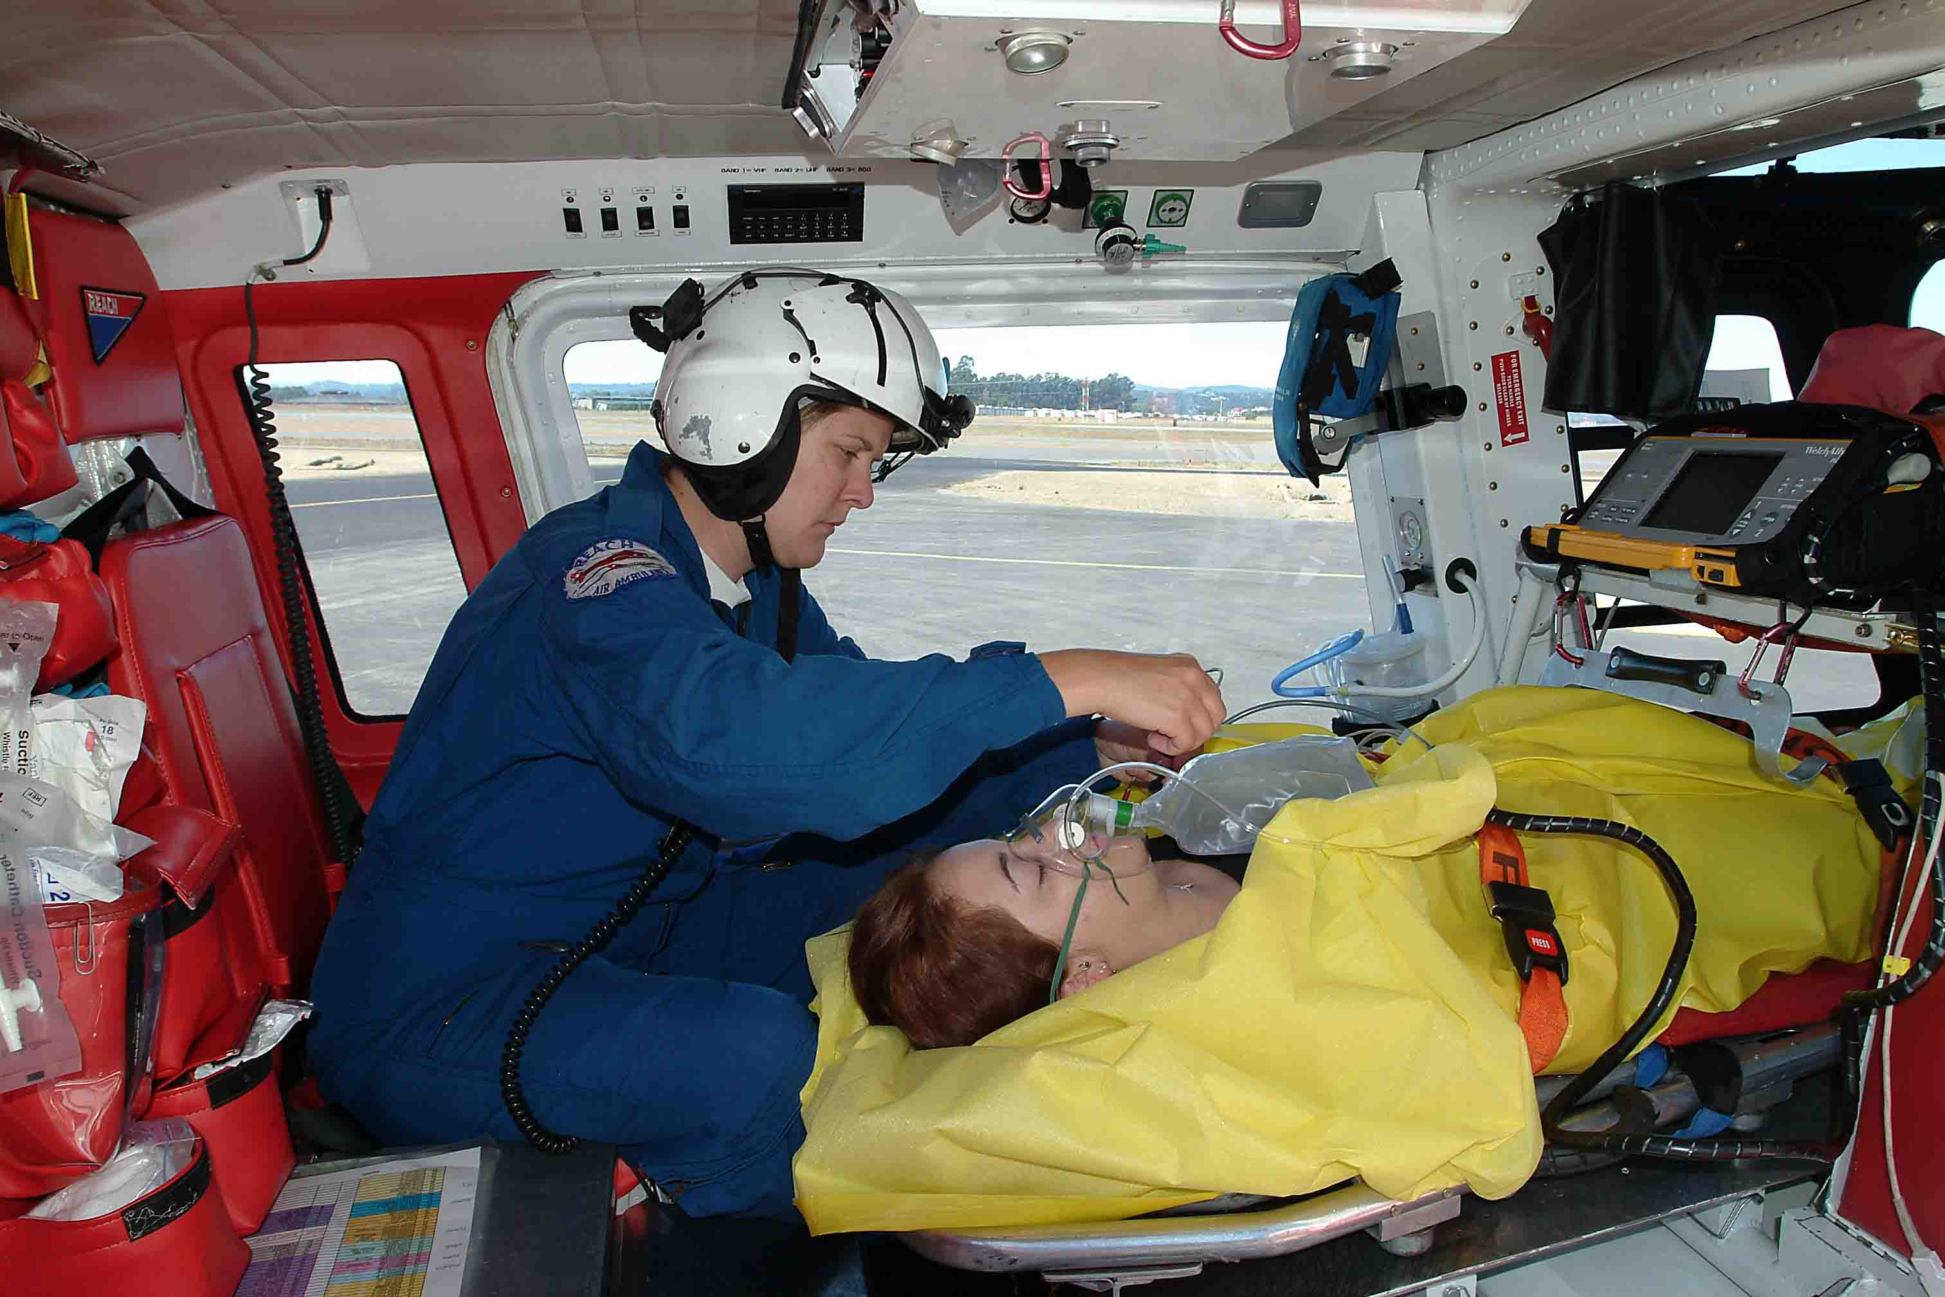
Second-Generation Technology
Technology prevents:
  Motion artifact.
  False readings during low-flow states.
  False bradycardias.
  False hypoxemias.
  Missed desaturations.
  Missed bradycardias.
  Data dropouts.
  Effects of dyshemoglobins.

Slide 60
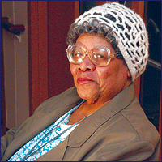
Myths
Age affects SpO₂
Gender affects SpO₂
Anemia affects SpO₂
SpO₂ inaccurate in dark-skinned individuals.
Jaundice affects SpO₂.

Slide 61
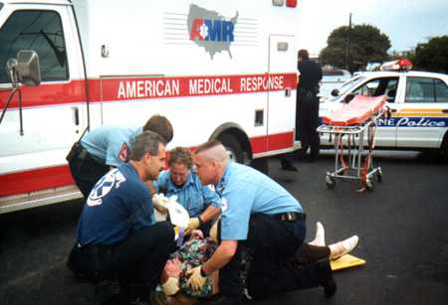
Prehospital Usage
Assure scene safety.
Initial assessment.
ABCs
Apply oxygen when appropriate (either with or after oximetry).
Secondary Assessment
Ongoing monitoring.

Slide 62
Always treat the patient and not the oximeter.

Slide 63
Reading the Oximeter
SpO₂ (%)
PI (%)
Signal Strength
Pulse Rate (bpm)

Slide 64
What Does it Mean?
SpO₂ READING (%) | INTERPRETATION
95 – 100 | Normal
91 – 94 | Mild Hypoxemia
86 – 90 | Moderate Hypoxemia
< 85 | Severe Hypoxemia

Slide 65
Interventions
SpO₂ READING (%) | INTERPRETATION | INTERVENTION
95 – 100 | Normal | Change FiO₂ to maintain saturation.
91 – 94 | Mild Hypoxemia | Increase FiO₂ to increase saturation.
86 – 90 | Moderate Hypoxemia | Increase FiO₂ to increase saturation. Assess and increase ventilation.
< 85 | Severe Hypoxemia | Increase FiO₂ to increase saturation. Increase ventilation.

Slide 66
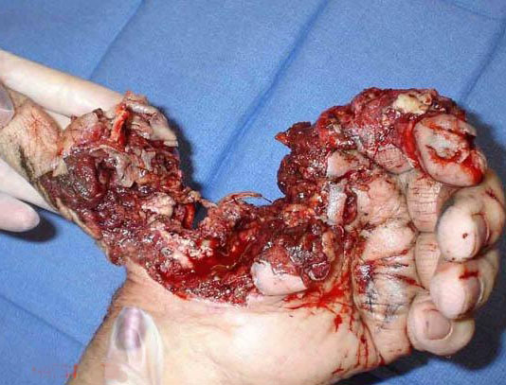
Oximetry to Assess Circulation
Oximeter probe can be placed onto tissue distal to an injury to detect circulation.
Oximeter can monitor distal circulation with fractures and crush injuries.
Clinical correlation always needed.

Slide 67
CARBON DIOXIDE

Slide 68
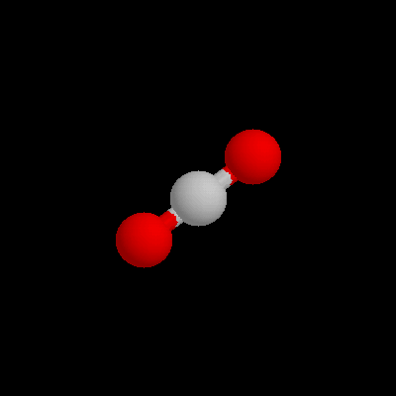
End-Tidal CO₂ Monitoring
CO₂ cannot be measured with the same technology used in oximetry.
CO₂ binds to a different site on hemoglobin compared to O₂.
No hemoglobin color change.
No hemoglobin conformation change.
Carbaminohemoglobin cannot be distinguished from deoxyhemoglobin via oximetry.

Slide 69
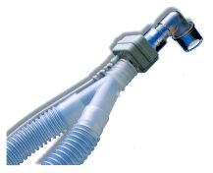
End-Tidal CO₂ Monitoring
CO₂ can be non-invasively monitored through measurement of exhaled air.
Sensors available for endotracheal tubes and for non-intubated patients.

Slide 70
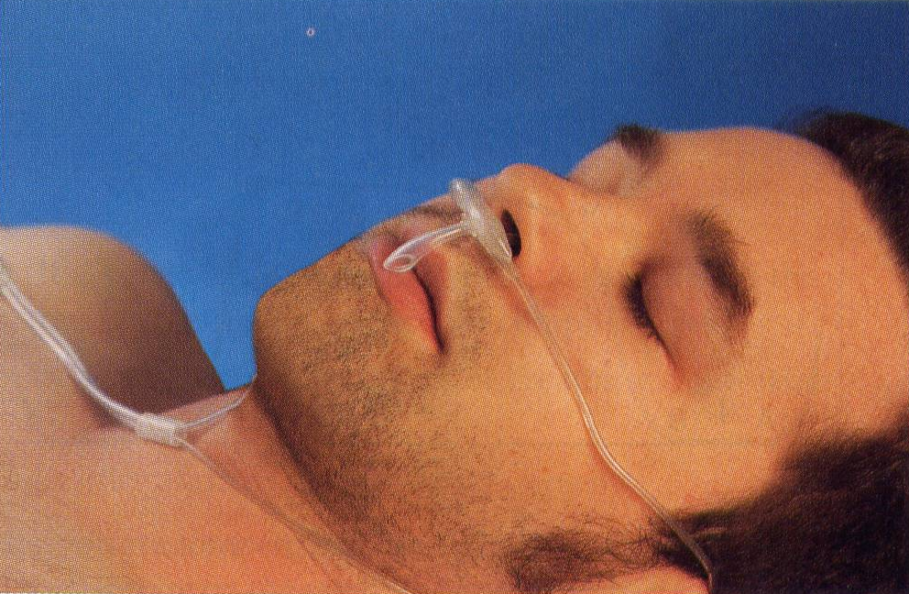
End-Tidal CO₂ Monitoring
Expired CO₂ detected with pH sensitive paper or infrared spectography.
Respiratory cycle results in a capnogram.
End-tidal CO₂ (EtCO₂) is the maximum amount of exhaled CO₂ at the end of respiration.

Slide 71
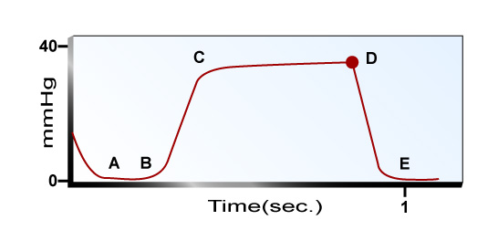
End-Tidal CO₂ Monitoring
Capnography provides information about ventilation.
Normal EtCO₂:
  ~ 5%
  ~ 35-37 mm Hg
Gradient (PaCO₂ and EtCO₂): 5-6 mm Hg
EtCO₂ can be used to estimate PaCO₂ in patients with normal lungs.
A → End of inhalation
B → Beginning of exhalation
B-D → Exhalation of alveolar gasses
D → EtCO₂
D-E → Inhalation

Slide 72
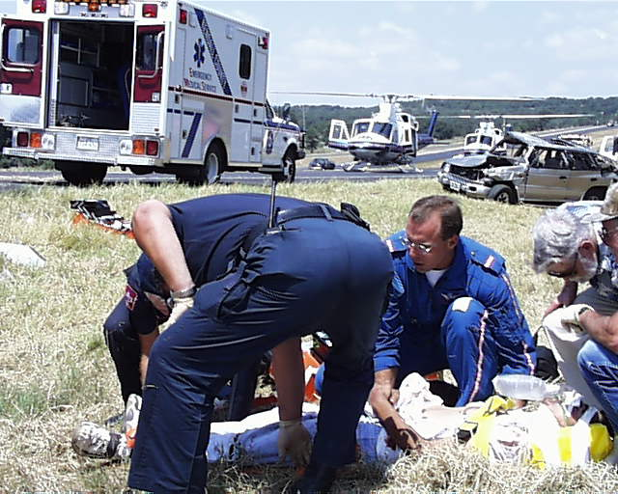
End-Tidal CO₂ Monitoring
Indications:
  Endotracheal tube placement.
  To determine the adequacy of ventilation.
  Continuous monitoring of a critical patient where ABGs may not be available.
  To maintain a specific carbon dioxide level (e.g., brain injury).

Slide 73
End-Tidal CO₂ Monitoring
Elevated or continually rising:
  Increased CO₂ production (e.g., fever, seizures).
  Decreased alveolar ventilation (e.g., CNS depression, ↓ V_{min}, muscular disorder).
  Equipment malfunction (e.g., bad sensor).

Slide 74
End-Tidal CO₂ Monitoring
Lowered of continually diminishing:
  Decreased CO₂ production (e.g., hypothermia, cardiac arrest, pulmonary embolism).
  Increased alveolar ventilation (e.g., tachypnea, hyperpnea, ↑V_{min}).
  Equipment malfunction (e.g., obstruction of ventilation system, misplaced ET tube, bad sampling head).

Slide 75

Transcutaneous CO₂ Monitoring
Technology available for almost 30 years.
Primarily used in neonates.
Transcutaneous O₂ often available.
Correlates to PCO₂.
Probe is heated and must be moved often.
Measurements based upon pH.

Slide 76
CARBON MONOXIDE

Slide 77

Carbon Monoxide
Carbon monoxide (CO) is the leading cause of poisoning deaths in industrialized countries.
~ 3,800 people in the US die annually from CO poisoning.

Slide 78

Carbon Monoxide
CO results from the incomplete combustion of carbon-based fuels.
It is odorless, colorless and tasteless.
CO is heavier than air and tends to accumulate in the lower aspect of structures.

Slide 79

Carbon Monoxide
CO displaces O₂ from the hemoglobin molecule forming carboxyhemoglobin (COHb).
CO affinity for hemoglobin ~250 times greater than O₂.
CO-Hb has a bright red color.
Patients become progressively hypoxemic.

Slide 80


Signs and Symptoms
Cherry red skin color not always present and, when present, is often a late finding.
Severity | COHb Level | Signs & Symptoms
Mild | < 15 - 20% | Headache, nausea, vomiting, dizziness, blurred vision.
Moderate | 21 - 40% | Confusion, syncope, chest pain, dyspnea, weakness, tachycardia, tachypnea, rhabdomyolysis.
Severe | 41 - 59% | Palpitations, dysrhythmias, hypotension, myocardial ischemia, cardiac arrest, respiratory arrest, pulmonary edema, seizures, coma.
Fatal | > 60% | Death
COHb levels do not always correlate with symptoms nor predict sequelae.

Slide 81

Carbon Monoxide
CO detection previously required hospital-based ABGs to measure COHb.
Technology now available to detect COHb levels in the prehospital and ED setting.

Slide 82

Carbon Monoxide
New generation oximeter/CO-oximeter can detect 4 different hemoglobin forms.
Uses 8 different wavelengths of light.
Provides:
  SpO₂
  SpCO
  SpMET
  Pulse rate

Slide 83


Slide 84

CO-Oximetry
CO evaluation should be routine at all levels of EMS and the fire service.
All field personnel should be educated in use of the oximeter and CO-oximeter.
Missed CO poisoning is a significant legal risk for EMS and fire service personnel.

Slide 85
CO-Hb Levels in Persons 3-74 Years
Smoking Status | % COHb (mean ± σ) | % COHb (98th percentile)
Nonsmokers | 0.83 ± 0.67 | < 2.50
Current Smokers | 4.30 ± 2.55 | ≤ 10.00
All persons combined | 1.94 ± 2.24 | ≤ 9.00

Slide 86

Treatment
Treatment is based on the severity of symptoms.
Treatment generally indicated with SpCO > 12-15%.
High-concentration O₂ should be administered to displace CO from hemoglobin.
Be prepared to treat complications (e.g., seizures, cardiac ischemia).

Slide 87

Treatment
Prehospital CPAP can maximally saturate hemoglobin and increase oxygen solubility.
Strongly suggested for moderate to severe poisonings.

Slide 88

Treatment
Efficacy of hyperbaric oxygen therapy (HBO) is a matter of conjecture although still commonly practiced.
Generally reserved for severe poisonings.
May aid in alleviating tissue hypoxia.

Slide 89

Treatment Algorithm

Slide 90

CO Poisoning Considerations
Significant and evolving body of literature now suggests that there are numerous long-term and permanent sequelae from CO poisoning.

Slide 91

CO Poisoning Considerations
Fetal hemoglobin has a much greater affinity for CO than adult hemoglobin.
Pregnant mothers may exhibit mild to moderate symptoms, yet the fetus may have devastating outcomes.

Slide 92

CO Poisoning
A simple COHb reading can save a life and prevent long-term problems.
Remember, CO poisoning is the great imitator.
Missed CO exposure often leads to death and disability.
CO is a particular risk for firefighters.

Slide 93
METHEMOGLOBIN

Slide 94

Methemoglobin
METHb is hemoglobin with heme in the Fe³⁺ state.
Cannot bind O₂.
SpMET levels usually < 1% (Range 1-3%)
Reflects hemoglobin at the end of its functional life.
Results in dark reddish-brown blood.
Most frequently seen in children < 4 months (blue baby).

Slide 95
Methemoglobinemia
As SpMET levels increase, a functional anemia occurs (total Hb normal but significant percentage of Hb non-functional).
Cyanosis begins (usually around lips) when SpMET >10 - 15%.
Organs with high O₂ demands (e.g., CNS, cardiovascular system) manifest toxicity first.

Slide 96

Methemoglobinemia Causes
Inherited:
  Hemoglobin disorder (HgM).
  Enzyme disorders (e.g., G6PD deficiency).
Acquired:
  Nitrites
  Nitrates
  Sulfonamides
  Lidocaine
  Benzocaine
  Certain aromatic hydrocarbons
  Dyes

Slide 97
Symptoms
SpMET | Symptom
1-3% | Normal, asymptomatic
3-15% | Slight grayish blue skin discoloration
15-20% | Asymptomatic, but cyanotic.
25-50% | Headache, dyspnea, confusion, weakness, chest pain.
50-70% | Altered mental status, delirium.

Slide 98
Prehospital Treatment
High-concentration O₂.
Remove offending agents.
Methylene blue (accelerates the enzymatic degradation of METHb) is antidote.

Slide 99
CO and Cyanide Poisoning
Hydroxocobalamin is the cyanide antidote of choice for mixed cyanide and CO poisonings.
Parts of cyanide antidote kit (amyl nitrite, sodium nitrite) induce methemoglobinemia.
Cyanide antidotes and CO poisoning can lead to elevated COHb and METHb significantly reducing O₂ capacity of blood.
Sodium nitrite should be avoided for combination cyanide/CO poisonings when SpCO >10%.
Hydroxocobalamin converts cyanide to cyanocobalamin (Vitamin B₁₂) which is renally-cleared.

Slide 100

Financial Disclosure
This program was prepared with an unrestricted grant from Masimo. Masimo did not control content.

Slide 101
Credits
Content: Bryan Bledsoe, DO, FACEP
Art: Robyn Dickson (Wolfblue Productions)
Power Point Template: Code 3 Visual Designs
The following companies allowed use of their images for this presentation:
  Brady/Pearson Education
  Scripps/University of California/San Diego
  JEMS/Brook Wainwright
  Bryan Bledsoe, DO, FACEP
  Masimo, Inc.

Slide 102
Credits
This is a product of Cielo Azul Publishing.

