Slide 1
Resuscitation Of The Pregnant Patient
Patrick Sinclair, DO

Slide 2

Risk By the Numbers
Prevelance: 1/20,000 to 1/50,000 ongoing pregnancies
Complicates 1/12,000 US hospitalizations related to delivery
Its frequency has remained stable over the past 15yrs.

Slide 3
Causes
The BEAU-CHOPS mnemonic:
  Bleeding/DIC (17%)
  Embolism (29%)
  Anesthesia (2%)
  Uterine Atony
  Cardiac Disease (peripartum cardiomyopathy) (8%)
  Hypertensive Disease (2.8%)
  Other
  Placenta (abruption/previa)
  Sepsis (13%)

Slide 4
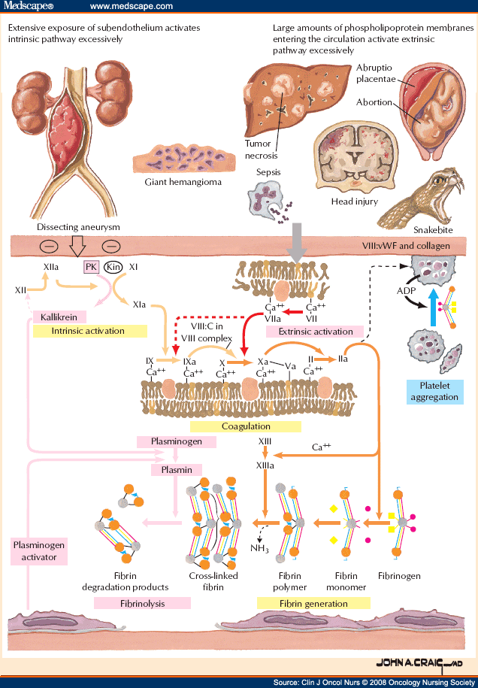
DIC
Increased PT, PTT, and thrombin times
Thrombocytopenia
Elevated fibrin degradation products
Low fibrinogen concentration (least sensitive and late finding)
Treatment:
Massive transfusion protocol
- usually RBCs, FFP, and platelets in a 1:1:1 ratio
Causes:
Massive hemorrhage, placental abruption, HELLP syndrome, amniotic fluid embolus, acute fatty liver of pregnancy, septic abortion

Slide 5
Peripartum Cardiomyopathy
Development of heart failure in the last month of pregnancy or within five months of delivery
Clinical symptoms consistent with heart failure
Prognosis is variable (complete recovery, partial recovery, no recovery) and there is significant risk in subsequent pregnancies
Management follows standard heart failure tx guidelines
  (ARBs and ACEs contraindicated in pregnancy ->hydralazine)
A clear pathophysiology is unknown (inflammatory and immunological theories vs. hemodynamic vs. prolactin vs. genetic)
Risk Factors: age>30, multiparity, African descent, multiple fetuses, hx of pre-E, E, postpartum HTN, cocaine, long-term oral tocolytic therapy w/ terbutaline (beta agonists)

Slide 6
Amniotic Fluid Embolus
Amniotic fluid enters maternal circulation through endocervical veins, the placental insertion site, or uterine trauma
Rare: 1 to 12 per 100,000 deliveries
Most commonly occurs during delivery or postpartum
Can cause 1) cardiogenic shock 2) respiratory failure 3) anaphylactoid response
Unpredictable, unpreventable and a clinical diagnosis
Tx: O2, vasopressors and IVF (hemodynamic support)
Maternal Mortality: ~20% Fetal Mortality: 20-60% (50% w/ neurologic sequelae)

Slide 7

Toxicology
Magnesium – Calcium gluconate
Bupivicaine induced arrythmia – Amiodarone
Bupivicaine Toxicity – lipid emulsion (20%)
Hyperkalemia – Sodium Bicarbonate

Slide 8
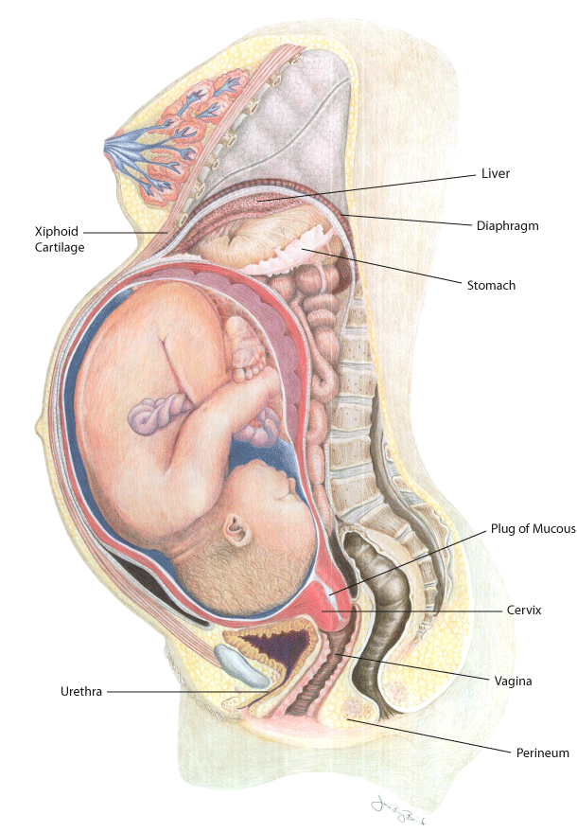
And Now Back to Resuscitation…
First, a few points:
  Normal pregnancy is associated with
    a mild respiratory alkalosis
    Decreased functional residual capacity
    Increased O2 consumption
    Increased pulmonary shunting
It all comes down to the ABCs

Slide 9
Airway and Breathing
Changes in the maternal airway can make intubation difficult (edema, increased secretions)
Use ET tube that is .5mm-1.0mm smaller in internal diameter than what would be used for a non-pregnant patient
Elevated diaphragm may result in the need for decreased ventilation volumes and increased resistance to ventilation
Hyperventilation can be particularly serious as the resulting respiratory alkalosis can be more severe resulting in uterine vasoconstriction and fetal hypoxia (acidosis)

Slide 10
Cardiovascular Support
Chest compressions should be targeted above the center of the sternum
IV access: bilateral 14 gauge antecubitals or IO access, or central lines
When defibrillating, make sure all FHM and TOCO devices are disconnected from that patient to avoid electrocution (thus FHM is contraindicated in resuscitation of the pregnant patient)
Avoid aortocaval compression!

Slide 11
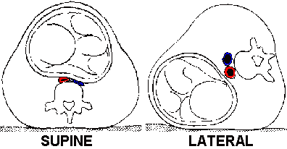
Aortocaval Compression
Critical for perfusion and venous return!
Studies favor the use of manual uterine displacement over table tilt (less episodes of hypotension and lower ephedrine requirement)
Manual displacement also allows for the patient to remain supine allowing for maximum resuscitative force during chest compressions
If a tilt is used, optimal angle=27, which allows for 80% of maximal force

Slide 12
The Decision to Deliver
“The 4-Minute Rule” states that C-section should be initiated if ROSC has not occurred within 4 minutes of maternal cardiorespiratory collapse and delivery of the newborn should occur within 5 minutes
This also requires a minimum gestational age of 24 weeks; necessitating that estimation of gestational age be part of the ABC assessment of the pregnant patient
24 wga = 4 finger breadths above the umbilicus

Slide 13
Delivery as A TX
Studies have reported a return of maternal circulation in as many as 60% of cases
Relieving aortocaval compression results in a 60-80% increase in CO
Delivery within 5 minutes of collapse remains extremely elusive
Mortality: Maternal = 40%-83%, Neonate = 11%-58%

Slide 14
References
Uptodate.com – “Resuscitation in Pregnancy”
Kundra P, et al Manual displacement of the uterus during Caesarean section. Anaesthesia 2007; 62:460
Rees GA, Willis BA. Resuscitation in late pregnancy. Anaesthesia 1988; 43:347
Uptodate.com – “DIC During Pregnancy”
Uptodate.com – “Amniotic Fluid Embolism Syndrome”

